Slide 1

Co-presented by
TECHNOLOGY TRACK SESSION
Agentic AI
From AI Pilots to Enterprise-Scale Agentic AI
Time
14:00–14:45 CEST | 08:00–08:45 EDT
Date
15 / 09 / 26
Notes:
COVER SLIDE. Replace the session title, date, time, partner names and the two speaker blocks. Drop headshots into the grey photo squares (right-click > Change Picture). Keep the CORESHIFT 2026 lockup untouched.

Slide 2









Your speakers
Meet the team presenting this session
Remi Dyon
Satheesh Kothakapu
Dewain Robinson
Principal PM Manager – CAT
VP Technologies – AI for Business
VP of Analysis and Training

Slide 3
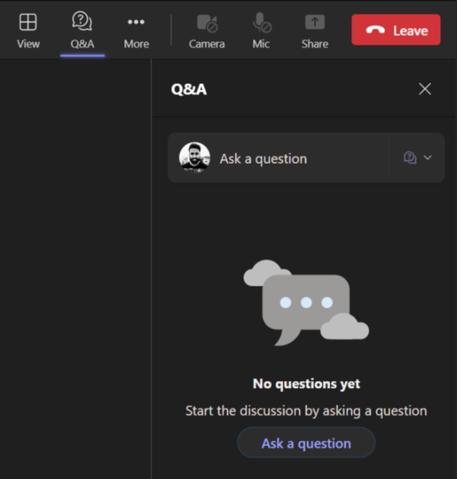
Housekeeping – Asking speaker a question
We want to hear from you!
Please submit your questions. We’ll reserve time for Q&A at the end of the webinar.
1
To submit questions, click on the Q&A at the top right corner
2
Clicking on the Q&A icon will open a window where you can type your question.
3
Click on the ‘Ask a question’ button & type your question.

Slide 4
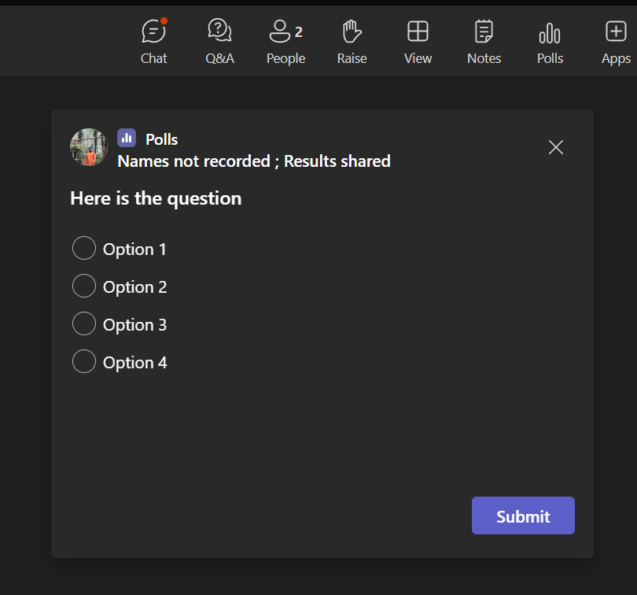
Housekeeping -Participating in Polls
Your opinion is valuable to us!
Please take part in our polls to help us understand your views.
1
Submit Your Vote:
A new window will pop up with the poll question.
Choose your answer from the provided options
2
Confirm Your Selection:
After selecting your option, make sure to hit the 'Submit' button to record your response..

Slide 5


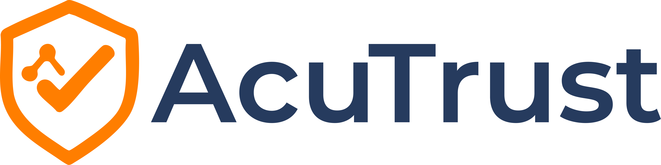

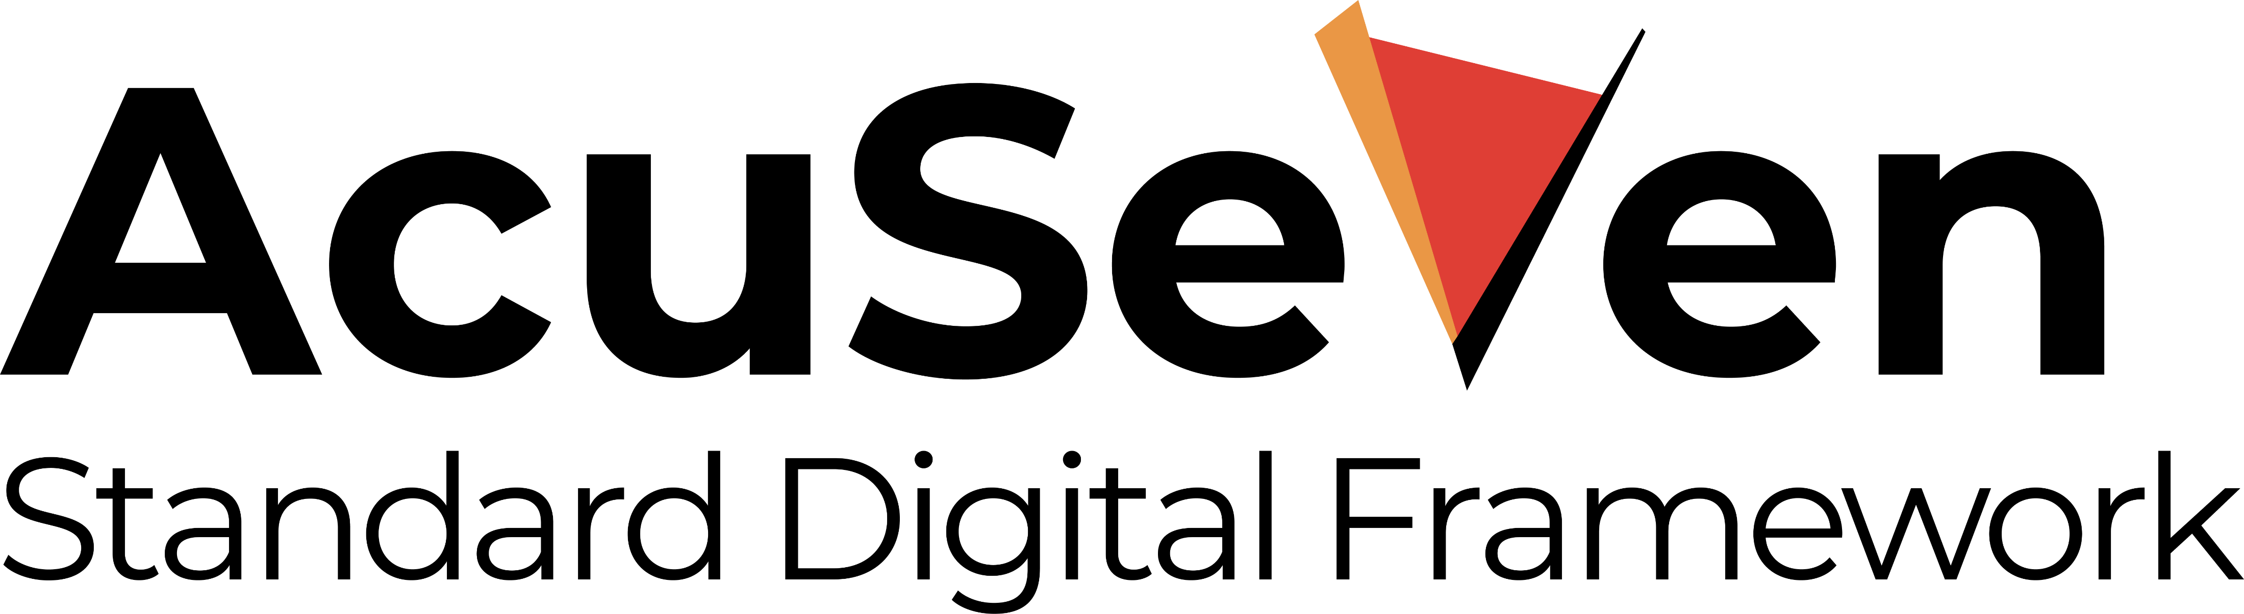

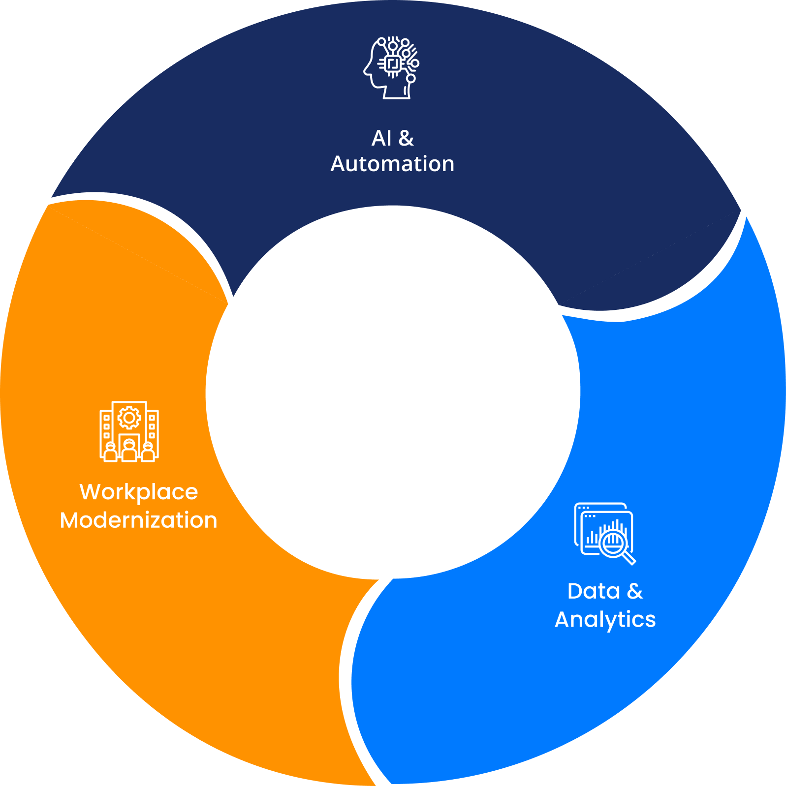




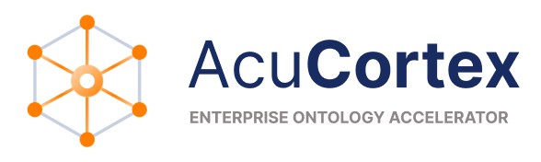
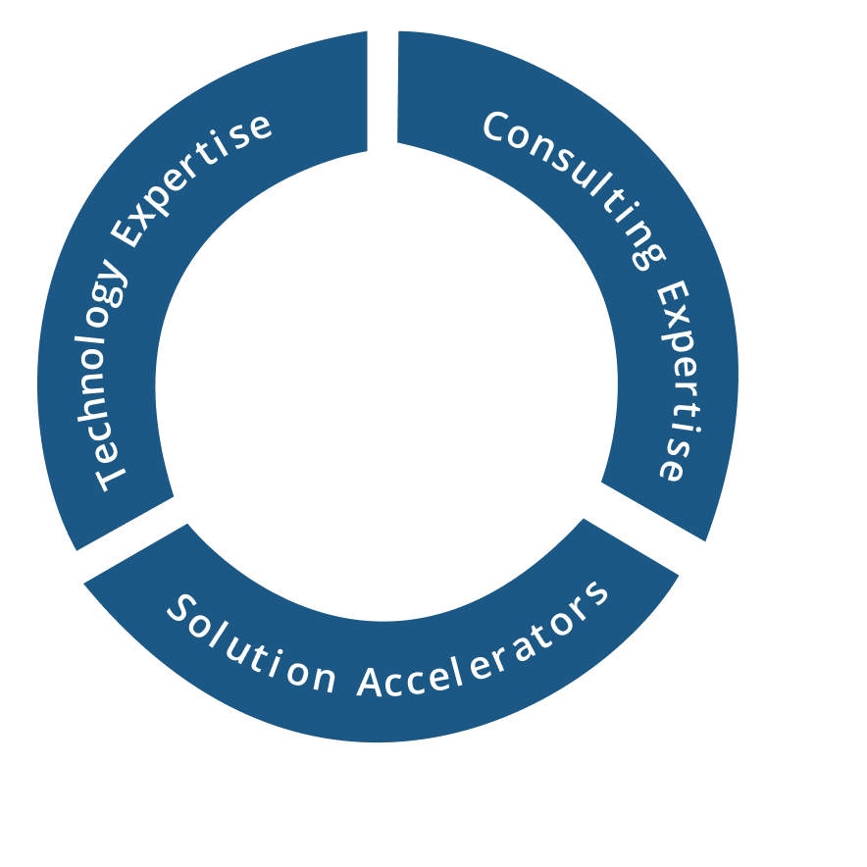
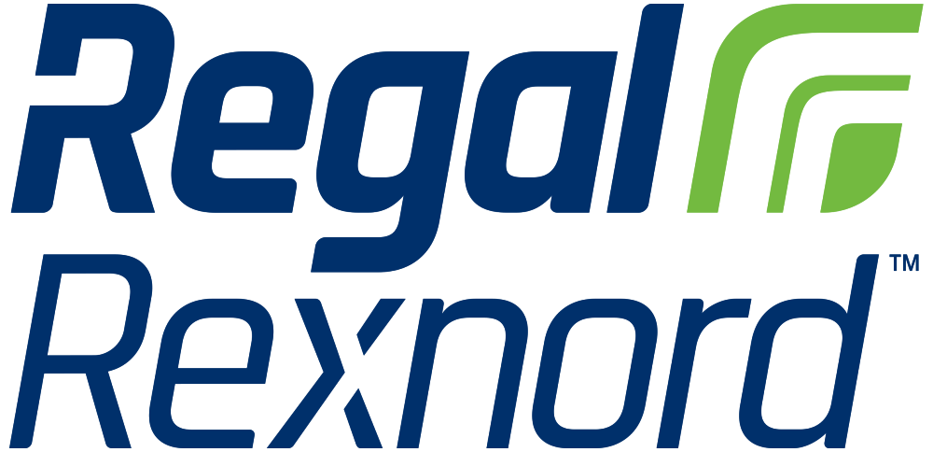




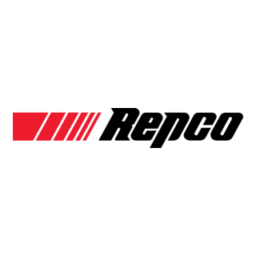

















About Acuvate
Acuvate is a global player in next-generation digital solutions & services that modernize, automate and transform enterprise applications. With over 19+ years of experience, we have been enabling our clients globally to steer their digital transformation strategy using AI, Data & Cloud.
ACCELERATORS
TRUSTED BY 200+ ENTERPRISES WORLDWIDE INCLUDING SEVERAL FORTUNE 500
Manufacturing
Our Focus
CPG, Retail
Oil & Gas,
Energy
Healthcare and Life Sciences
BSFI
Government
19+
Years in the Industry
500+
Multi-Skilled Professionals
3 Continents, 7 offices
North America, Europe, Asia
Travel and Hospitality / Others

Slide 6
From Pilot to Production
How to productize Copilot Studio agents with measurable quality, operational control, and evidence from real use.
EVAL FROM DAY 1
REAL CHANNELS
COST + LATENCY
OBSERVABILITY
Notes:
Timing: 2 minutes
- Open with the promise: the audience will leave with a practical checklist for moving an agent from pilot to production.
- Set the tone: this is not a feature tour; it is operating experience, failure modes, and the tools that make them manageable.
- Introduce the split: Microsoft field patterns first, then Acuvate's implementation evidence and case study.
Source grounding: User-provided CoreShift session brief; Copilot Studio TDM Product Pitch Deck, slides 28-32.
External-sharing note: Draft uses current product concepts and field guidance only; confirm branding and product naming before delivery.

Slide 7

Poll 1
Where Is Your Organization Today
With Enterprise Agents?

Slide 8

From Pilot to Production​
How to productize Copilot Studio agents with measurable quality, operational control, and evidence from real use.​
EVAL FROM DAY 1​
REAL CHANNELS​
COST + LATENCY​
OBSERVABILITY​

Slide 9
SESSION CONTRACT
One outcome: a credible path from pilot to production
5 minutes to align, 20 minutes of field patterns, 15 minutes from Acuvate, then 10 minutes of questions.
5
20
15
10
MIN
MIN
MIN
MIN
Frame
Microsoft
Acuvate
Q&A
What changes after a pilot
Eval, ALM, cost, scale, observability
Practice + case study
Apply it to your agent
LEAVE WITH
A production-readiness checklist you can use in your next design review.
Quality | release discipline | channel reality | unit economics | performance | operational evidence
Notes:
Timing: 3 minutes
- Use this slide to establish timing and the audience contract.
- Ask for a mental example: one pilot agent the audience would like to put into production.
- The rest of the session tests that example against six gates.
Source grounding: User-provided session timings and desired audience outcome.
External-sharing note: Draft uses current product concepts and field guidance only; confirm branding and product naming before delivery.

Slide 10
One Outcome: A Credible Path From Pilot To Production
5 minutes to align, 25 minutes of field patterns, 10 minutes from Acuvate, then 10 minutes of questions.
5
25
10
10
Min
Min
Min
Min
Microsoft
Frame
Acuvate
Q&A
Dynamics Communities
What Changes After A Pilot
Eval, ALM, Cost,
Scale, Observability
Practice + Case Study
Apply it to Your Agent
LEAVE WITH
A production-readiness checklist you can use in your next design review.
Quality | release discipline | channel reality | unit economics | performance | operational evidence

Slide 11
WHAT CHANGES
A Pilot Proves Possibility. Production Proves Repeatability.
The agent is no longer a demo; it becomes a service with users, dependencies, budgets, and consequences.
PILOT QUESTION
PRODUCTION QUESTION
"Can it work?"
"Can we operate it?"
1
Curated prompts
1
Core + edge + deny behavior
2
Known users
2
Real users in real channels
3
Maker-led fixes
3
Versioned releases and rollback
4
Average-case demo
4
Peak load, cost, latency, audit
FIELD PATTERN
Most pilots do not fail on the happy path. They stall because nobody defined ownership for the other paths.
Notes:
Timing: 3 minutes
- Contrast proof-of-concept success with production operating responsibility.
- Emphasize that repeatability includes behavior, release, economics, and evidence - not only technical availability.
- Customer pattern: teams celebrate the curated demo before assigning ownership for edge cases, telemetry, and support.
Source grounding: Copilot Studio TDM Product Pitch Deck, slides 28-31 and 117-119; Copilot Studio ALM, slide 2.
External-sharing note: Draft uses current product concepts and field guidance only; confirm branding and product naming before delivery.

Slide 12
A Pilot Proves Possibility. Production Proves Repeatability.
The agent is no longer a demo; it becomes a service with users, dependencies, budgets, and consequences.
PILOT QUESTION​
PRODUCTION QUESTION
"Can it work?"​
"Can we operate it?"​
Curated Prompts
Core + Edge + Deny Behaviour
Known Users
Real Users In Real Channel
Maker - Led Fixes
Versioned Releases and Rollback
Average - Case Demo
Peak load, Cost, Latency, Audit
FIELD PATTERN
Most pilots do not fail on the happy path. They stall because nobody defined ownership for the other paths.

Slide 13
EVAL
ALM
ECONOMICS
SCALE
OBSERVE
GATE 1 | QUALITY
Start evals on day 1: core, edge, and deny
Turn vague expectations into acceptance criteria and a living eval set before the pilot teaches users the wrong behavior.
CORE
EDGE
DENY
Must succeed
Must recover
Must refuse
Typical jobs, grounded answers, correct tool use, expected hand-offs.
Ambiguous, incomplete, repeated, unusual, or dependency-failure inputs.
Out-of-scope, privacy, unsafe, policy-breaking, or unauthorized requests.
"Create the request with the required fields."
"The user omitted the project ID."
"Show another employee's private data."
Acceptance criteria -> test prompts -> expected behavior -> test method -> release threshold
Notes:
Timing: 4 minutes
- Define core evals as what the agent must do, edge evals as how it must recover, and deny evals as what it must not do.
- For each acceptance criterion, begin with a few high-quality cases rather than a large noisy set.
- Use deterministic checks for exact requirements, semantic or judge-based methods for meaning, and humans for high-stakes ambiguity.
- The point of eval is hill-climbing: find failures that improve the agent, not a vanity pass rate.
Source grounding: Agent Eval Training Content, slides 5, 19-23, 36-37; Copilot Studio TDM Product Pitch Deck, slide 32.
External-sharing note: Draft uses current product concepts and field guidance only; confirm branding and product naming before delivery.

Slide 14
Start Evals On Day 1: Core, Edge, And Deny
Turn vague expectations into acceptance criteria and a living eval set before the pilot teaches users the wrong behavior.
Must Succeed
Typical jobs, grounded answers, correct tool use, expected hand-offs.
"Create the request with the required fields."
CORE
Must succeed
Must Refuse
Ambiguous, incomplete, repeated,
unusual, or dependency-failure inputs.
Out-of-scope, privacy, unsafe, policy-
breaking, or unauthorized requests.
EDGE
DENY
"The user omitted the project ID."
"Show another employee's private data."
Acceptance criteria -> test prompts -> expected behavior -> test method -> release threshold

Slide 15
FIELD PATTERN
EVAL
ALM
ECONOMICS
SCALE
OBSERVE
Production Activity Becomes The Next Eval Set
Every unexpected behavior should become a regression test. Otherwise, the organization is paying repeatedly for the same lesson.
2
Select
1
Observe
Prioritize risk, frequency, and business impact
3
Convert
Queries, failures, drop-offs, tool errors, satisfaction
Add the behavior to core, edge, or deny evals
LEARN
from real use
6
Measure
4
Improve
Did quality improve without cost or latency regression?
5
Release
Prompt, grounding, tool, flow, policy, or UX
Run regression, review, deploy, then compare
Notes:
Timing: 4 minutes
- Describe the eval set as a living artifact: unexpected behavior, new edge cases, and user feedback become new tests.
- Separate signal collection from prioritization; not every odd conversation deserves immediate engineering effort.
- Regression includes quality, cost, and latency. A smarter answer that doubles response time can still be a production regression.
- Make the owner explicit for each stage of this loop.
Source grounding: Agent Eval Training Content, slides 36, 37, 49-50; Copilot Studio TDM Product Pitch Deck, slides 110 and 113.
External-sharing note: Draft uses current product concepts and field guidance only; confirm branding and product naming before delivery.

Slide 16
Production activity becomes the next eval set
Every unexpected behavior should become a regression test. Otherwise, the organization is paying repeatedly for the same lesson.
1
Observe
Improve
4
Queries, failures, drop-offs,tool errors, satisfaction​
Prompt, grounding, tool,flow, policy, or UX
2
Select
Release
5
Prioritize risk, frequency,and business impact
Run regression, review,deploy, then compare
LEARN
from real use
3
Convert
Measure
6
Add the behavior to core,edge, or deny evals
Did quality improve withoutcost or latency regression?

Slide 17
Publish Is A Button. Production Is A Release System.
Package changes, promote them through environments, and validate the agent in the channel where people actually use it.
DEV
TEST / QA
PROD
REAL CHANNEL
Teams
Build in solutions
Run regression + channel tests
Managed, controlled, observable
identity | cards | links | hand-off | mobile
SOLUTIONS
CONFIG
CONTROL
AUTOMATE
RECHECK
Package agent + dependencies together
Use environment variables and connection references
Deploy managed; do not customize production
Pipeline export, review, promotion, and rollback
Channels, App Insights, and some security settings
Channel acceptance tests are product tests: the Teams experience can fail even when the test pane passes.
Notes:
Timing: 4 minutes
- Use solutions, environment variables, managed deployment, and pipelines as the release foundation.
- Call out the manual edges from the ALM source deck: channel deployment, Application Insights integration, and selected security configuration.
- Test in Teams - not only the Copilot Studio test pane - including identity, adaptive cards, links, hand-off, and mobile rendering.
- Production fixes return to development and move forward through the same release path.
Source grounding: Copilot Studio ALM, slides 2, 5-6; Copilot Studio TDM Product Pitch Deck, slides 24-25 and 30.
External-sharing note: Draft uses current product concepts and field guidance only; confirm branding and product naming before delivery.

Slide 18
Model The Workload Before Adoption Models It For You
Estimate cost and latency per successful outcome - not only per user or per message.
UNIT ECONOMICS
LATENCY BUDGET
Users
x
Runs
x
Agent(s)
x
Credits
Successful outcomes
End-to-end p95
Set a target by channel and task
1
Estimate with real traffic assumptions
1
Channel
2
Track per scenario, department, and tool
2
Orchestration
3
Set budgets, alerts, and capacity allocation
3
Skills / Knowledge / Tools / Data
4
Compare cost with time or value saved
4
Response rendering
Notes:
Timing: 4 minutes
- Cost must be modeled per successful outcome because agent behavior varies by scenario, tool use, and retries.
- Use the Copilot Studio usage estimator for a starting point, then replace assumptions with real traffic and feature usage.
- For latency, allocate an end-to-end budget across channel, orchestration, tools/data, and response rendering.
- Choose deterministic steps where input-to-output is known; reserve agentic reasoning for ambiguity that justifies the cost and time.
- For scale to thousands, test peak concurrency, dependency limits, timeouts, and graceful progress or hand-off behavior.
Source grounding: Copilot Studio TDM Product Pitch Deck, slides 111 and 114-116; Copilot Studio Technical Deep Dive v1.1, slide 19.
External-sharing note: Draft uses current product concepts and field guidance only; confirm branding and product naming before delivery.

Slide 19
Agent Factory Implementation Blueprint for Enterprises
Powered by OrgBrain
Architect once: Microsoft 365 Graph + enterprise data → Work IQ → agents / Copilot Studio → connectors / APIs → Cowork orchestration + governance - then reuse the spine across verticals as packaged skills & reusable IP.
Agents
Serving
Layer
Conversational Agents & Copilots
Agentic Process Automation
Agentic BizApps
Decision & Insight Applications
Copilot Studio | M365 Copilot
Power Automate | Copilot Studio Flows
Power Apps | D365 CRM | CCaaS
Power BI | Fabric Dashboards
Agent Builders
Migration
Agent Registry
Experience Management
Declarative → Copilot Studio → Custom-Engine
Acuvate Optimum | RPA | Data
M365 Copilot | Agent SDK | AI Foundry
Notifications | Accessibility | Localization
Copilot Cowork — Orchestration for Long-Running Work
Complex, multi-tool, approval-aware execution that returns completed work - grounded in Work IQ, inside the Microsoft 365 trust boundary
Agent
OS
Layer
Agent Orchestration & Runtime Layer
Orchestration Frameworks
Tools & API
Prompt & Policy Templates
Content Management
MS Agent Framework | Semantic Kernel | Copilot Studio
MCP | A2A | REST
Guardrails | Responsible AI | Grounded-only
Knowledge Graph | Dataverse
Model & AI Capability Layer
Agent 365 · Adoption, Readiness & Change Enablement · Industry Workshops · Data Health Check
Model Catalog
Model Ops
AI Services
Microsoft Foundry — GPT | Claude | Phi | Llama
Microsoft Foundry — Fine-tuning | Eval | Benchmarking
AI Search | Doc Intelligence | Speech | Vision | NLP
Work IQ - Context & Semantic Intelligence Layer
Work IQ Context Layer
Governed by Design
Exposed via A2A · MCP · REST
Semantic Intelligence
Assembles context across M365 + external systems
Signed-in-user permissions · labels · controls preserved
Context APIs replace custom retrieval pipelines
Fabric IQ Ontology | Foundry IQ | Unified Info Model
Trust, Governance & Responsible AI
Platform Operations & FinOps
Agent Governance
AI Agent Data Readiness + Acuvate Safety Agents
Platform Ops & Automation
FinOps & Cost
Agent 365 | Entra Agent ID | Purview | AI Ops
Data Pipelines | Vector/Graph Store | Defender | HSSE
AIOps | IaC | Azure Functions | Auto Scaling
Agent Cost | Model Cost Optimization
Data
Ops
Knowledge Graph Spine - Microsoft 365 Work Graph + Enterprise Data
Microsoft 365 Work Graph
Enterprise Data
Connectors — Synced
Connectors — Federated / MCP
API Management
People · Meetings · Emails · Files · Chats · Calendars
Databases · Warehouses · Lakes · Structured · Unstructured
Semantic index in Microsoft Graph for retrieval & reuse
Dynamic / sensitive data kept in source at query time
MCP | A2A | REST | Connectors
Agent Lifecycle: Design → Register → Approve → Deploy → Monitor → Evolve

Slide 20

Agent Factory Implementation Blueprint for Enterprises
Powered by
Thought Leadership
Agents
Servin Layer
Agents
Servin Layer
Conversational Agents & Copilots Voice | Text
Agentic Process Automation
RPA++ | BPM Augmentation
Agentic BizApps
Power Apps| D365 CRM | CCaaS
Decision & Insight Applications
Dashboards | Self Service BI
Agent Builders
MS Foundry | Copilot Studio | M365 Copilot
Migration
Agents | RPA | Applications | Data
Experience Governance
Notifications | Accessibility | Localization
Agent Orchestration & Runtime Layer
Orchestration Frameworks
MS Agent Framework | Semantic Kernel | Copilot Studio
Tools & API MCP | A2A | REST API
Prompt & Policy Templates
Agent Catalog
Org Agent Market place | Reusability
Agent Monitoring
MS Foundry | Copilot Studio
Model & AI Capability Layer
Model Catalog
MS Foundry | Agent 365 SDK
Model Ops
MS Foundry
AI Services
OCR, NLP, Speech
AI Services
OCR, NLP, Speech
Adoption, Readiness & Change Enablement
Industry & Use-case Workshops
| Leadership workshop | Data health check
Agent OS Layer
Trust, Governance & Responsible AI
Platform Operations & Automation
Data & Agent Governance
Agent Control pane | Purview | AI Ops
AI Agent Data Readiness AI Data pipelines ( Clean , Curate , Contextualize) | Data Store (Vector, Graph) | Data Products | MDP | CDP
Infra Provisioning & Monitoring
IAC | Services/Functions | Auto Scaling
Semantic & Context Intelligence Layer
Business Ontology
Unified Information Model
DataOps
Enterprise and External Data Sources
Databases
Datawarehouse Datalakes
Unstructured Data
Structured Data
APIs to External Sources
Agent Lifecycle
Design → Register → Approve → Deploy → Monitor → Evolve
16

Slide 21
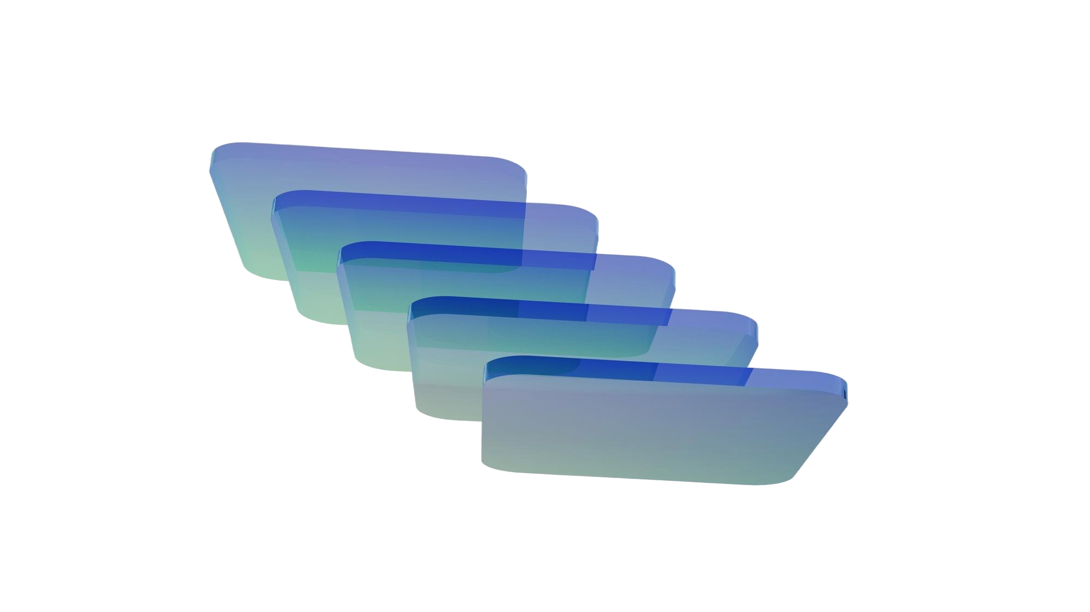

Success Stories
Large Beverages Customer
Large Beverages Customer
Large Banking Customer
Master Data Management Agent
Artwork and Brief Creator Agent
Email Automation and Classification Agent
Centralizes, cleanses, and governs enterprise master data with AI precision.
Generates on-brand artwork and creative briefs instantly.
Reads, classifies, and routes emails intelligently with human in loop intervention.
Large Retail Customer
Technology Customer
Large Semi Conductor Customer
Invoice Automation Agent
Asset Intelligence Agent
Customer 360 Agent
Extracts, matches, and processes invoices end-to-end with zero touch.
Tracks, analyzes, and optimizes enterprise assets using real-time AI.
Unifies customer data into a single, actionable intelligence profile.
Cruiseline Customer
Large Semi Conductor Customer
Retail Bread Chain
Voice Agent
Royalty Extraction & Claim Automation Agent
Multi Agent
Enables natural voice interactions to automate tasks and surface insights.
Accelerates claims processing by automating validation, routing, and resolution.
Orchestrates multiple AI agents collaborating to solve complex business workflows.

Slide 22

Is your agent ready to leave the pilot?
Use the questions on your own agent. If an answer is "we will know after launch," that is generally the launch risk.
01
QUALITY
Core, edge, and deny evals pass?
02
CHANNEL
Validated with real users in Teams?
03
PERFORMANCE
Peak-load latency and failure behavior tested?
04
RELEASE
Versioned environments and rollback?
05
ECONOMICS
Cost per successful outcome known?
06
OPERATIONS
Owner, alerts, telemetry, and improvement loop?

Slide 23
How To Optimize Skill Creation For Outcomes
Skill can be created with different level of guidance: from a pure goal to deterministic code execution.
Pure goal
State the outcome only. Max flexibility, least predictable.
+ Sample output
Show the shape you want. Fixes format without fixing method.
+ Step-by-step
Spell out the procedure the model should follow.
+ Supporting files
Give additional context or provide templates and files that could be useful.
+ Python
Run exact code. Max control, min variance.
← more AI flexibility & scope & slower
more determinism & control & narrow scope →
INSTRUCTION
Every time you create a PDF, make it branded with Zava colors, and use a tone of voice which is appropriate with our values.
CONTENT
When you make the PDF report branded with Zava colors, you must have our logo in the top left in every slide. Additionally, you should always have a thank you slide at the end with copyright information.
CONTENT
When you make that Zava PDF, follow this procedure:
Start from a blank HTML.
Brand the HTML file according to the above.
Convert that HTML into a PDF using chromium.
CONTENT
If you need to create a Zava PDF, read the “Trademark Brand Guidelines.pdf” file and only add content that have been created from the included PPTX templates.
CONTENT
When you make that Zava PDF, use this report.py script I created to generate all the slides. Example run:
python3 report.py --template title_slide --content […]
Notes:
A skill can be designed in different ways. As a maker, you can choose how much flexibility or control to give the AI agent. This slide maps common design patterns along that spectrum.
We use PDF generation as an example. The skill is triggered whenever an end user asks the agent to create a PDF. Although the subject of the PDF may vary, the skill focuses exclusively on PDF generation. As a maker, you have one key requirement: every PDF must comply with your company branding. You create a skill to enforce that requirement. The question is how much flexibility you want to retain for the AI agent while doing so.
At the far left of the spectrum is the pure-goal approach. You state the desired outcome (for example, that each PDF must follow the company brand) but you do not prescribe how to achieve it. The agent is free to determine the best approach for the specific PDF it is creating. You can still provide guidance, such as the required logo placement or a copyright disclaimer, but the agent retains broad latitude to find an appropriate solution. Then you would need to move on the right. Depending on the what strict you want to enforce those requirements, you can stay in the center or move to the top right. For example, you can decide to provide a sample output. In this case, the AI can look at your website to take inspiration, for example. Or you can describe in deep details what you want. So the AI will be guided with your natural language and with the outputs that you're providing it to better follow your company branding. This might remove some flexibility to the AI, which means that maybe if the AI thinks there is a better solution to enforce company branding while still creating the PDF, it would still not take that route if it's not similar to the sample output you are providing. But that's fine because that's what you want. Choosing this mode would still be somehow slow because you're not providing a template to fill, but you're providing an output to copy. So the same thing that made the pure goal slow are still there. And this is true also for token consumption. A more deterministic approach would be step by step. This approach can produce more original results, such as new ways to arrange components on a page while respecting the defined guardrails. However, greater flexibility can also make the process slower and increase token consumption. The agent may need to reason through several approaches, generate a result, inspect it (for example, by reviewing the generated PDF) and iterate until it meets the requirements.
If you need to enforce the requirements more strictly, move to the right of the spectrum. A first option is to provide a sample output. The agent can use a branded website, an example PDF, or a detailed description as a reference. This gives the agent clearer direction while still allowing some freedom in how it creates the document. The trade-off is that the agent may not pursue an alternative layout that it considers better if that layout differs too much from the provided example. In this case, that limitation is intentional: consistency with the desired brand experience matters more than creative variation. Because the agent is still interpreting an example rather than filling a fixed template, the process can remain relatively slow and token-intensive.
A more deterministic approach is to provide step-by-step instructions. Rather than only describing the desired result, you specify the procedure the skill must follow. For example, the skill could start with an HTML file, update it with the requested content, apply predefined branded HTML elements, and then convert the result into a PDF. The agent no longer needs to decide how to create the PDF; it focuses primarily on selecting and adding the appropriate content.
You can add even more control by supplying PPTX templates that the agent fills in and converts to PDF. In this model, the agent cannot freely choose a page layout. Instead, it selects the appropriate template for each page and populates it with the requested content.
At the far right is full determinism, achieved through a Python script. The script can be created once, uploaded as part of the skill, and used to generate specific slide or page types from supplied content. The skill does not decide which commands to run or how to construct the layout: the script handles those decisions consistently. The AI agent provides only the content. This approach offers the least flexibility but the greatest consistency, control, and efficiency. The visual outcome is highly predictable and closely aligned with the approved brand design.

Slide 24
Observe Outcomes, Not Only Uptime
A healthy endpoint can still deliver the wrong answer, call the wrong tool, cost too much, or quietly lose users.
WHO
WHEN
WHAT
HOW
OUTCOME
Audience, role, cohort, entitlement
Adoption, peak load, seasonality
Intent, knowledge, tools, channel
Latency, retries, cost, errors
Success, hand-off, value, feedback
AGENT 365 / ADMIN CONTROLS
Fleet visibility | ownership | policy | lifecycle
COPILOT STUDIO ANALYTICS
Usage | engagement | outcomes | satisfaction
COPILOT AGENT KIT
Decisions | tool calls | knowledge | failures
APPLICATION INSIGHTS
Traces | dependencies | latency | exceptions
BUSINESS SIGNAL
Completion | time saved | cost avoided | escalation
Notes:
Timing: 4 minutes
- Frame observability as five questions: who used the agent, when, for what, how it behaved, and whether the user achieved the intended outcome.
- Use the management layer for fleet ownership and policy, Copilot Studio analytics for adoption and outcomes, activity telemetry for reasoning and tool use, and Application Insights for technical traces and dependencies.
- Join technical signals to a business signal; otherwise teams optimize response counts instead of value.
- Close the loop by feeding failed or surprising sessions into the next eval set.
Source grounding: Copilot Studio TDM Product Pitch Deck, slides 31, 110, 112-113; user-provided Agent 365 observability requirement.
External-sharing note: Draft uses current product concepts and field guidance only; confirm branding and product naming before delivery.

Slide 25
PILOT -> PRODUCTION FLIGHT CHECK
Is your agent ready to leave the pilot?
Use the questions on your own agent. If an answer is "we will know after launch," that is generally the launch risk.
QUALITY
RELEASE
Core, edge, and deny evals pass?
Versioned environments and rollback?
CHANNEL
ECONOMICS
Validated with real users in Teams?
Cost per successful outcome known?
PERFORMANCE
OPERATIONS
Latency and failure behavior tested?
Owner, alerts, telemetry, and improvement loop?
Questions
Notes:
Timing: 10 minutes
- Invite questions using the checklist: ask participants which gate is currently least defined for their agent.
- If time is short, take one question on quality, one on operating model, and one on economics or performance.
- Close with the core message: production readiness is a loop, not a launch event.
Source grounding: Synthesis of the four source decks and user-provided desired audience takeaway.
External-sharing note: Draft uses current product concepts and field guidance only; confirm branding and product naming before delivery.

Slide 26
You Are Now In Production And The Bill Has Arrived…
Tokens got cheaper. Enterprise AI bills went up anyway.
WHAT WE BUDGETED
WHAT ARRIVED
Cheaper tokens
A bigger bill
Token prices fell ~80%
Inference is ~85% of AI budgets
One question in, one answer out
Agents burn 5–30x the tokens
Inference was a rounding error
$0.04 → $1.20 per interaction
Notes:
These are the market numbers, and they are all from 2026 reporting.
Inference is now ~85% of enterprise AI budgets — it is no longer a rounding
error next to training or licensing. 60% of AI projects exceed their original
cost estimate by 30-50%.
The agent-specific numbers are the ones that land: agents burn 5-30x the tokens
of a chatbot, and a single agentic customer-service interaction went from about
$0.04 in 2023 to about $1.20 in 2026 — roughly 30x. The mechanism is on the
right: one user request becomes 10-20 model calls, and every one of those calls
re-sends the whole conversation so far.
Pause here. Most rooms have never internalised that second point. You do not pay
for what the agent reads. You pay for what it re-reads, once per turn, forever.
Sources: packet.ai LLM Inference Cost 2026; oplexa.com AI Inference Cost Crisis
2026; cockroachlabs.com "The Bill Arrives"; the-sourcecode.com on token costs
breaking enterprise business cases.
Detail held back from the slide:
· The price fall was 2025 to 2026, so the line item should have fallen too.
· Pilots were priced off chatbot-era math — one question in, one answer out.
· 60% of projects overrun their estimates by 30 to 50%.
· One agentic task is 10 to 20 model calls, not one.
· The $0.04 to $1.20 move is per agentic interaction, since 2023.

Slide 27
The Upgrade Path
One axis: how much the agent carries. Every row is the same 62-page RFP, on a 200K-token context window.
THE APPROACH
MEASURED ON ONE RFP RUN
WINDOW OCCUPANCY · 200K TOKENS
BARE AGENT
44 turns
81%
1
hunts for the method
hunt, draft, three rework rounds
peak — carries everything
MCP-HEAVY
Still 44 turns
72%
2
more tools, still no method
~143K of tool definitions, and it still hunts
resident before turn one
SKILL
13 turns
32%
3
the method is written down
load, draft, one review round
peak — carries the method
SKILL + CODE
150K → 2K
1%
4
tools run outside the chat
one workflow, once tools execute as code
was 75% before
Most teams are on the first two steps. Step three pays for itself in a week.
Notes:
One slide, one axis: how much the agent has to CARRY. Everything else here is a
consequence of that. Walk down it — do not read it out.
STEP 1, BARE AGENT. No method, so it hunts. The plan is re-derived every run,
and the hunting is what pushes it to 81% of the window.
STEP 2, MCP-HEAVY. This is the trap, and it is where most teams go next. When the
agent cannot find things, the instinct is to connect more servers — and that is
how you get ~143K of schemas resident before turn one, plus the tool-selection
collapse from 43% to under 14%. Say it plainly: a connection is not a method. You
gave it more places to look, not a reason to stop looking.
STEP 3, SKILL. The method is written down, so there is nothing to hunt for.
Metadata at rest, body on match, references on demand — that is slide 04 doing
its job. 13 turns, 32% of the window.
STEP 4, SKILL + CODE. The script calls the tools in a sandbox and only the result
comes back; the intermediate data never enters the window at all. This is where
the 150,000-to-2,000 figure comes from.
The shading is the argument — the rows get lighter as the load drops.
Land the footnote: step two to three pays for itself in a week. Step three to
four is an engineering project. Do them in that order, and do not let anyone skip
to four.
What the numbers are measured against — say this before you walk the rows:
· Every row is the same task: one 62-page RFP with 47 requirements, same model, on a 200K-token context window.
· "% of window" is peak context — the most the window ever held at once during that run. 81% of 200K is about 161,500 tokens; 32% is about 64,600.
· "Turns" is the number of model calls the task took end to end.
· "~143K resident" is different: it is what the tool definitions from three MCP servers occupy before the first turn, so the run starts most of the way full and the agent is still hunting for the method.
· "150K → 2K" is one workflow, before and after the tools execute as code outside the chat rather than passing their payloads back through the window.
What the numbers are measured against — say this before you walk the rows:
· Every row is the same task: one 62-page RFP with 47 requirements, same model, on a 200K-token context window.
· "% of window" is peak context — the most the window ever held at once during that run. 81% of 200K is about 161,500 tokens; 32% is about 64,600.
· "Turns" is the number of model calls the task took end to end.
· Row two is the one to slow down on. Three MCP servers put roughly 143K of tool definitions into the window before the first turn — that is 72% of a 200K window gone before the agent has read anything. Put it next to row one: the bare agent PEAKS at 81%; the MCP-heavy agent STARTS at 72%. And it is still hunting for the method, so it has the same work to do with a fraction of the room to do it in.
· If someone asks why more tools is not simply better: tool-pick accuracy falls from about 43% to under 14% as the tool count climbs. More tools, worse choices, less space.
· "150K → 2K" is one workflow, before and after the tools execute as code outside the chat rather than passing their payloads back through the window.
What the numbers are measured against — say this before you walk the rows:
· Every row is the same task: one 62-page RFP with 47 requirements, same model, on a 200K-token context window.
· "% of window" is peak context — the most the window ever held at once during that run. 81% of 200K is about 161,500 tokens; 32% is about 64,600.
· "Turns" is the number of model calls the task took end to end.
· Row two is the one to slow down on, and the honest framing is that the turn count does not move. Adding MCP servers does not teach the agent the method, so it still hunts and it still takes about 44 turns. What changes is the window: roughly 143K of tool definitions sit resident before the first turn — 72% of a 200K window held before the agent has read anything. Any gain here is slight, and it is not where the win is.
· If someone asks why more tools is not simply better: tool-pick accuracy falls from about 43% to under 14% as the tool count climbs. More tools, worse choices, less space.
· "150K → 2K" is one workflow, before and after the tools execute as code outside the chat rather than passing their payloads back through the window.
What the numbers are measured against — say this before you walk the rows:
· Every row is the same task: one 62-page RFP with 47 requirements, same model, on a 200K-token context window.
· "% of window" is peak context — the most the window ever held at once during that run. 81% of 200K is about 161,500 tokens; 32% is about 64,600.
· "Turns" is the number of model calls the task took end to end.
· Row two is the one to slow down on, and the honest framing is that the turn count does not move. Adding MCP servers does not teach the agent the method, so it still hunts and it still takes about 44 turns. What changes is the window: roughly 143K of tool definitions sit resident before the first turn — 72% of a 200K window held before the agent has read anything. Any gain here is slight, and it is not where the win is.
· If someone asks why more tools is not simply better: tool-pick accuracy falls from about 43% to under 14% as the tool count climbs. More tools, worse choices, less space.
· "150K → 2K" is one workflow, before and after the tools execute as code outside the chat rather than passing their payloads back through the window.
Detail held back from the slide:
· Step four — moving tool execution outside the chat — is an engineering project, not a week of work. Do not promise it in the same breath as step three.

Slide 28
The Ledger
Same solicitation, same documents, same model. Read row three.
THE RUN
A · BARE AGENT
B · RFP SKILL
Model calls
44 turns
13 turns
Tokens read
118,900
50,300
Input tokens billed
4,411,400
619,200 — 86% less
Peak context
161,500 — 81%
64,600 — 32%
Cost per RFP
$13.87
$2.07
Notes:
Read the third row out loud, then the second, then stop.
Path A reads 118,900 tokens. Path A is BILLED for 4,411,400. The gap is the turn
count, and the turn count is rediscovery.
44 turns versus 13. Six document opens just to work out which product we were
bidding — two of them dead ends. Nine more to reconstruct the security answers
from scattered docs. Three review rounds, because each round found something the
agent had invented or mis-framed.
$13.87 versus $2.07 per RFP. At forty a month that is $555 against $83. Nobody
gets promoted for saving $472 a month — so use the last row for the CFO and the
row above it for the architect.
Peak context: 81% of a 200K window versus 32%. Path A spends its final turns
above the level where the Chroma work measured accuracy falling off. So the run
that costs seven times more is ALSO the run doing its most delicate work — the
legal and pricing sections — in the degraded zone.
Caveat honestly: this is a model, not a measurement. Every input is a constant at
the top of the script. Invite them to argue with it — the argument survives most
assumption changes because the driver is the turn count, not the rates.
Detail held back from the slide:
· Path A is 44 turns — hunt, draft, then three rework rounds. Path B is 13 — load, draft, one round.
· The 4,411,400 is the context re-sent 44 times; 619,200 is 86% less.
· Peak context is 161,500 against a 200K window, versus 64,600.
· At 40 RFPs a month that is $554.93 versus $82.88.
· This is a model, not a measurement — every input is a constant at the top of demo/token-ledger.js.

Slide 29
Find Your Own
Do not write forty skills. Write the one you keep explaining.
SPOT IT · THREE QUESTIONS
SHIP IT · THREE MOVES
1
Where do you explain it twice?
1
Write the playbook as steps
Search your own transcripts.
Numbered and in order, not prose.
2
What would two peers do identically?
2
Move the sources into the skill
That part belongs in the skill.
So nothing has to be hunted.
3
Where does a wrong answer cost?
3
Name what it must refuse
Standardization justifies it there.
That is what makes it reviewable.
86–89% of agent pilots stall on governance, not on model capability.
Notes:
Practical close. Do not go home and write forty skills.
SPOT IT: pull the transcripts you already have and look for the same explanation
typed twice. Then ask which of your steps two competent colleagues would perform
identically. Then find the task where a wrong answer costs real money — that is
where the standardization, not the savings, justifies the work.
SHIP IT: write the playbook as steps, not as prose. Move the sources INTO the
skill so nothing has to be hunted. Name what the skill must refuse — that section
is what makes the output reviewable. Then measure the same way we just did:
turns, peak context, and cost per run.
Worth saying out loud: 86-89% of enterprise agent pilots never reach production,
and the top blockers are evaluation gaps, governance friction and model
reliability — not model capability. A skill is a governance artefact that happens
to save money.
Sources: Forrester/Anaconda 2026 via luizneto.ai and zenvanriel.com; Gartner on
governance rework.
Detail held back from the slide:
· The practical instruction is one skill, not forty — the one you find yourself explaining twice.

Slide 30
From Requirement To Funded Build
Plugins built for your organization specify, plan and price the work; the actuals sharpen the next estimate.
GENERATED BY YOUR ORGANIZATION'S OWN PLUGINS
1
Requirements
2
Functional spec
3
Technical spec
4
Execution plan
5
Cost estimate
Captured with Copilot from meetings, chat and documents
What the agent must do, and for whom
How it gets built: harness, tools, data, controls
The work broken into ordered, sizeable steps
Effort and Copilot Credits priced from the plan, on your rate card
7
Approval
7
Build
8
Actuals
ACTUALS → ESTIMATOR
The effort is signed off before anyone builds
The plan executes against the approved scope
Real turns, credits and hours captured on completion
The next estimate is calibrated on what your team actually does.
https://samples.theagentdude.com
Notes:
This is the delivery pipeline that sits behind every credit number in this module. One input, one chain, one loop.
Requirements are recorded once, from the business. Worth calling out how: you do not need to build anything for this step. Copilot already sits in the meetings, the chat threads and the documents where requirements actually get said, so use it to pull all of those inputs into one recorded requirement set. That matters because the functional and technical specs are only ever as complete as what was captured here — several sources in, one artefact out. And recorded once means not re-explained per stage and not held in someone's head — the same rediscovery tax we cover later in the deck, paid by humans.
Everything on the top row after that is generated by plugins your organization owns — not a generic tool. They encode your templates, your architectural standards, your rate card. That is what makes the output usable without a rewrite. The requirements become a functional specification — what the agent must do and for whom. That becomes a technical specification — which harness, which tools, which data, which controls. That becomes an execution plan: the work broken into ordered, sizeable steps. And the plan becomes a cost estimate: effort and Copilot Credits. Each artefact is derived from the one before it, so the price at the end is traceable all the way back to a requirement.
Say the reason out loud: you cannot price a paragraph, but you can price a list of steps. That is why the estimate is the last thing the plugin produces, not the first thing a human guesses.
The bottom row is the human loop. The effort is approved on a real figure, before anyone builds. Then the plan executes against the approved scope.
The return path is the part most teams skip. When the build finishes, capture the actuals — real turns, real credits, real hours — and feed them back into the estimator. Close that loop three or four times and your estimates stop being guesses and start being calibration against what your team actually does.
Tie it back to the module: the PPAC guardrails bound what a build is allowed to spend. This pipeline is how you decide what it should spend in the first place.

Slide 31
Poll 2
What Is Currently Stopping You From Scaling Agents Further?

Slide 32
Why The Pilots Stalled And What Production Required
Two of our customers has two starting points. Same symptoms as every stalled pilot and the fixes were architectural, not prompt tweaks.
SYMPTOMS IN THE PILOT
ROOT CAUSE ON ASSESSMENT
WHAT PRODUCTION REQUIRED
CASE 1 · LARGE MANUFACTURING
Answers varied run to run for the same question
Latency users could feel; the manual process was faster
No trace of what the agent did on a given request
Every release was a manual, unrepeatable deployment
No planning layer - every request took the same path through the same model, however simple
No LLM router, no cache: one model for every step; repeated FAQ traffic re-computed each time
Hand-built retrieval with no evaluation set, so accuracy regressions were invisible until users complained
No tool / MCP layer or observability - each integration bespoke, nothing measurable
Orchestrator with planning and LLM routing across multiple models; no provider lock-in
Evaluation framework and model comparison as the gate for every prompt and retrieval change
Caching & RAG pipeline optimisation for accuracy and latency
Safety agent and guardrails; CI/CD with SIT and test automation; observability and a central control plane
In-house multi-model agent, stuck at PoC
Store-facing parts and FAQ assistant over catalogue, fitment and ERP data. Worked for the pilot cohort; could not be handed to the wider business.
PoC → production, phased: stabilise, optimise, extend
CASE 2 · LARGE RETAIL ENTERPRISE
Accuracy fell as topics and sources were added
Latency rose with user load, not just with query complexity
Each new LoB integration destabilised what already worked
No governance, monitoring or security controls beyond the test pane
One agent carried every intent, knowledge source and connector - instructions and knowledge competed for the same context
Every query touched every source; nothing was scoped, cached or routed
PoC built outside ALM discipline - no environments, solutions or release path
Security, telemetry and ownership were never designed in, so they could not be added late
Multi-agent architecture on the Microsoft ecosystem: an orchestrating agent routing to specialist agents per domain / LoB
Knowledge and tools scoped per agent, so accuracy and latency stop degrading as scope grows
Security and compliance controls, comprehensive observability and centralized agent management from the first release
Environments and a release path, so a new function is an added agent - not a rebuild
Copilot Studio agent, stuck at department scale
One agent over SharePoint and several line-of-business systems. Fine in testing; could not be opened to a broader user base.
Departmental pilot → enterprise-scale deployment
1
Notes:
I will talk about two different customers with two different starting points. what users saw, what we found underneath, and what production needed.
Case 1. A large manufacturing customer. They built a multi-agent solution for their consumers — to answer FAQs, do product search and handle e-commerce tasks — integrated with their PIM database and ERP system. For the pilot group it worked well. But they could not roll it out wider.
Here is what users saw. Ask the same question twice, get two different responses. Product search accuracy was poor. Responses were slow, with very high latency. Nobody was tracking how much each request was costing. And any update to the knowledge was a risk, because there was no way to test it before it went live.
Here is what we found underneath. There was no planning layer. Every user question went down the same fixed, deterministic flow — not an agentic one. There was no router and no cache, so the same FAQ was being recomputed every time, at full cost and full latency. There was no eval setup, so when accuracy dropped, nobody knew until users complained. No tool layer, no monitoring. Every integration was a one-off and nothing was measurable.
What production needed. An orchestrator that plans the request and routes it to the right agent, the right tool and the right model — so the right model is used for the right task. An eval framework, so every change to a prompt or to retrieval passes through it before it ships. This is what Remi was calling "evals from day one" — we added it after the fact. Cache for repeated queries. Rebuilt retrieval. A safety agent. CI/CD with proper integration testing. Monitoring. And one control plane to run it all from.
We did not rebuild this one. The agents were fine. The platform around them was missing.
Case 2. A large retail customer. They built a Copilot Studio agent for their store employees to query data from SharePoint and other knowledge sources. It was fine in testing with a few pilot users. The real problems started when the user base grew. Performance dropped. It became very hard to add a new knowledge source or a new integration — adding something new kept breaking what already worked. There was no proper testing, no monitoring, no evals.
What we found underneath. One agent was carrying every intent, every piece of knowledge, every integration. So the instructions and the knowledge were fighting for the same context. Every question hit every source. Nothing was scoped, nothing was routed, nothing was cached. And there was no ALM setup, so everything was manual. That is Remi's "publish is a button" problem.
What production needed was a re-architecture. A proper orchestrator that routes each request to the right specialist agent based on the user input. Knowledge and connectors scoped to the right agent — so accuracy holds, and adding a new source or a new integration is easy and does not break the rest. Security and monitoring from step one. And a proper ALM pipeline.
The pattern. Two different use cases, two different fixzes. In both, the same five things were missing: an evaluation gate, routing and caching, an orchestrator, a release pipeline, and monitoring from one control plane. None of that is model work. All of it is platform work

Slide 33
Agent Factory Implementation Blueprint for Enterprises
Powered by
Architect once: Microsoft 365 Graph + enterprise data → Work IQ → agents / Copilot Studio → connectors / APIs → Cowork orchestration + governance - then reuse the spine across verticals as packaged skills & reusable IP.
Agents
Serving
Layer
Conversational Agents & Copilots
Agentic Process Automation
Agentic BizApps
Decision & Insight Applications
Copilot Studio | M365 Copilot
Power Automate | Copilot Studio Flows
Power Apps | D365 CRM | CCaaS
Power BI | Fabric Dashboards
Agent Builders
Migration
Agent Registry
Experience Management
Declarative → Copilot Studio → Custom-Engine
Acuvate Optimum | RPA | Data
M365 Copilot | Agent SDK | AI Foundry
Notifications | Accessibility | Localization
Copilot Cowork — Orchestration for Long-Running Work
Complex, multi-tool, approval-aware execution that returns completed work - grounded in Work IQ, inside the Microsoft 365 trust boundary
Agent
OS
Layer
Agent Orchestration & Runtime Layer
Orchestration Frameworks
Tools & API
Prompt & Policy Templates
Content Management
MS Agent Framework | Semantic Kernel | Copilot Studio
MCP | A2A | REST
Guardrails | Responsible AI | Grounded-only
Knowledge Graph | Dataverse
Model & AI Capability Layer
Agent 365 · Adoption, Readiness & Change Enablement · Industry Workshops · Data Health Check
Model Catalog
Model Ops
AI Services
Microsoft Foundry — GPT | Claude | Phi | Llama
Microsoft Foundry — Fine-tuning | Eval | Benchmarking
AI Search | Doc Intelligence | Speech | Vision | NLP
Work IQ - Context & Semantic Intelligence Layer
Work IQ Context Layer
Governed by Design
Exposed via A2A · MCP · REST
Semantic Intelligence
Assembles context across M365 + external systems
Signed-in-user permissions · labels · controls preserved
Context APIs replace custom retrieval pipelines
Fabric IQ Ontology | Foundry IQ | Unified Info Model
Trust, Governance & Responsible AI
Platform Operations & FinOps
Agent Governance
AI Agent Data Readiness + Acuvate Safety Agents
Platform Ops & Automation
FinOps & Cost
Agent 365 | Entra Agent ID | Purview | AI Ops
Data Pipelines | Vector/Graph Store | Defender | HSSE
AIOps | IaC | Azure Functions | Auto Scaling
Agent Cost | Model Cost Optimization
Data
Ops
Knowledge Graph Spine - Microsoft 365 Work Graph + Enterprise Data
Microsoft 365 Work Graph
Enterprise Data
Connectors — Synced
Connectors — Federated / MCP
API Management
People · Meetings · Emails · Files · Chats · Calendars
Databases · Warehouses · Lakes · Structured · Unstructured
Semantic index in Microsoft Graph for retrieval & reuse
Dynamic / sensitive data kept in source at query time
MCP | A2A | REST | Connectors
Agent Lifecycle: Design → Register → Approve → Deploy → Monitor → Evolve

Slide 34
How our Framework Help Customers?
What both customers had to put in place and what Agent Factory gives you on day one.
1
Assess before you rebuild
2
Make evaluation the release gate
3
Route models; don't marry one
Score the pilot against the six gates - quality, release, channel, economics, performance, operations before deciding to fix, re-architect or retire. Most pilots need re-architecture, not a restart.
Build the core / edge / deny eval set before users teach the agent the wrong behaviour. Every production surprise becomes a regression test, and no release ships without passing it.
Select the model per task on accuracy, latency and cost, and cache where query patterns repeat. This is where both latency and unit cost were recovered.
BLUEPRINT Adoption, Readiness & Data Health Check
BLUEPRINT Model Ops - Fine-tuning · Eval · Benchmarking
BLUEPRINT Model Catalog · FinOps & Cost
4
Design for many agents, not one
5
Ship through a pipeline
6
Observe outcomes; govern centrally
A single agent wired to every system becomes the bottleneck. Orchestrate specialist agents over shared context via MCP / A2A so new functions are added, not rebuilt.
Environments, versioned solutions, automated promotion and rollback. Publish is a button; production is a release system - remove manual deployment entirely.
Trace every decision and tool call, tie telemetry to a business outcome, and register, own and police every agent from one control plane.
BLUEPRINT Agent Orchestration & Runtime · Work IQ
BLUEPRINT Platform Ops & Automation - AIOps · IaC
BLUEPRINT Trust, Governance & Responsible AI - Agent 365
Start here: bring one pilot agent to an Agent Factory readiness workshop. You leave with its scorecard against the six gates and a sequenced path to production.
3
Notes:
So what do you take back? Six moves. Each one maps to a layer of the blueprint you just saw.
One. Assess before you rebuild. Score your pilot against the six gates Remi gave you — quality, release, channel, economics, performance, operations — before you decide to fix it, re-architect it or retire it. Case 1 we kept. Case 2 we rebuilt. You only know which by assessing. And if you start from scratch, you throw away everything the pilot already taught you.
Two. Make evaluation the release gate. Write the core, edge and deny cases before users teach the agent the wrong behaviour. Every surprise in production becomes a regression test. Nothing ships without passing.
Three. Route models. Don't marry one. Pick the model per task, based on accuracy, latency and cost. Cache where the same question keeps coming back. This is where latency and cost come down.
Four. Design for many agents, not one. One agent wired to every system becomes the bottleneck. That was case 2. Use specialist agents over shared context, through MCP and A2A. Then a new function is an added agent, not a rebuild.
Five. Ship through a pipeline. Environments, versioned solutions, promotion and rollback. Publish is a button. Production is a release system. Both customers were deploying by hand — remove that completely.
Six. Observe outcomes and govern centrally. Trace every decision and every tool call. Tie the telemetry to a business outcome, not a message count. Register, own and control every agent from one place.

Slide 35
Poll 3
How soon do you see your organization moving AI agents from pilot to production at scale?

Slide 36


Slide 37





Co-presented by
THANK YOU
Recommended Insights & Resources
We are a global player in next-generation digital solutions & services that modernize, automate and transform enterprise applications. With over 19+ years of experience, we have been enabling our clients globally to steer their digital transformation strategy using Cloud, Data & AI. We build & develop smart & sustainable solutions to help our customers transform their conventional processes to match the next-generation technological trend.
We have a strong presence in the US, Europe, and Middle East, where we serve multiple ultra-large customers as well as SMBs from various sectors such as Public Sector, CPG, Retail, Oil & Gas, Energy, Manufacturing, BFSI, Healthcare, etc.
The Agent Dude – https://theagentdude.com
DC Training – https://dcaitraining.com
Microsoft Copilot Agents Architecture Bootcamp - Microsoft Copilot Agents Architecture Bootcamp
Blog: Field notes for building real Copilot Studio agents - https://microsoft.github.io/mcscatblog/
Contact: advisors@acuvate.com

