Slide 1
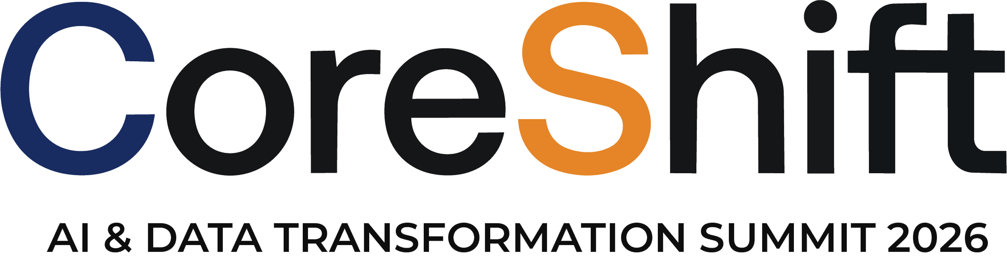
TECHNOLOGY TRACK SESSION
Ontologies & Semantic Context
Building Shared Business Context for AI
Presented by
Time
15:00–15:45 CEST | 09:00–09:45 EDT
Date
15 / 09 / 26
Notes:
COVER SLIDE. Replace the session title, date, time, partner names and the two speaker blocks. Drop headshots into the grey photo squares (right-click > Change Picture). Keep the CORESHIFT 2026 lockup untouched.

Slide 2







Your speakers
Meet the team presenting this session
Poonam Chug
Ramesh Nelluri
Vice President – Business Unit Head
EMEA Global Black Belt (GBB) - Cloud & AI Data Solution Advisory

Slide 3


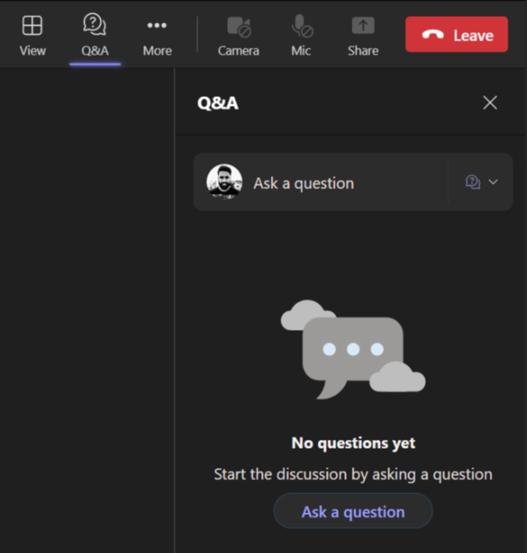
Housekeeping – Asking speaker a question
We want to hear from you!
Please submit your questions. We’ll reserve time for Q&A at the end of the webinar.
1
To submit questions, click on the Q&A at the top right corner
2
Clicking on the Q&A icon will open a window where you can type your question.
3
Click on the ‘Ask a question’ button & type your question.

Slide 4
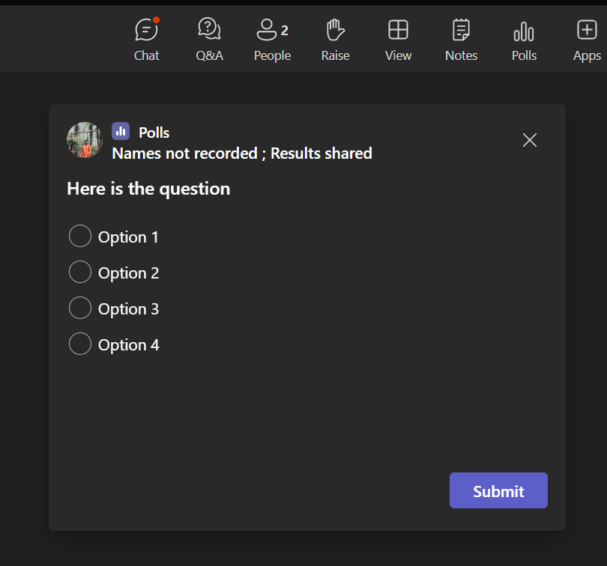
Housekeeping -Participating in Polls
Your opinion is valuable to us!
Please take part in our polls to help us understand your views.
1
Submit Your Vote:
A new window will pop up with the poll question.
Choose your answer from the provided options
2
Confirm Your Selection:
After selecting your option, make sure to hit the 'Submit' button to record your response..

Slide 5


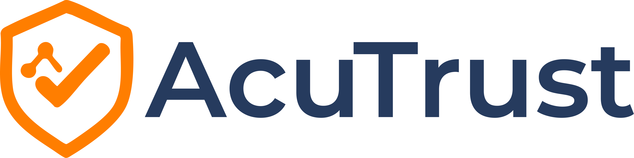

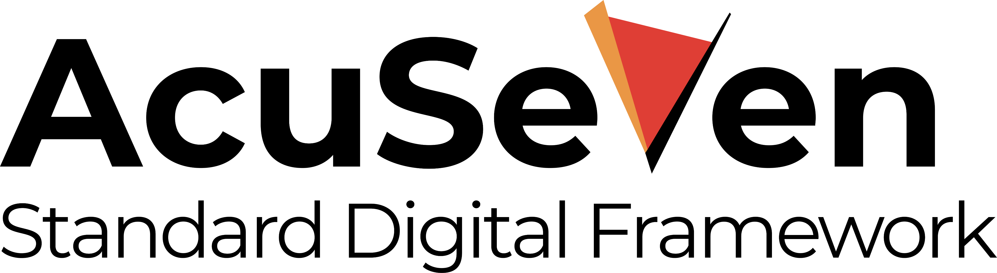

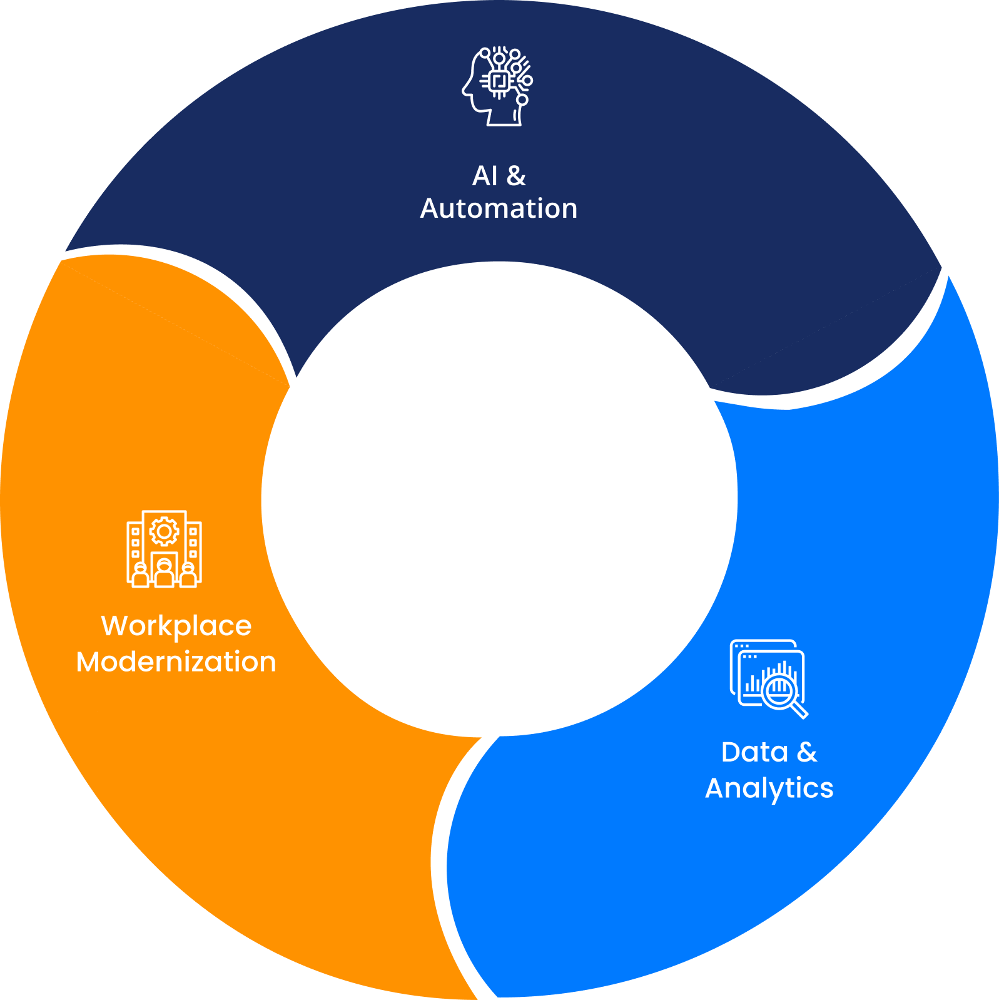





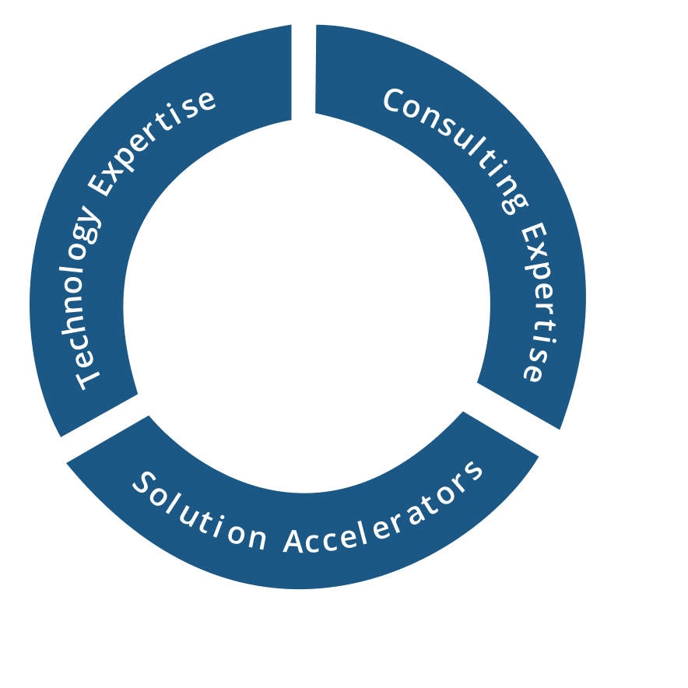
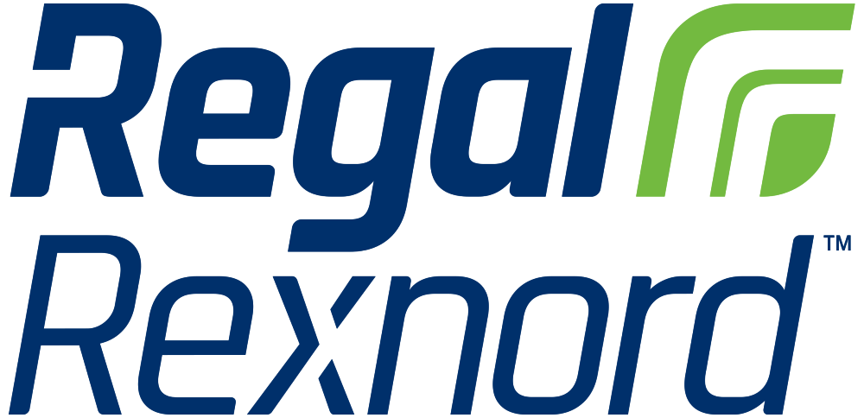
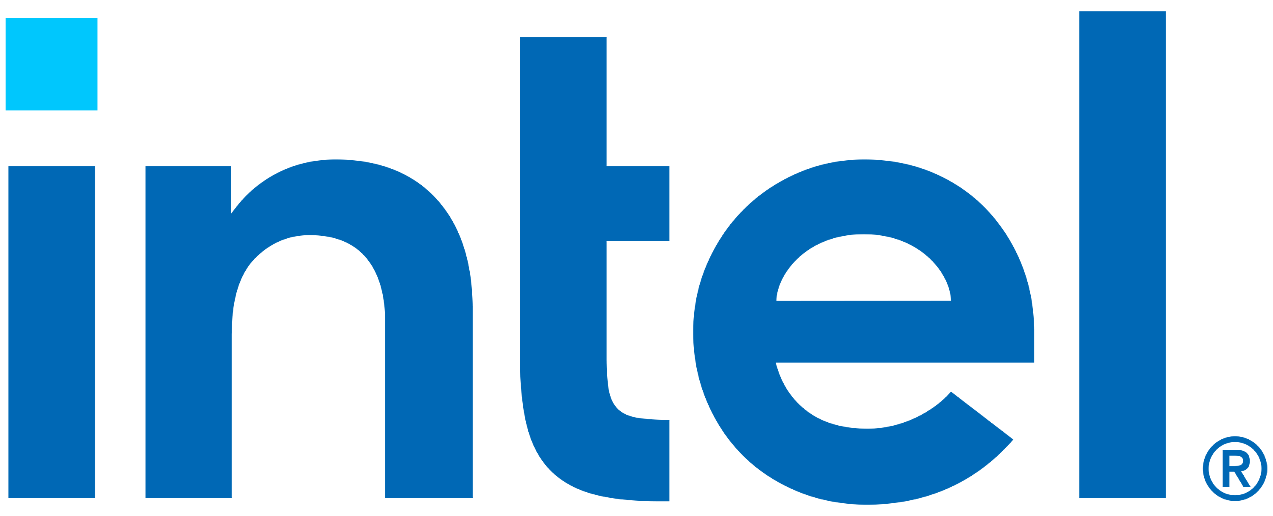


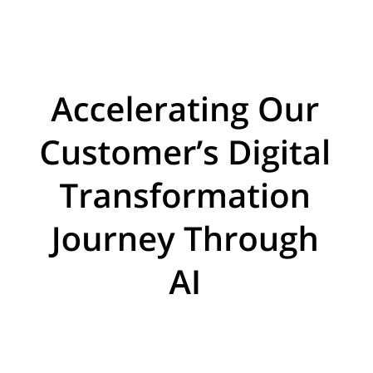
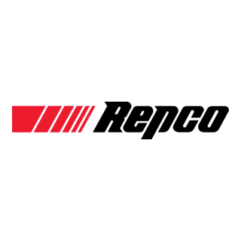





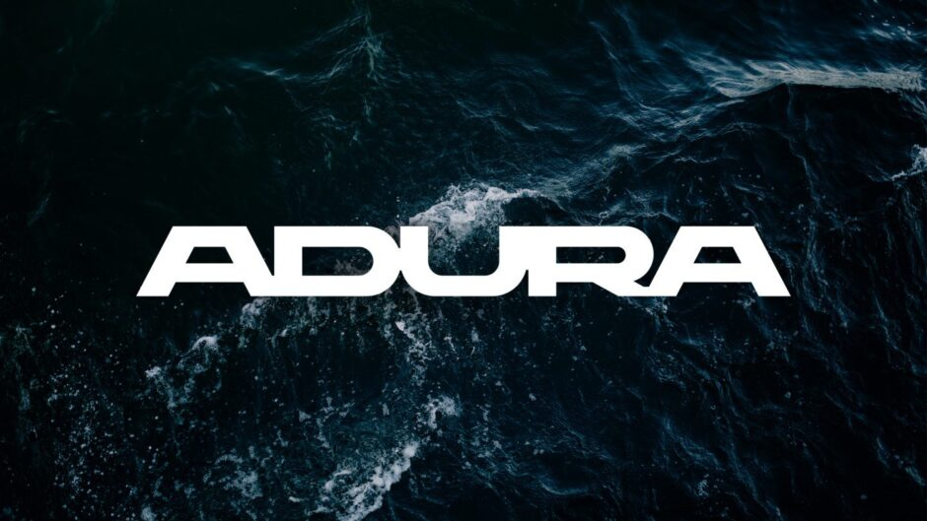











About Acuvate
Acuvate is a global player in next-generation digital solutions & services that modernize, automate and transform enterprise applications. With over 19+ years of experience, we have been enabling our clients globally to steer their digital transformation strategy using AI, Data & Cloud.
ACCELERATORS
TRUSTED BY 200+ ENTERPRISES WORLDWIDE INCLUDING SEVERAL FORTUNE 500
Manufacturing
Our Focus
CPG, Retail
Oil & Gas,
Energy
Healthcare and Life Sciences
BSFI
Government
19+
Years in the Industry
500+
Multi-Skilled Professionals
3 Continents, 7 offices
North America, Europe, Asia
Travel and Hospitality / Others

Slide 6

Poll 1
What is the biggest challenge you face today when using enterprise
data for AI?

Slide 7


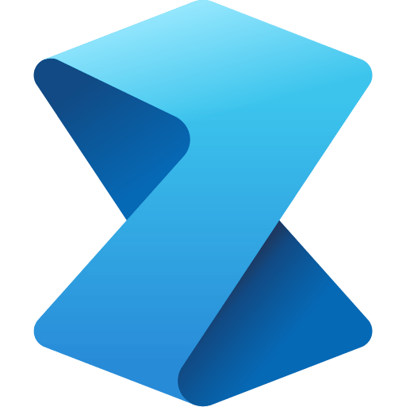





Microsoft Fabric
The unified data platform for AI transformation
Databases
Data
Factory
Analytics
Real-Time Intelligence
Power BI
IQ
Fabric Platform
Copilot
OneLake
Governance
Notes:
Fabric combines the best of Microsoft Power BI, Azure Synapse Analytics, and Azure Data Factory to create a single, unified software as a service (SaaS) platform with core workloads—each purpose-built for specific personas and specific tasks.​
Let’s explore how all these experiences empower data and business professionals alike to unlock the potential of their data and lay the foundation for the era of AI.​ Fabric empowers every team in the analytics process with the role-specific experiences they need, so data engineers, data warehousing professionals, data scientists, data analysts, and business users feel right at home. ​
You can think of Fabric as almost as Office for Data. Just like Office 365 has word for document authoring, PowerPoint for presentations, Excel for spreadsheets, etc. in Microsoft Fabric, you have the core workloads. ​
Data Factory provides more than 150 connectors to cloud and on-premises data sources, drag-and-drop experiences for data transformation, and the ability to orchestrate data pipelines.​
Analytics is also a new combination of three workloads: Data Engineering, Data Science, and Data Warehousing. Within Analytics, data professionals have all the tools they need for more complex authoring and modeling
Data Engineering enables great authoring experiences for Spark, instant start with live pools, and the ability to collaborate.​
Data Science provides an end-to-end workflow for data scientists to build sophisticated AI models, collaborate easily, and train, deploy, and manage machine learning models. ​
Data Warehousing provides a converged lake house and data warehouse experience with industry-leading SQL performance on open data formats.​
Databases enables the streamlining of AI application development with simple, intuitive, and autonomous databases that provision in seconds. With Fabric’s new Databases workload you can unlock innovative new scenarios for AI transformation.
Real-Time Intelligence is the combination of Real-Time Analytics and Activator, that allow you to ingest streaming data with high granularity, dynamically transform streaming data, query data in real-time for instant insights, and trigger actions like alerting a production manager when equipment is overheating or rerunning jobs when data pipelines fail.
IQ elevates how organizations work with data to think and act at the level of business concepts, enabling them to see a unified view of the business, answer new questions faster, and trust AI agents to make high-stakes decisions.
Power BI in Fabric provides industry-leading visualization and AI-driven analytics that enable business analysts and business users to gain insights from data. The Power BI experience is also deeply integrated into Microsoft 365, providing relevant insights where business users already work. ​
And with Microsoft Fabric’s new workload hub, you can discover, add, and manage partner created workloads from industry-leading ISVs like EPIC, London Stock Exchange, Informatica, and ESRI.

Slide 8
Fabric IQ
A semantic foundation that powers trustworthy agentic experiences and accelerates
time-to-insight
Streamline creation of a semantic data foundation with
no-code tools
Leverage a shared system of intelligence and act on
context-rich insights
Power Microsoft Foundry agents that understand your
business context
Empower everyone to build a shared semantic foundation and align data, models, and systems in real time using no-code tools built into the solutions they already use
Work from a consistent, trusted foundation where people and AI use shared business concepts, logic, and rules to uncover insights faster and take action ​in the moment
Fuel AI agents where they’re built with shared business context, so they learn, adapt, and build on each other’s knowledge to drive smarter decisions aligned business priorities
Notes:
Fabric IQ elevates how organizations work by creating a consistent semantic foundation that connects people, data, and AI. It powers trustworthy, agentic experiences and accelerates time-to-insight by continuously shaping how the business operates in real time.
With no-code tools built into the solutions people already use, IQ makes it easy for anyone to contribute to a shared semantic foundation. Teams can align data, models, and systems in real time – removing barriers between business and technical users. From there, everyone can work from a shared system of intelligence. People and AI use common business concepts, logic, and rules to uncover context-rich insights faster and act on them in the moment.
Finally, this foundation powers Microsoft Foundry agents that truly understand the business. They learn and adapt with every interaction, capturing institutional knowledge to drive smarter decisions aligned to business priorities.

Slide 9

Microsoft Fabric Platform
Microsoft Fabric
The unified data platform for AI transformation
Semantic
Model
Ontology
Digital
Twin Builder
Graph
Plan
Data Agent
Operations
Agent
IQ
Fabric Platform
Copilot
OneLake
Governance
Notes:
Fabric combines the best of Microsoft Power BI, Azure Synapse Analytics, and Azure Data Factory to create a single, unified software as a service (SaaS) platform with core workloads—each purpose-built for specific personas and specific tasks.​
Let’s explore how all these experiences empower data and business professionals alike to unlock the potential of their data and lay the foundation for the era of AI.​ Fabric empowers every team in the analytics process with the role-specific experiences they need, so data engineers, data warehousing professionals, data scientists, data analysts, and business users feel right at home. ​
You can think of Fabric as almost as Office for Data. Just like Office 365 has word for document authoring, PowerPoint for presentations, Excel for spreadsheets, etc. in Microsoft Fabric, you have the core workloads. ​
Data Factory provides more than 150 connectors to cloud and on-premises data sources, drag-and-drop experiences for data transformation, and the ability to orchestrate data pipelines.​
Analytics is also a new combination of three workloads: Data Engineering, Data Science, and Data Warehousing. Within Analytics, data professionals have all the tools they need for more complex authoring and modeling
Data Engineering enables great authoring experiences for Spark, instant start with live pools, and the ability to collaborate.​
Data Science provides an end-to-end workflow for data scientists to build sophisticated AI models, collaborate easily, and train, deploy, and manage machine learning models. ​
Data Warehousing provides a converged lake house and data warehouse experience with industry-leading SQL performance on open data formats.​
Databases enables the streamlining of AI application development with simple, intuitive, and autonomous databases that provision in seconds. With Fabric’s new Databases workload you can unlock innovative new scenarios for AI transformation.
Real-Time Intelligence is the combination of Real-Time Analytics and Activator, that allow you to ingest streaming data with high granularity, dynamically transform streaming data, query data in real-time for instant insights, and trigger actions like alerting a production manager when equipment is overheating or rerunning jobs when data pipelines fail.
IQ elevates how organizations work with data to think and act at the level of business concepts, enabling them to see a unified view of the business, answer new questions faster, and trust AI agents to make high-stakes decisions.
Power BI in Fabric provides industry-leading visualization and AI-driven analytics that enable business analysts and business users to gain insights from data. The Power BI experience is also deeply integrated into Microsoft 365, providing relevant insights where business users already work. ​
And with Microsoft Fabric’s new workload hub, you can discover, add, and manage partner created workloads from industry-leading ISVs like EPIC, London Stock Exchange, Informatica, and ESRI.

Slide 10
Demo: Creating ontologies
An ontology turns your business from data-rich and meaning-poor into meaning-rich and action-ready

Slide 11
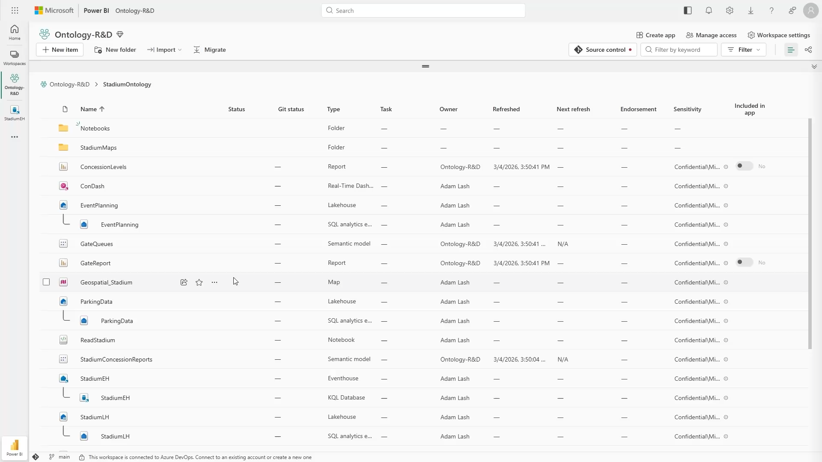
Notes:
Demo length – 2 minutes 23 seconds

Slide 12
Why Enterprises need Ontology?
AI is only as good as the business context it understands.
Today's enterprise AI initiatives often struggle because business knowledge is fragmented across people, systems and documents. Without shared business context, AI can retrieve information—but it cannot reliably reason across the enterprise.
Today’s Enterprise Challenges
Challenge | Business Impact
ERP, MES, Historian, CRM and Documents operate in silos | Slow cross-functional decision making
Different departments define KPIs differently | Multiple versions of the truth
AI lacks understanding of business relationships | Hallucinations and poor recommendations
Critical knowledge resides with experienced employees | Knowledge loss and operational risk
Duplicate business definitions across teams | Weak governance and inconsistent reporting
The challenge isn't data availability. The challenge is giving AI a common business language.

Slide 13




What is an Ontology?
A model that mirrors how your business actually works — across every data silo
Definition: An ontology is a business-language map of your entities — plants, lines, shipments, SKUs, carriers — and the relationships between them. It is a digital twin of the business process, not just the data warehouse.
Why it's needed
What it connects
The value it adds
Enterprise data lives in disconnected silos with inconsistent names — "line_id" here, "LID" there.
An AI agent over raw silos doesn't know 6 = Stuttgart or that a shipment row, a document, and an email are the same shipment.
So it guesses — and guesses confidently. That's where hallucinations come from.
Structured data — production, sales, logistics numbers (Fabric IQ).
Documents & policies — SLAs, SOPs, audits (Foundry IQ).
Work context — email & Teams threads (Work IQ).
External signals — weather, compliance (Web IQ).
Grounded, cited answers — every fact traceable to its source, no guesswork.
Business language — ask in plain English; no IT report request needed.
Decisions, not dashboards — one question traverses all layers into an answer.
Entities
Relationships
Rules & policy
Actions
The real things you manage — Product, Plant, Supplier, Customer.
How they connect — “Plant PRODUCES Product”, “Recipe CONTAINS Ingredient”.
Business logic, shared definitions, lineage and constraints on every entity.
What can be done — reorder, re-route, flag risk — so agents can act, not just read.
An ontology = business context for AI.

Slide 14
How the ontology powers Copilots & agents
The ontology is your complete enterprise context — all four IQs together. It is the layer every Copilot and agent above reasons and acts on.
Experiences
Microsoft 365 Copilot · Copilot Studio agents · Autonomous agents (Microsoft Scout)
Agents
Microsoft 365 Copilot
(agent builder)
Copilot Studio
(low / no-code)
Microsoft Foundry
(pro-code)
Partner & custom
MCP / API
Model Context Protocol (MCP) & APIs — the open standard connecting agents to the ontology, tools and systems
Microsoft IQ
the ontology
THE ONTOLOGY · complete enterprise context — all four IQs together
Fabric IQ
Foundry IQ
Work IQ
Web IQ
business entities & data
policies & documents
how people work
the open web
Data
MS Fabric OneLake · Microsoft 365 & Dynamics 365 · corporate stores & SharePoint · the web
Grounded in all four → agents reason with shared meaning, act within policy, and stay auditable.
5

Slide 15




MICROSOFT IQ FAMILY · COMPONENT 1 OF 4
Fabric IQ
Business entities & data context
Public preview
Fabric IQ turns your structured data on OneLake into a living ontology — semantic model, rules, operational data, policies and analytics, all in one governed layer.
Flexible Data Ingestion: Connect structured enterprise data into Microsoft Fabric using Mirroring, OneLake Shortcuts, or Fabric Data Factory Pipelines, based on the source system and integration pattern.
WHERE IT SITS
OneLake — unified data
↓
Ontology + Graph (meaning)
Semantic model
Graph
Model entities, relationships and metrics in your own business language (semantic models GA; ontologies in preview).
Relationship-first engine connecting entities, systems and signals at scale (GA).
↓
Data & Operations Agents
↓
Grounded business decisions
Data Agent
Operations Agent
Conversational analytics grounded in the ontology, answering in business terms.
Agentic AI that monitors live data, detects rule violations and acts — with approval.
6

Slide 16




MICROSOFT IQ FAMILY · COMPONENT 2 OF 4
Foundry IQ
Policies & documents context
Azure AI Search
Foundry IQ provides context on your organization's policies and authoritative documents. Built on Azure AI Search, it grounds agents in unstructured knowledge through reusable knowledge bases.
WHERE IT SITS
Docs, SharePoint, OneLake, Web MCP
Curated retrieval
Knowledge bases
↓
Defines which sources to use and serves the most relevant info to agents.
Reusable, governed knowledge shared across many agents and apps.
Curation + agentic retrieval
↓
Knowledge bases for agents
Grounded & cited
No RAG headache
Permission-aware answers with citations; security and compliance enforced.
Removes parsing, chunking, embedding and re-ranking that teams usually own.
↓
Grounded, cited answers
What is RAG?
Retrieval-Augmented Generation — the agent fetches relevant facts from your data at query time and adds them to the prompt, so answers are grounded in your content rather than the model's memory. Foundry IQ delivers this as a managed service.
7

Slide 17




MICROSOFT IQ FAMILY · COMPONENT 3 OF 4
Work IQ
How people work - context
APIs GA Jun 16
Work IQ provides context on how your people work. A contextual intelligence layer for Microsoft 365, it captures collaboration signals from documents, meetings, chats and workflows.
WHERE IT SITS
Microsoft Teams, Outlook, SharePoint, Onedrive
People & collaboration
Memory & personalisation
↓
Understands who works with whom, on what — mail, chat, documents, meetings.
Implicit and explicit memory across interactions — more than raw Microsoft Graph.
Graph (facts) + Work IQ (context)
↓
Copilot & custom agents
Powers Microsoft 365 Copilot
Open via APIs
↓
Work IQ APIs let custom agents tap the same work context directly.
Context-aware assistance
The intelligence behind Copilot's awareness of your habits and work patterns.
8

Slide 18




MICROSOFT IQ FAMILY · COMPONENT 4 OF 4
Web IQ
Web grounding for agents​
Limited access
Web IQ is the newest member — it provides context from the open web — AI-native, Bing-powered grounding APIs that bring fresh, citation-ready intelligence to agents, tuned to how agents search.
WHERE IT SITS
The open web (news, sites, media)
Real-world grounding
Fast & efficient
↓
Web pages, news, images and video — current intelligence beyond your walls.
Bing-powered grounding tuned to agent search patterns; fast, with fewer tokens.
Discover · rank · extract · package
↓
Citation-ready passages
Citation-ready
Model-agnostic & MCP-native
↓
Structured, attributable passages — transparent and controllable in any workflow.
Externally-grounded agents
Works with any model and plugs into the agent ecosystem via MCP.
9

Slide 19





From data to agents — the end-to-end story
Every Copilot answer and agent action travels the same path. The ontology — formed by all four IQs together — is where raw data becomes business meaning agents can trust.
Data
OneLake
The Ontology
Agents
Action
1
2
3
4
5
OT, IT, ERP & sensors
Documents & M365
Open web — on-prem & cloud
One unified copy
Structured & unstructured
No more silos
Fabric IQ · structured
Foundry IQ · documents
Work IQ · work context
Web IQ · open web
Copilot & Copilot Studio
Foundry (pro-code)
MCP / API
Grounded answers
Autonomous decisions
Auditable & owned
All four IQs = one ontology
What is MCP?
Model Context Protocol — an open standard (backed by Microsoft, OpenAI and Anthropic) that lets agents connect to data, tools and systems through one common interface instead of custom integrations for each. It is how agents plug into the ontology and act in your systems.
11

Slide 20
Poll 2
Where do you see the biggest potential for ontology in your organization?

Slide 21
Demo: Business Use Case
Putting the four IQs to work on one real question

Slide 22
LIVE DEMO
Healthy Drinks
CPG Beverage Manufacturing —
From Sensor to Boardroom: Unified Ontology-Grounded Analytics
12
15
140
562K
36
Plants
SKUs
Supermarkets
Sales Records
Relationships
5 USA Plants • 7 EU Plants • Jan 2025 – Jun 2026

Slide 23






Ontology – Use Case
(SAP) ERP
data
Strategy / planning data/docs
External data
Engineering Drawings
Logistics
Entities:
  Company HQ
  Production plants
  Products
  Super markets
  Logistics
  Customers
Overtime we can easily
add more entities
Logistics
Production
Plant
Production plant
Timeseries
data
Company
HQ
LOGIC data
Company HQ
Super Markets
Supermarkets
Customer survey data
Products
Products
Customers
Customers

Slide 24
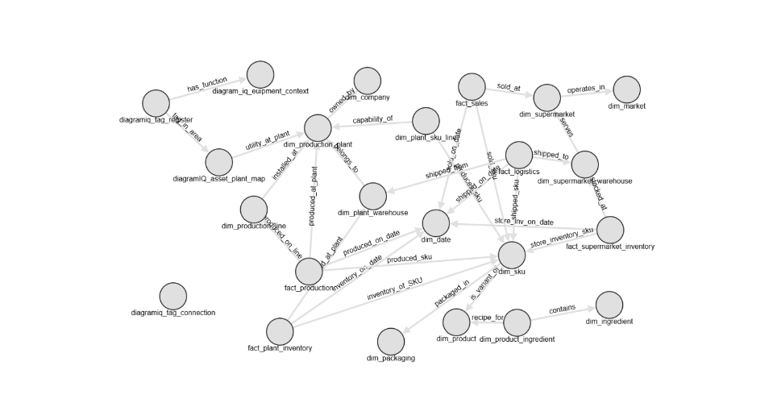
Healthy Drinks Ontology – Knowledge Graph (view)

Slide 25
One Shipment. Five Systems. No Answer.
No ontology — a route manager manually digs through five disconnected systems to find an answer nobody is fully sure of.
Scan for Delays
Dig Through Inboxes
Hunt the Contract
Piece It Together
Guess and Escalate
1
2
3
4
5
Opens the TMS (Transport Management System), checks each route manually
No ranking — scrolls every shipment to find one
Delay status is often outdated or missing
Searches a shared inbox manually, one thread at a time
Complaints and vendor updates look identical
No link between an email and its shipment
Opens the vendor's SLA contract PDF
Searches manually for the penalty clause
Not sure which version is the current one
No way to confirm the amount without legal
Three systems open, three different answers
Shipment, email and SLA don't line up
No single source anyone fully trusts
Escalates without being sure who's at fault
Penalty claim delayed — sometimes missed
Supermarket is still waiting for a real answer
Five systems. Forty minutes lost. Still not sure.
The hidden cost
The manual reality. This is today's average workflow, not the exception — SLA penalties get missed not because the data wasn't there, but because nothing connected it.

Slide 26
A Delayed Shipment, Resolved End-To-End
Logistics use case demo — a route manager triages a delayed shipment, checks the vendor's emails, and confirms an SLA penalty, without leaving the chat.
Delayed Shipments
Vendor & Customer Emails
SLA & Penalty Check
Grounded Answer
Resolve & Act
1
2
3
4
5
Opens the Logistics Copilot for the route
Delayed shipments ranked by vendor
Sorts ascending / descending to prioritise
Work IQ surfaces the latest delay emails
Supermarket complaints, vendor updates
Every message linked to its shipment
Foundry IQ retrieves the vendor's SLA
Checks the penalty clause for this shipment
Confirms the penalty amount due
Cites the exact contract clause
Shipment, emails & SLA tied together
One cited answer, no manual digging
Trusted enough to act on
Notify the vendor or escalate
File the penalty claim
Update the supermarket — case closed
One conversation, three IQs working together

Slide 27


One delay, two very different mornings
Without an ontology
With the ontology
Five systems. No shared context.
One Copilot, grounded in shipment, SLA & email context.
Opens the TMS, then the ERP, then the inbox — one at a time
Shipment IDs don't line up across systems
Delay emails buried in a shared inbox
SLA clause found by searching a contract PDF, by hand
Ranks every delayed shipment by vendor, instantly
Work IQ surfaces the exact delay email
Foundry IQ cites the SLA penalty clause
Every answer traceable to its source
Outcome: “Might be a penalty — not sure which vendor.”
Answer: “Vendor B — penalty confirmed under clause 4.2.”
The difference between a guess and a grounded answer.

Slide 28
Start Small. Deliver Value. Expand.
We don't recommend building an enterprise-wide ontology on Day One.Instead, we start with one high-value business problem, prove measurable value within weeks, and then expand the ontology across additional business domains.
Business Challenge
Discovery Workshop and Pilot Implementation 4 to 6 Week Pilot
Business Value Proven
Expand Ontology
Enterprise AI Platform
Typical Pilot Use Cases
4 to 6 weeks
to pilot
Supply Chain Optimization
Production Loss Analysis
Procurement Risk
Asset Maintenance
Shift Staffing
Engineering Drawing Intelligence
18

Slide 29

A 4–6 Week Pilot to Deliver Measurable Business Value
Objective: Solve one high-value business problem by building a focused ontology, grounding enterprise AI, and demonstrating measurable business outcomes—laying the foundation for future enterprise-wide expansion.
Week | Activities | Customer Input | Customer Outcome
Week 1 | Business Discovery | Leverage Acuvate's structured discovery framework to rapidly capture the business use case, ontology scope, and enterprise data landscape. | Pilot use case selected
Week 2 | Ontology Design | - | Shared business language established
Week 3 | Connect Data & Documents | - | Unified business context
Week 4 | Configure Copilot & AI Agent | - | Grounded AI responses
Week 5 | Business Validation | Validate the ontology and AI responses with business SMEs to ensure alignment with real-world processes and business rules | Trusted recommendations
Week 6 | Go Live & Knowledge Transfer | - | Measurable business value
Deliverables:
Business Ontology
Knowledge Graph
Fabric IQ Semantic Model
Foundry Knowledge Base
Grounded Copilot
Business Validation Report
18

Slide 30
Expected Business Outcomes with Ontology
Area | Expected Outcome
Decision Making | Faster cross-functional decisions
AI Accuracy | Reduced hallucinations through grounded business context
Business Trust | Consistent KPI definitions across departments
Productivity | Less time searching, more time deciding
Knowledge Management | Preserve institutional knowledge
Future AI Initiatives | Reusable ontology accelerates new AI use cases
Typical ROI
Faster investigations
Reduced manual reconciliation
Improved report consistency
Faster AI adoption
Lower implementation risk through phased delivery
The ontology becomes a reusable enterprise asset powering every future Copilot and AI Agent.
18

Slide 31
◉
Layered on top of a unified data foundation
▦
Millions of Power BI models to jumpstart ontology
The Fabric IQ
Advantage
◌
Native real-time platform for live business context
➜
Microsoft 365 & Microsoft Foundry integration
◒
Business agility from visual no-code modeling tools
Notes:
Converted from the user's uploaded image. All text recreated as editable PowerPoint objects; brand colors used: #182C61 dark blue and #FF7E00 orange.

Slide 32
Why Acuvate?
Microsoft AI & Data Partner
Industry Ontology Accelerators
Deep expertise across Microsoft Fabric, Azure AI Foundry, Copilot Studio and Microsoft Graph and Microsoft IQ system.
Pre-built industry ontologies, business entities, relationships and domain models for Manufacturing, Oil & Gas, Energy and CPG—accelerating implementation and reducing time to value.
Rapid Time to Value
End-to-End AI Enablement
Deliver measurable outcomes through a focused 4–6 week pilot before expanding enterprise-wide.
From ontology design and knowledge grounding to AI agents, governance and adoption.
Reusable Enterprise Foundation
Every pilot builds reusable business context that accelerates future AI initiatives.
18

Slide 33
Poll 3
How Soon Do You See Your Organization Using Ontology To Create A Shared
Business Context For AI?

Slide 34



Slide 35






Session Presented by
THANK YOU
We are a global player in next-generation digital solutions & services that modernize, automate and transform enterprise applications. With over 19+ years of experience, we have been enabling our clients globally to steer their digital transformation strategy using Cloud, Data & AI. We build & develop smart & sustainable solutions to help our customers transform their conventional processes to match the next-generation technological trend.
We have a strong presence in the US, Europe, and Middle East, where we serve multiple ultra-large customers as well as SMBs from various sectors such as Public Sector, CPG, Retail, Oil & Gas, Energy, Manufacturing, BFSI, Healthcare, etc.
Contact: advisors@acuvate.com

