Slide 1


TECHNOLOGY TRACK SESSION
Data and AI Governance
Building Trusted Data Foundations for Enterprise AI
Presented by
Time
17:00–17:45 CEST | 11:00–11:45 EDT
Date
15 / 09 / 26
Notes:
COVER SLIDE. Replace the session title, date, time, partner names and the two speaker blocks. Drop headshots into the grey photo squares (right-click > Change Picture). Keep the CORESHIFT 2026 lockup untouched.

Slide 2
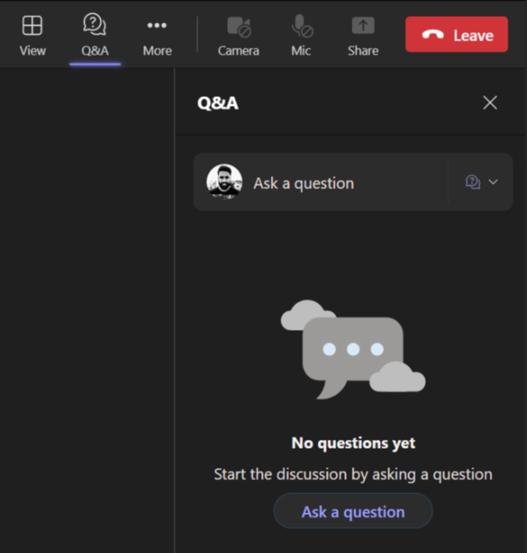
Housekeeping – Asking speaker a question
We want to hear from you!
Please submit your questions. We’ll reserve time for Q&A at the end of the webinar.
1
To submit questions, click on the Q&A at the top right corner
2
Clicking on the Q&A icon will open a window where you can type your question.
3
Click on the ‘Ask a question’ button & type your question.

Slide 3
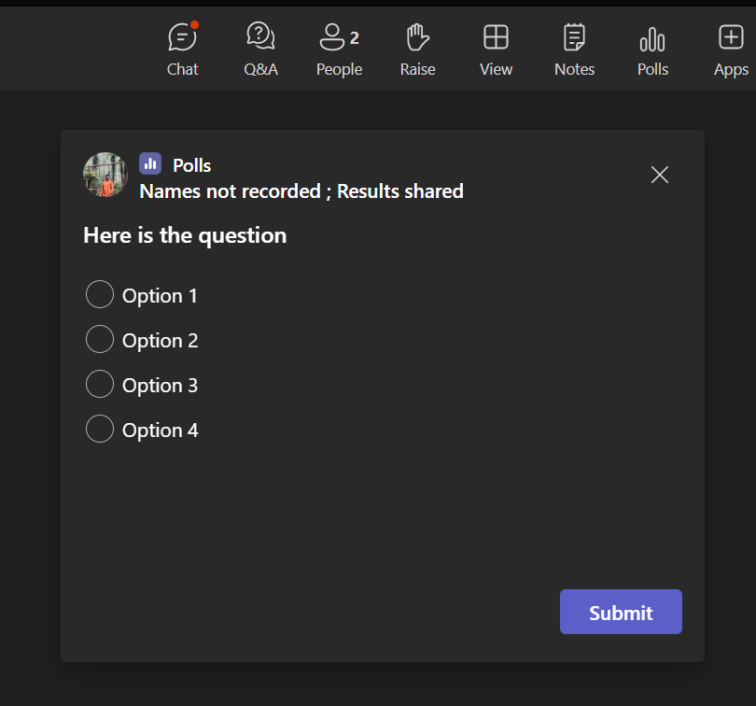
Housekeeping -Participating in Polls
Your opinion is valuable to us!
Please take part in our polls to help us understand your views.
1
Submit Your Vote:
A new window will pop up with the poll question.
Choose your answer from the provided options
2
Confirm Your Selection:
After selecting your option, make sure to hit the 'Submit' button to record your response..

Slide 4
It’s Monday Morning.
A client just called.
Confidential client data just showed up somewhere it shouldn’t have. An employee had been using an AI agent to move faster - nobody on the security team remembers approving it, and it’s been running for three months.

Slide 5
A Few Questions To Sit With First.
The Agent
The Organization
Can we shut it down? How fast can this agent be switched off — minutes, hours, or days?
Who owns this? Who's accountable — the employee, the agent's owner, IT, or the business unit?
1
1
Where did the data go? Can you trace what data it touched, where it came from, and where it ended up?
Is this the only one? How many agents like it are running right now that nobody's tracking?
2
2
Who built and ran it? Do you know who built this agent, who's been operating it, and whether it was ever authorized?
Would this trigger a notification? Does this cross the line into a reportable breach under GDPR or the EU AI Act?
3
3
What guardrails existed? What guidelines or policies was the employee given before they started using it?
Could you prove it? Could you hand a regulator a complete audit trail within the hour?
4
4

Slide 6







Your speakers
Meet the team presenting this session
Vishal Sharma
Andrei Negrut
Kalyan Enjamoori
Technical Specialist
Global Enterprise AI & Productivity Lead
Data Analytics and Governance Consultant
Notes:
@Andrei to introduce

Slide 7
The opportunity
and the governance gap holding it back
1
Current Landscape
how AI agents operate today
2
A maturity model
and why “Level 3” is the real threshold
Operating model
3
responsible AI, adoption, and security
4
Demo
5
A phased roadmap
What we'll cover
and the business case for acting now
6
ROADMAP

Slide 8
What we'll cover
2
Current landscape
1
The opportunity
how AI agents actually operate today
3
A maturity model
and the governance gap holding it back
and why “Level 3” is the real threshold
What we'll cover
6
A phased roadmap
4
Operating model
and the business case for acting now
5
Live demo
responsible AI, adoption, and security
dashboards that make governance real

Slide 9




SECTION 01 · OPPORTUNITIES & GAPS
Agentic AI Is Moving From Pilot To P&L Impact
74%
97%
of the most advanced GenAI initiatives are meeting or exceeding ROI expectations
of organizations report commitment to agentic AI adoption
$2.6–4.4T
$8.5B→$45B
projected addition to global GDP from agentic AI by 2030
agentic AI market growth projected from 2026 to 2030
2

Slide 10
SECTION 01 · OPPORTUNITIES & GAPS
Agentic AI is moving from pilot to P&L impact
97%
$2.6–4.4T
74%
$8.5B→$45B
projected addition to global GDP from agentic AI by 2030
of the most advanced GenAI initiatives are meeting or exceeding ROI expectations
agentic AI market growth projected from 2026 to 2030
of organizations report commitment to agentic AI adoption
Sources: Deloitte State of GenAI; IDC – Agentic AI: A Playbook for Corporate Innovation.

Slide 11
SECTION 01 · OPPORTUNITIES & GAPS
But Governance Readiness Hasn't Kept Pace
70%
21%
88%
10%
of organizations have no well-defined AI governance model
of enterprises have mature governance for autonomous agents
of enterprises had a confirmed or suspected AI agent security incident in the past year
of organizations feel fully prepared for an AI system audit
Adoption velocity is outpacing governance readiness - the gap itself is now the primary risk.
Sources: EY Tech Risk – AI Governance, Risks and Compliance Survey 2025; ISACA 2026 research.

Slide 12
SECTION 02 · CURRENT LANDSCAPE
Governing AI as an Operating System
Notes:
Poll -

Slide 13

Poll 1
Which AI Domains Does Your Organization
Currently Face Challenges With?

Slide 14
SECTION 02 · CURRENT LANDSCAPE
Agent Types
SIMPLE
ADVANCED
1
Retrieval
2
Task
3
Autonomous
Retrieves information from grounding data, reasons, summarizes, and answers user questions.
Takes action when asked — automates workflows and replaces repetitive tasks for users.
Operates independently — dynamically plans, orchestrates other agents, learns, and escalates.
Governance intensity should scale with autonomy.
Notes:
Mention tools that can create these Agents

Slide 15
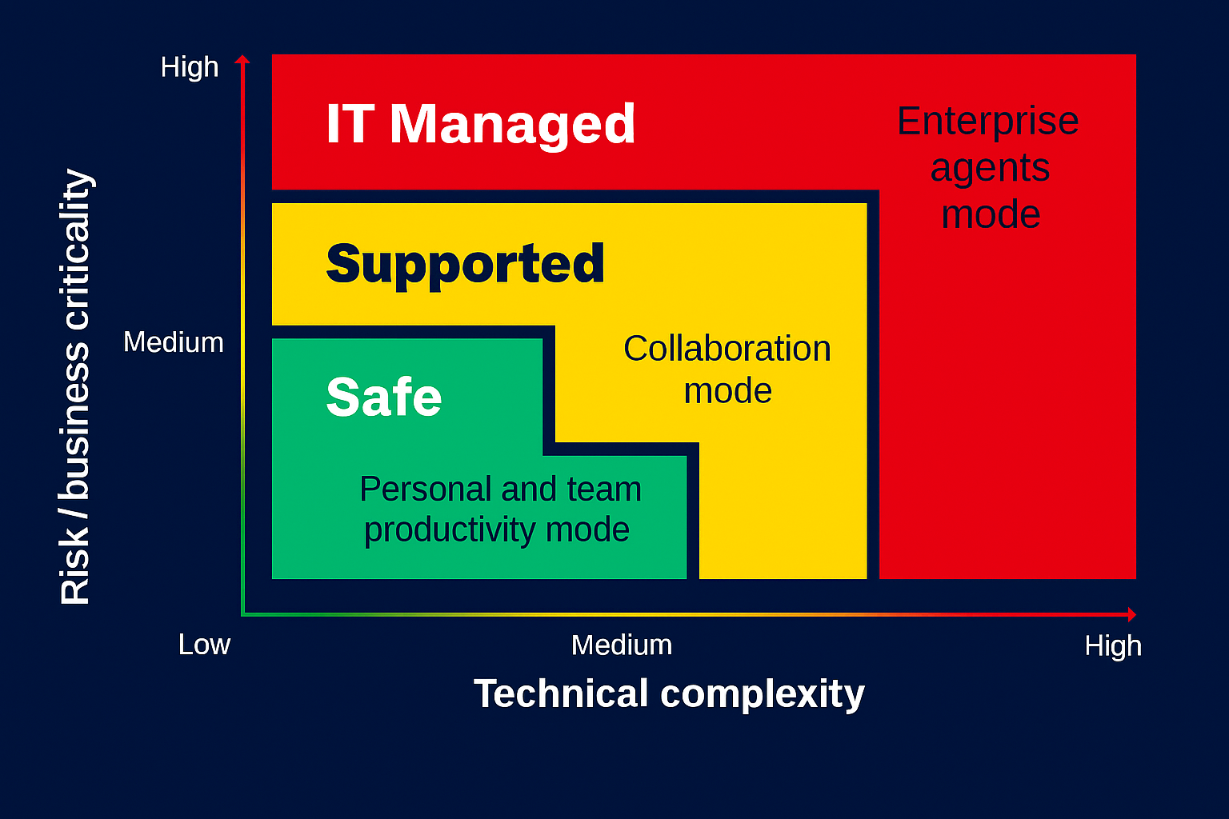
SECTION 02 · CURRENT LANDSCAPE
Zoned Implementation
Zone 1
Zone 2
Zone 3
Safe / Citizen
Collaboration
IT-Managed
Simple retrieval agents. Runs in the user's own context. No autonomy. Self-service, DIY build.
Personal agents with knowledge + actions. DLP-enforced. Admin-approved publishing.
Enterprise, high-risk, autonomous agents. Pro-dev + IT owned. Full Dev/Test/Prod lifecycle.
Notes:
@Andrei to share his views about Citizen development and other implementation at NXP

Slide 16
SECTION 02 · CURRENT LANDSCAPE
Agent sprawl: biggest risk
Agent sprawl is the uncontrolled growth and proliferation of autonomous AI agents across an organization without centralized visibility, ownership, or governance.
Functional Duplication Multiple agents doing the same task across teams — 2–5× wasted compute, inconsistent outputs.
1
Shadow Agents Agents deployed outside IT governance, unregistered — security blind spots, compliance violations.
2
Orphaned Agents Agents whose purpose has expired but keep running — ongoing cost for zero value, expanded attack surface.
3
4
Permission Creep Agents accumulating access beyond their original scope — privilege escalation, regulatory exposure.
5
Unmonitored Delegation Multi-agent chains with no visibility or authorization tracking — loss of accountability, cascading failure.

Slide 17
SECTION 03 · GOVERNANCE FRAMEWORK & MATURITY
AI agent governance framework
People and Processes
1
Define Governance Principles & Strategy anchored on Responsible AI and Regulatory Compliance
Define Governance goals and align to Org Goals
Establish – Strategic, Tactical and Operational metrics for continuous monitoring and mitigation
Communication plan to communicate the risk of ungoverned agents, and the upside of governed ones, as adoption scales.
Define Governance principles and Strategy
1
Continuous Improvement and Monitoring
Form an executive Steering Committee and AI Governance Council. Name an accountable owner for every agent. Invest in AI Literacy
2
3
4
2
Define Governance Roles & Ownership
Establish Agent Registry &
Authorization
Define the Agent Lifecycle
Track every agent as an asset. Log what it can access, and require sign-off before production
3
Define the stages every agent moves through - design, pilot, approval, retirement
4
Technology
5
6
7
8
Implement Dedicated Agent Identities, Least-privilege execution, Restricted Access Controls, Agent Registry & Agent Kill Switch
5
Implement Agent Security Controls
Govern Models & Evaluations
Capture End-to-End Lineage
Monitor Agent Performance & Quality
Version every model and prompt change; evaluate quality, safety, and drift before deployment
6
Maintain end-to-end lineage for audit readiness, regulatory reporting, and root-cause investigation of non-compliant outputs.
7
Define SLAs for agent accuracy and safety, monitor drift and task success, and remediate underperforming agents
8

Slide 18

SECTION 03 · GOVERNANCE FRAMEWORK & MATURITY
Governance isn't one-size-fits-all
Centralized
Federated
Hybrid
IT owns everything. Consistent and uniform, but slower to respond locally.
Business units run their own agents with top-level coordination. Fast and locally responsive.
Central rules for high-risk decisions; federated autonomy for low-risk ones.
Best for high-regulation, low-experimentation contexts.
Risks inconsistency and shadow IT.
What most mature organizations end up with.
Notes:
@Andrei to share his experience of Hybrid Governance at NXP

Slide 19
SECTION 03 · GOVERNANCE FRAMEWORK & MATURITY
A five-level maturity model for agent governance
L1
L2
L3
L4
L5
Ad-hoc
→
Reactive
→
Defined
→
Managed
→
Optimized
No formal governance
Basic registry, incident-triggered
Formal policy, RBAC, HITL, Sensitivity Labels
Quantitative metrics, automation
Self-improving, governance-as-code
Level 3 — “Defined” — is identified as the minimum viable governance standard. Below it, governance delivers little real protection.

Slide 20
SECTION 03 · GOVERNANCE FRAMEWORK & MATURITY
Governance Activities at each level
Minimal Governance
Governance Framework
 | L1 Ad-hoc | L2 Reactive | L3 Defined | L4 Managed | L5 Optimized
LIFECYCLE & IDENTITY
Agent registry & lifecycle mgmt. | – | Basic registry | Centralized catalog | + Automated lifecycle mgmt. | Automated lifecycle mgmt.
Identity & access control (RBAC) | – | – | ✓ | ✓ | ✓
RUNTIME GOVERNANCE
Observability | – | – | ✓ | ✓ | ✓
Policy enforcement | – | – | Manual policy | Automated policy | Automated policy
Data governance / boundaries | – | – | Classification & Security Labels | ✓ | ✓
Human oversight (HITL) | – | – | ✓ | ✓ | ✓
PORTFOLIO GOVERNANCE
Sprawl containment | – | – | Incident-triggered | Automated detection & Kill Switch | Predictive detection
Audit & compliance | – | – | ✓ | ✓ | ✓
Inter-agent coordination | – | – | ✓ | ✓ | ✓
Risk classification | – | – | ✓ | ✓ | ✓
IMPROVEMENT & RESILIENCE
Incident response | – | Incident-triggered | ✓ | ✓ | ✓
Continuous improvement | – | – | – | – | + Governance-as-code

Slide 21
Poll 2
How Mature Is Your Organization’s Data & AI Governance Today?

Slide 22
SECTION 03 · GOVERNANCE FRAMEWORK & MATURITY
AI agent governance framework
People and Processes
1
Define Governance Principles & Strategy anchored on Responsible AI and Regulatory Compliance
Define Governance goals and align to Org Goals
Establish – Strategic, Tactical and Operational metrics for continuous monitoring and mitigation
Communication plan to communicate the risk of ungoverned agents, and the upside of governed ones, as adoption scales.
Define Governance principles and Strategy
1
Continuous Improvement and Monitoring
Form an executive Steering Committee and AI Governance Council. Name an accountable owner for every agent. Invest in AI Literacy
2
3
4
2
Define Governance Roles & Ownership
Establish Agent Registry &
Authorization
Define the Agent Lifecycle
Track every agent as an asset. Log what it can access, and require sign-off before production
3
Define the stages every agent moves through - design, pilot, approval, retirement
4
Technology
5
6
7
8
Implement Dedicated Agent Identities, Least-privilege execution, Restricted Access Controls, Agent Registry & Agent Kill Switch
5
Implement Agent Security Controls
Govern Models & Evaluations
Capture End-to-End Lineage
Monitor Agent Performance & Quality
Version every model and prompt change; evaluate quality, safety, and drift before deployment
6
Maintain end-to-end lineage for audit readiness, regulatory reporting, and root-cause investigation of non-compliant outputs.
7
Define SLAs for agent accuracy and safety, monitor drift and task success, and remediate underperforming agents
8

Slide 23
SECTION 04 · GOVERNANCE IMPLEMENTATION
Responsible AI
Governance Framework
1
Fairness
2
Reliability & Safety
3
Privacy & Security
Are we being fair to everyone who will use this?
Can we trust it to work well, even in tough situations?
Is personal information safe here?
4
Inclusiveness
5
Transparency
6
Accountability
Is this designed to work for everyone, including different abilities?
Could we explain how this works to a non-expert?
Who is responsible if something goes wrong — and how do we act on it?

Slide 24
SECTION 04 · GOVERNANCE IMPLEMENTATION
Turning employee resistance into adoption
Governance Framework
30%
cite internal resistance as a top barrier to AI adoption
40%
of adoption success hinges on culture & change management — not the technology
33%
offer comprehensive AI training today; 44% still rely on passive, self-serve resources
Why employees resist
How to fix it
1
Job displacement fears AI feels like a threat to expertise and judgment, not a support for it.
1
Reframe AI as a co-pilot Enhances human judgment — it isn't digital labor built to replace it.
2
Stand up a change team ~4 FTE, owning communication and onboarding; budget 12+ weeks to proficiency.
2
The AI fluency gap Especially acute in tenured workforces unfamiliar with new tools.
3
Replace passive training Hands-on workshops plus collaborative “promptathons,” not just self-serve links.
3
Black-box complexity No visibility into how decisions are made erodes trust and slows adoption.
4
Embed AI into daily work Make it part of tools staff already use — not one more app to learn.
5
Publish ethical guardrails Clear, open policy on data handling, privacy, and bias builds confidence.
4
IP & security anxiety Unclear data ownership raises fear of accidental leaks or breaches.
6
Celebrate real success stories Socialize tangible wins to turn friction into collaboration.
Sources: EY Tech Risk AI Governance Survey 2025; IDC — Agentic AI: A Playbook for Corporate Innovation; Forrester — TEI of Microsoft 365 Copilot; KPMG — Intelligent Government Report.
Notes:
@Andrei to share adoption approaches or his experiences at NXP

Slide 25
SECTION 04 · GOVERNANCE IMPLEMENTATION
Modernizing the data & infrastructure stack
61%
rank data quality & governance as their top infrastructure priority
45.9%
are increasing automation of deployment & autoscaling
38%
cite data integration across sources as a leading investment focus
The four-layer enterprise data stack
Modernizing for agentic scale
Data & content management Event brokering, change-enabled table formats, vector, graph, and synthetic data.
Hardware, compute & network capacity Right-sized compute and expanded network capacity for concurrent, elastic agent workloads.
1
1
Data control Real-time data, policy, and change intelligence that inform agents what to act on.
Unified platforms & environment zoning One governed data platform, segmented into zones matched to sensitivity and risk.
2
2
Data synthesis New capabilities layered in — RAG, graph, search, and multimodal reasoning.
3
Policy-driven AIOps Automated, policy-enforced deployment and monitoring replace manual, ad hoc operations.
Business activity Where agent actions land: dynamic insights, autonomous operations, decisioning support.
3
4

Slide 26
SECTION 04 · GOVERNANCE IMPLEMENTATION
Hardening the security architecture
Identity, access & data protection
Containment & oversight
Dedicated agent identities Move off shared API keys onto dedicated non-human identities (e.g., Microsoft Entra ID) with explicit RBAC, so every agent action is uniquely traceable and logged.
Overshare & access restrictions Restricted Access Control (RAC) and Restricted Content Discovery (RCD) stop users or agents from discovering or surfacing overshared sensitive files.
1
1
Least-privilege execution Agents run strictly within the authenticated user's permission boundary, preventing privilege escalation into restricted enterprise repositories.
Zoned environments & connector security Segmented networks and vetted connectors contain the blast radius of any one agent.
2
2
Sensitivity classification & auto-labeling Automated tools like Microsoft Purview and Information Protection label PII, financial records, and IP — agents are built to respect those labels.
Real-time auditing & runtime monitoring Every agent action is logged for detection and forensic replay, fostering trust and minimizing operational errors.
3
3
DLP policies Tenant- and environment-level Data Loss Prevention policies restrict non-compliant data movement, auto-label sensitive outputs, and quarantine non-compliant assets.
Lifecycle-wide governance Controls span design, deployment, operation, and retirement — not just launch.
4
4

Slide 27
SECTION 03 · GOVERNANCE FRAMEWORK & MATURITY
AI agent governance framework
People and Processes
1
Define Governance Principles & Strategy anchored on Responsible AI and Regulatory Compliance
Define Governance goals and align to Org Goals
Establish – Strategic, Tactical and Operational metrics for continuous monitoring and mitigation
Communication plan to communicate the risk of ungoverned agents, and the upside of governed ones, as adoption scales.
Define Governance principles and Strategy
1
Continuous Improvement and Monitoring
Form an executive Steering Committee and AI Governance Council. Name an accountable owner for every agent. Invest in AI Literacy
2
3
4
2
Define Governance Roles & Ownership
Establish Agent Registry &
Authorization
Define the Agent Lifecycle
Track every agent as an asset. Log what it can access, and require sign-off before production
3
Define the stages every agent moves through - design, pilot, approval, retirement
4
Technology
5
6
7
8
Implement Dedicated Agent Identities, Least-privilege execution, Restricted Access Controls, Agent Registry & Agent Kill Switch
5
Implement Agent Security Controls
Govern Models & Evaluations
Capture End-to-End Lineage
Monitor Agent Performance & Quality
Version every model and prompt change; evaluate quality, safety, and drift before deployment
6
Maintain end-to-end lineage for audit readiness, regulatory reporting, and root-cause investigation of non-compliant outputs.
7
Define SLAs for agent accuracy and safety, monitor drift and task success, and remediate underperforming agents
8

Slide 28
Poll 3
Which Area Of The AI Governance Framework would you prioritize first?

Slide 29
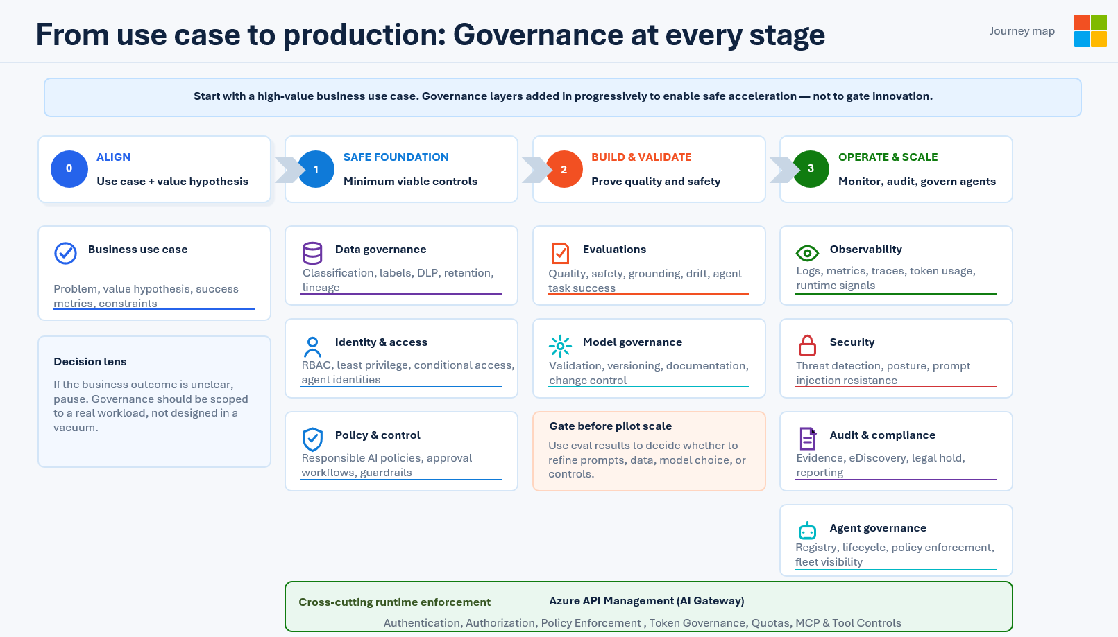




SECTION 04 · GOVERNANCE IMPLEMENTATION
Governance at every stage

Slide 30






SECTION 04 · GOVERNANCE IMPLEMENTATION – CASE STUDY - NXP
Six pillars NXP put in place
Nothing is enabled tenant-wide by default* — every layer is gated by license, security group, a signed user agreement, a data-protection boundary and an approval body.
Tiered AI access model
Governed use-case lifecycle
Agent enablement with guardrails
Four layers — everyday chat, Copilot for work data, lightweight agent building, full Copilot Studio — each with its own approval route.
Intake → triage → governance review → delivery → value realization, with a defined gate and deliverable at every phase.
Request form, signed user agreement, license and access validation, documented usage rules, and pre-checks before agents are shared.
Data protection with Purview
Platform controls
Cost transparency
Sensitivity labels, DLP, retention and audit assessed as one control set, with risk ratings and named next actions.
Environment-level DLP with connector classification, Dev/Test/Prod lifecycle, IT-only production publishing, restricted agent-to-agent.
Per-agent usage caps, maker access scoped to a security group, environment capacity allocation and a simple agent sizing model.

Slide 31





SECTION 04 · GOVERNANCE IMPLEMENTATION – CASE STUDY - NXP
SharePoint Advanced Management + Purview
PROTECTING THE DATA COPILOT CAN SEE
SharePoint Advanced Management
Microsoft Purview
Find and fix oversharing before Copilot reaches the content
Copilot inherits every classification and control
Data access governance reports to surface oversharing and drive remediation
Sharing-link and permissions reporting ahead of license assignment
Restricted access control and limits on organization-wide sharing links
Site access reviews and site lifecycle management
Sensitivity labels and encryption honored by Copilot at retrieval time
DLP guardrails preventing sensitive content being re-used or summarized
Retention and records management for a clean, relevant content estate
Audit and insider-risk monitoring over prompts and access
Owner accountability
Scoped visibility
Mapped to frameworks
Recurring access and label reviews owned by site owners
Sensitive repositories excluded from Copilot on justified request
Controls aligned to NIST 800-53 and the NIST AI RMF

Slide 32
SECTION 05 · DEMO
Dashboards Demo

Slide 33
SECTION 06 · ROADMAP
A Phased Path From Proof Of Concept To Scale
0–3 MONTHS
3–6 MONTHS
6–12 MONTHS
Proof of Concepts
Focused Rollouts
Prepare for Scale
Register every agent; name an accountable owner
Require RBAC and human-in-the-loop, anchored in the six Responsible AI principles
Start in Zone 1/2 agents to prove governance doesn't slow delivery
→
Layer in Model Governance & Evaluations — quality, safety, grounding, drift
Turn on Observability (logs, metrics, traces) to catch shadow, orphaned, and duplicate agents
Extend to Zone 2 collaboration agents, DLP-enforced
→
Automate policy enforcement, kill-switch, and lifecycle management — Level 4
Track governance with quantitative metrics
Extend to Zone 3 IT-managed agents: full dev/test/prod lifecycle, centralized runtime enforcement
Implementation types
Zone 1 – Citizen Development
Zone 2 – Collaboration
Zone 3 – IT-Managed
Maturity Levels
L1 – Ad-hoc
L2 – Reactive
L3 – Defined
L4 – Managed
L5 - Optimized

Slide 34


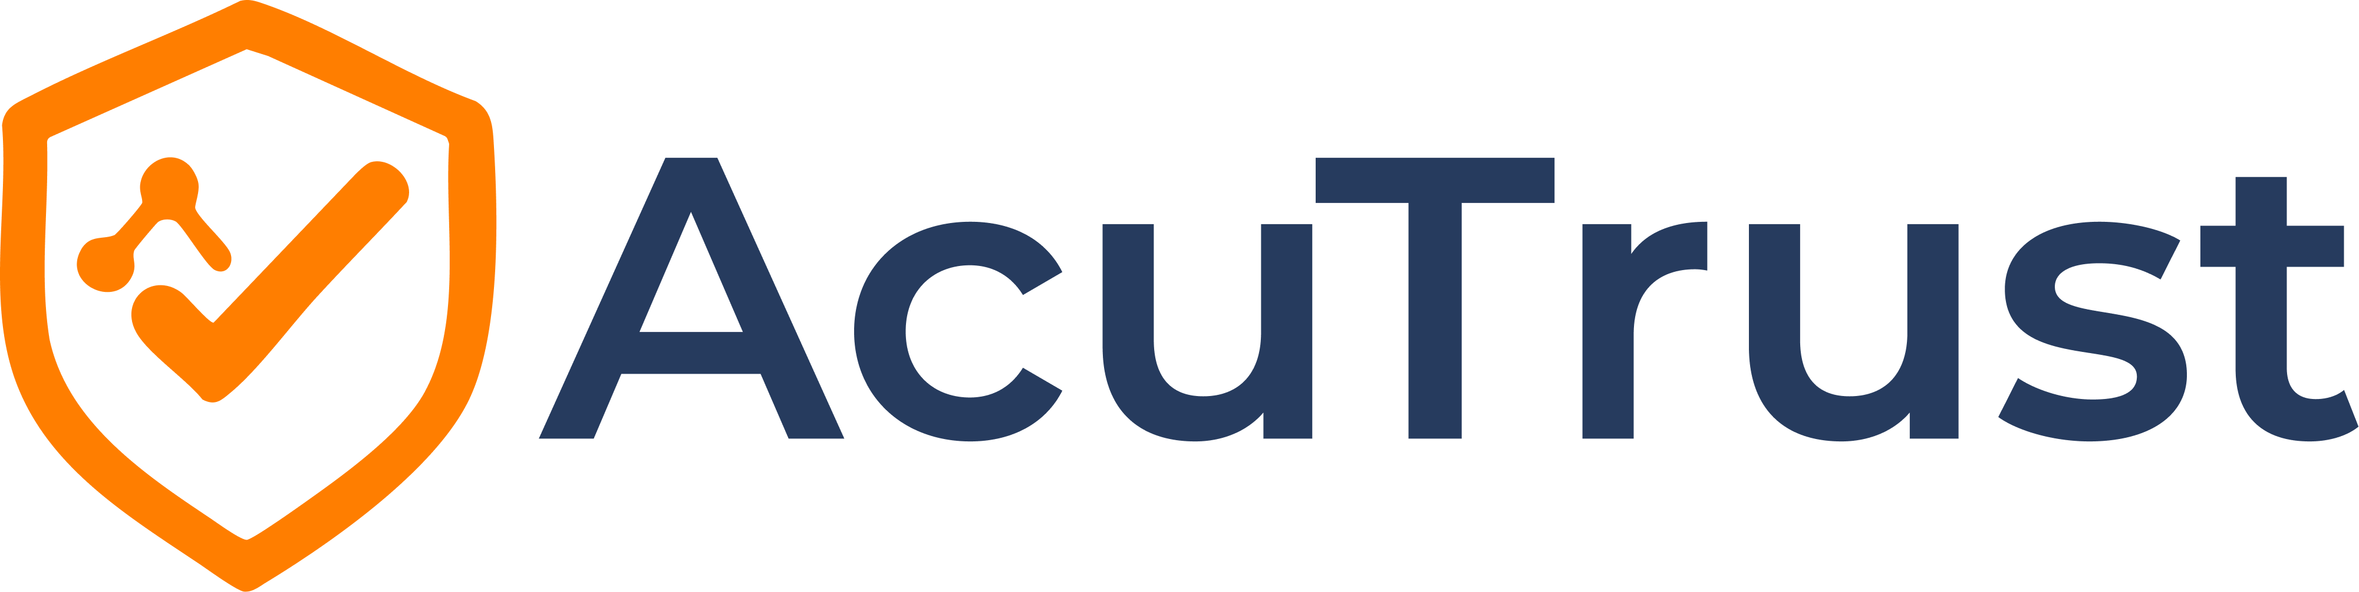

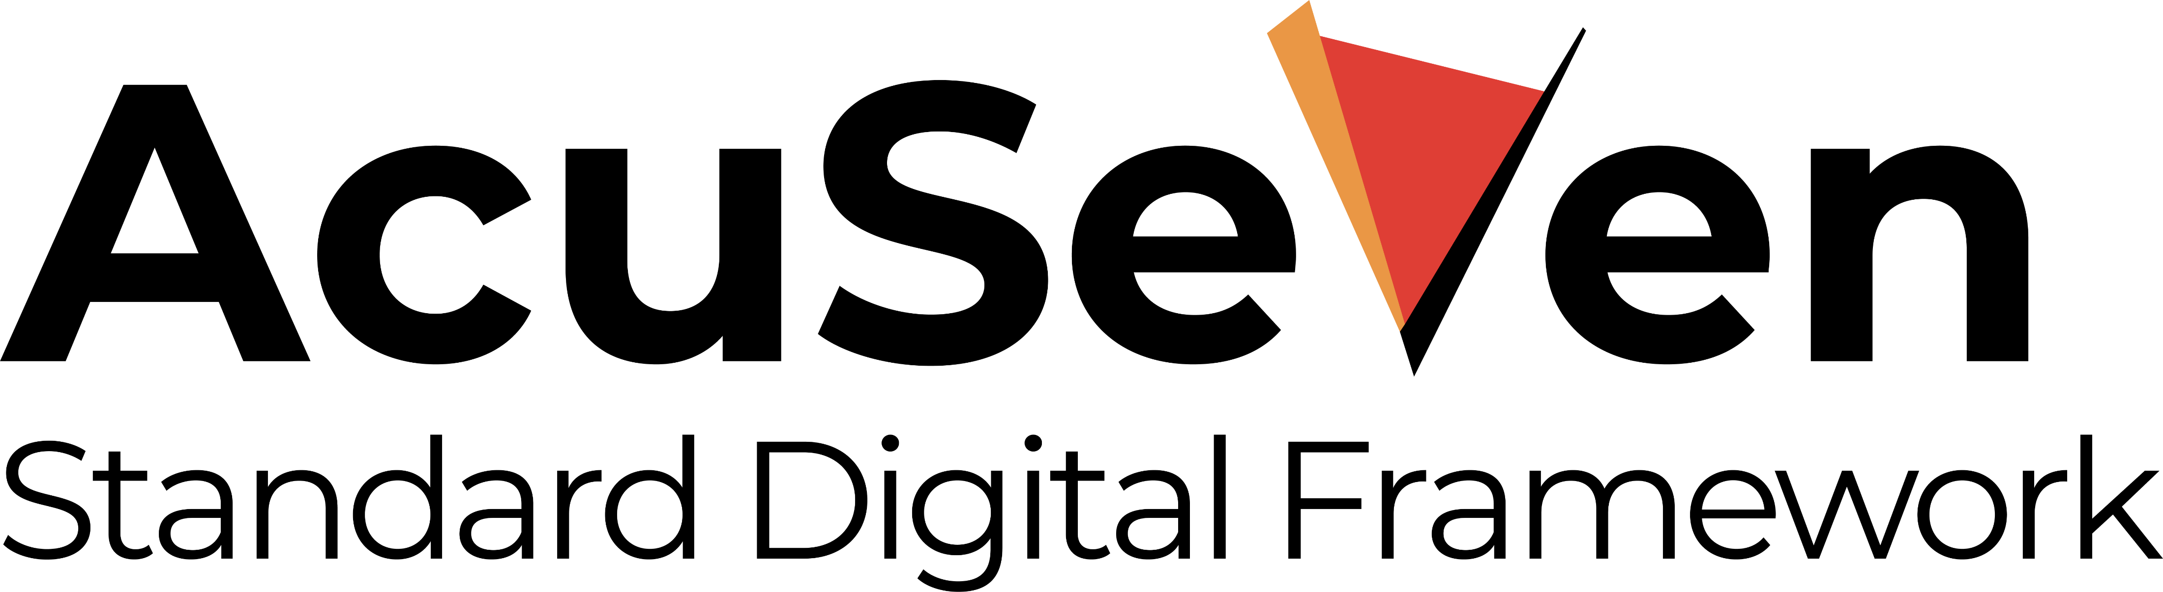

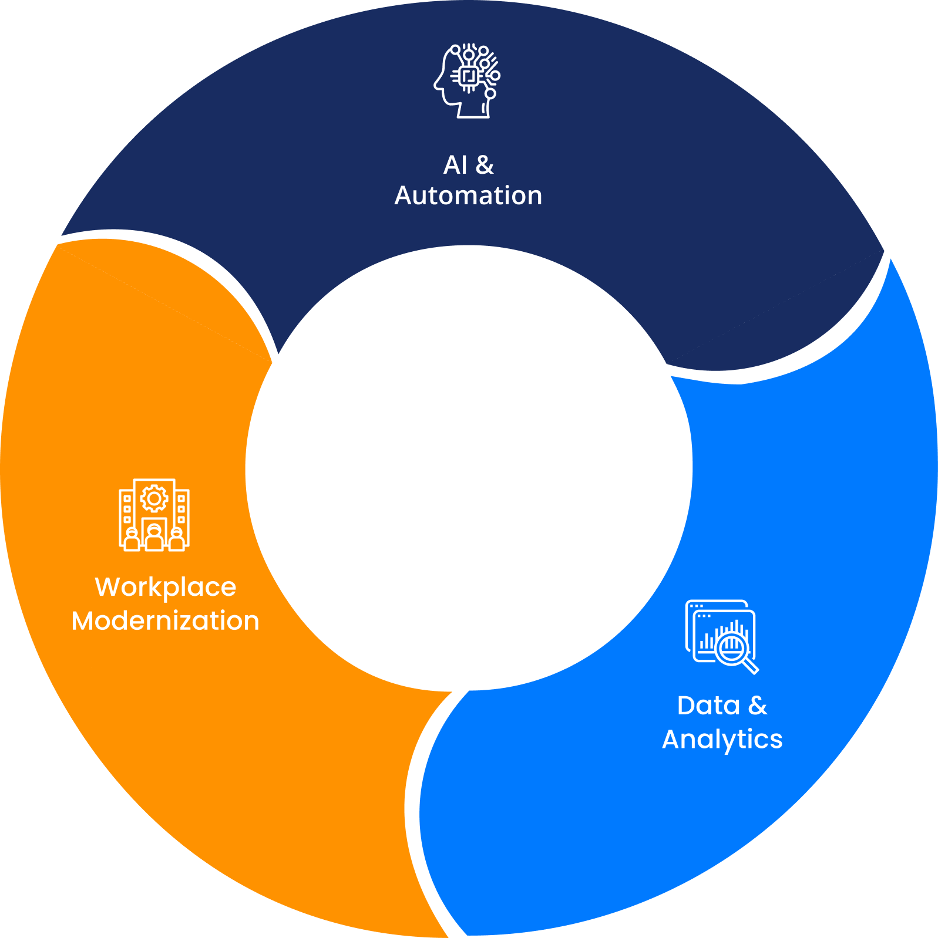




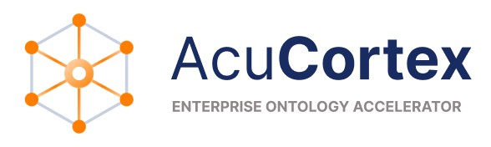
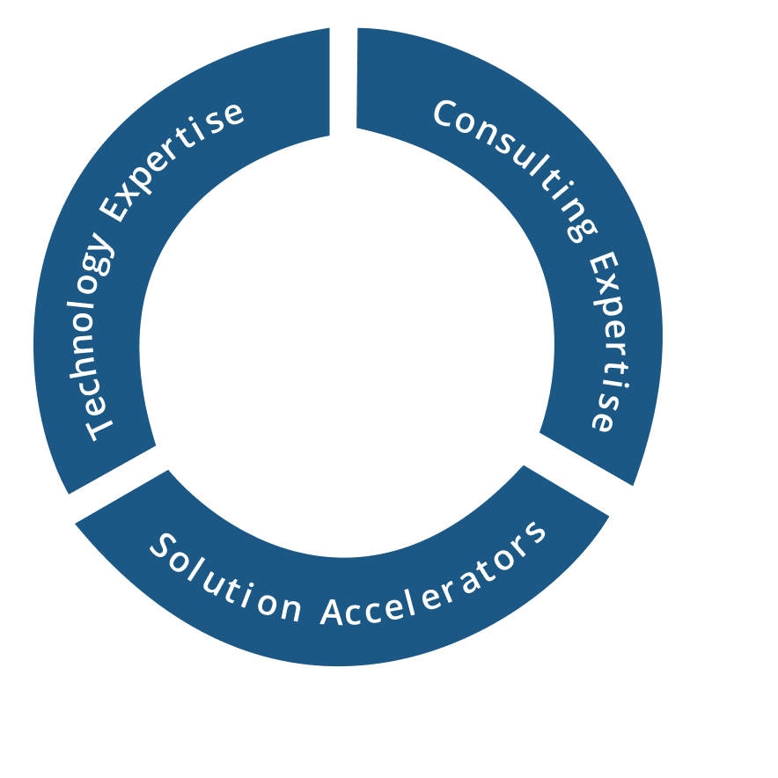
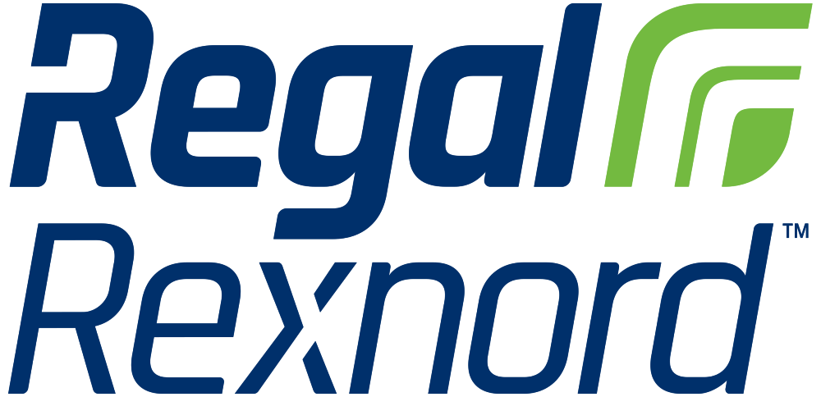



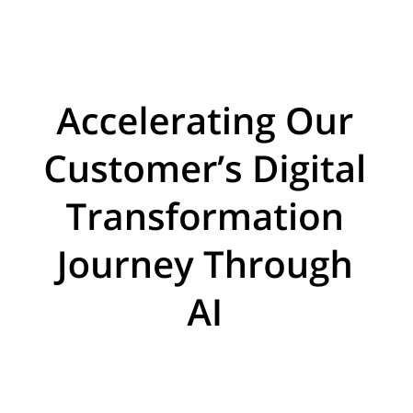
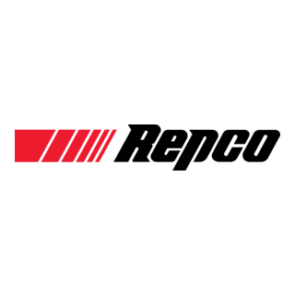






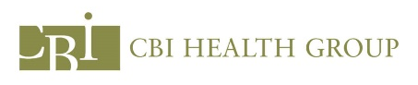










About Acuvate
Acuvate is a global player in next-generation digital solutions & services that modernize, automate and transform enterprise applications. With over 19+ years of experience, we have been enabling our clients globally to steer their digital transformation strategy using AI, Data & Cloud.
ACCELERATORS
TRUSTED BY 200+ ENTERPRISES WORLDWIDE INCLUDING SEVERAL FORTUNE 500
Manufacturing
Our Focus
CPG, Retail
Oil & Gas,
Energy
Healthcare and Life Sciences
BSFI
Government
19+
Years in the Industry
500+
Multi-Skilled Professionals
3 Continents, 7 offices
North America, Europe, Asia
Travel and Hospitality / Others
Notes:
Global player in next generation digital solution & services that modernize, automate and transform enterprise application.
We help in accelerating our customer digital transformation through AI using our technical and consulting expertiese leavering our solution accelerators using AI , data & cloud.

Slide 35
NEXT STEPS
1. Setup Governance Audit controls in Purview & M365
2. Implement Dashboards for tracking metrics across multiple streams
- Agent Governance
- User Licenses
User Adoption
Impact metrics
Inventory Report
3. Establish Level 3 Governance Readiness with defined policies, controls & oversight in 2-Weeks.

Slide 36



Slide 37






Session Presented by
THANK YOU
We are a global player in next-generation digital solutions & services that modernize, automate and transform enterprise applications. With over 19+ years of experience, we have been enabling our clients globally to steer their digital transformation strategy using Cloud, Data & AI. We build & develop smart & sustainable solutions to help our customers transform their conventional processes to match the next-generation technological trend.
We have a strong presence in the US, Europe, and Middle East, where we serve multiple ultra-large customers as well as SMBs from various sectors such as Public Sector, CPG, Retail, Oil & Gas, Energy, Manufacturing, BFSI, Healthcare, etc.
Contact: advisors@acuvate.com

