Slide 1
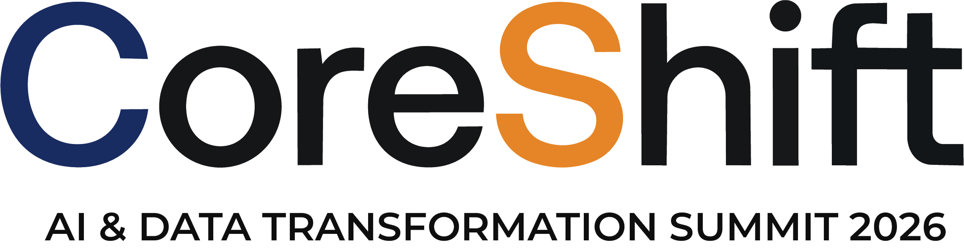


INDUSTRY TRACK SESSION
Executive Roundtable
Scaling Enterprise AI: Customer Perspectives & Lessons Learned
Presented by
Time
17:00–17:45 CEST | 11:00–11:45 EDT
Date
16 / 09 / 26
Notes:
COVER SLIDE. Replace the session title, date, time, partner names and the two speaker blocks. Drop headshots into the grey photo squares (right-click > Change Picture). Keep the CORESHIFT 2026 lockup untouched.

Slide 2
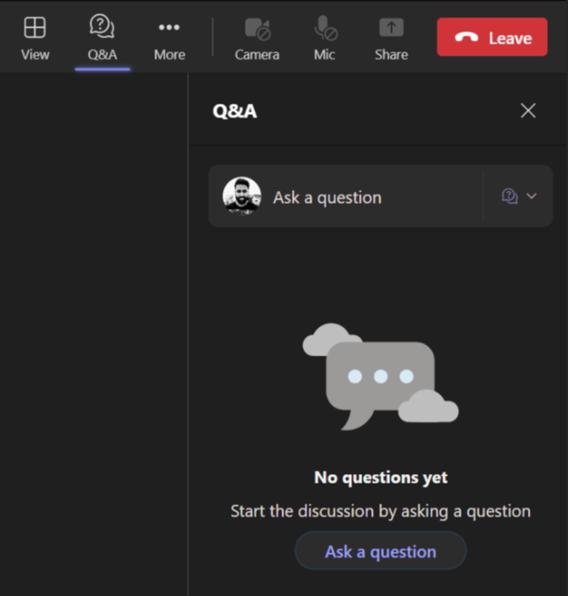
Housekeeping – Asking speaker a question
We want to hear from you!
Please submit your questions. We’ll reserve time for Q&A at the end of the webinar.
1
To submit questions, click on the Q&A at the top right corner
2
Clicking on the Q&A icon will open a window where you can type your question.
3
Click on the ‘Ask a question’ button & type your question.

Slide 3









Your speakers
Meet the team presenting this session
Ninja Subramanian
Sundeep Jain
Chelsea Horton
Bruno Marques
Chris Lohret
AI Business Transformation Sales Lead - Manufacturing
Enterprise AI Strategy, Global Cloud and Digital Infrastructure Leader
AI Transformation Leader
Business Applications Energy/Telco/ProServ Lead @EMEA
Apps and AI Specialist

Slide 4
The Roundtable Is Now Live
Executive Roundtable
Scaling Enterprise AI: Customer Perspectives & Lessons Learned

Slide 5
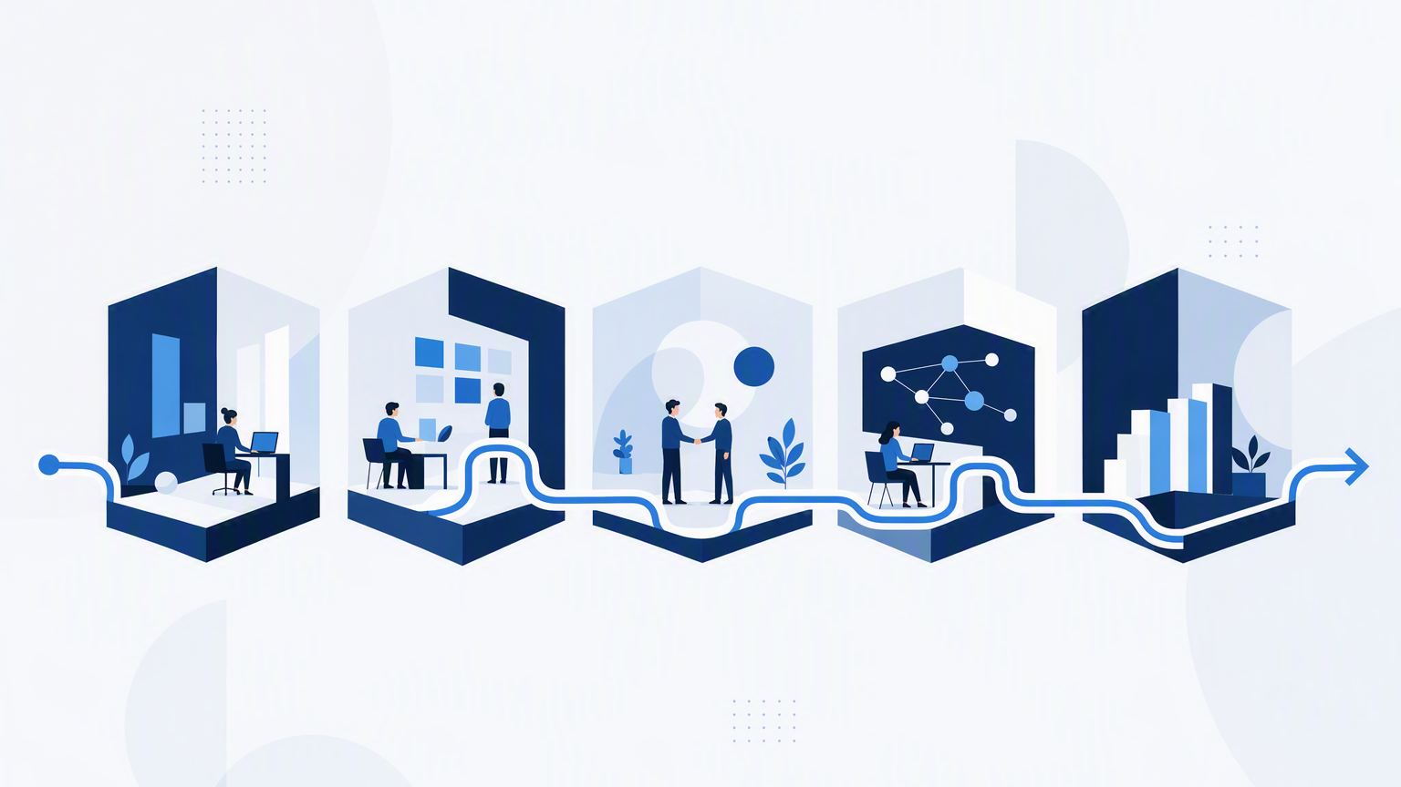
Fragmented Ownership Stalls Automation Programs More Often Than Technical Integration
Before You Automate, Answer
Ownership
Who owns the outcome end to end?
Authority
Who decides when the process crosses org lines?
Outcome
What measurable business result improves?
The best programs establish clear business ownership first, then use technology to redesign the process around the outcome.
Notes:
QUESTION 1 - Architecture vs. Delivery
In large automation programs, what is the bigger obstacle: technical integration, or fragmented ownership?
ANSWER
In my experience, large automation programs rarely stall because the technology can't be integrated. They stall because ownership is fragmented.
You can solve an API problem. You can connect a legacy system. You can work through identity, security, and data issues. Those are engineering problems with engineering solutions. The harder problem is when a process crosses five departments, nobody owns the process end to end, and every group has a different set of priorities, policies, and success metrics.
That's where architecture and delivery have to come together. Before automating a process, I want to know: Who owns the outcome? Who can make decisions when the process crosses organizational boundaries? And what measurable business result are we trying to improve?
One of the mistakes organizations make is automating individual tasks without addressing the process around them. You end up with pockets of automation but not necessarily a better operating model.
So if I had to choose between technical integration and fragmented ownership, fragmented ownership is usually the bigger obstacle. The best automation programs create clear business ownership first and then use technology to redesign the process around the outcome.
THEME: Enterprise AI isn't primarily a technology transformation; it's an operating-model transformation enabled by technology.

Slide 6
The Agent Is An Orchestration Layer Over Systems The Organization Already Trusts
An Employee Or Customer Expresses The Outcome They Need
Governed Agent Orchestration Layer
Identity · APIs · connectors · business rules · governed automation
Microsoft 365
Content and collaboration
Entra Id
Identity and access
Line Of Business
SQL, Dataverse, legacy
Power Automate
Existing workflows
Power Bi / Fabric
Analytics and reporting
Done correctly the technology becomes less visible: the person states the outcome, and the automation absorbs the organizational complexity behind it.
The goal of AI automation is not to digitize bureaucracy — it is to remove it.
Notes:
QUESTION 2 - Tackling Complexity and Red Tape
How should AI automation deal with organizational complexity and administrative red tape?
ANSWER
The goal of AI automation shouldn't be to digitize bureaucracy. It should be to remove it.
We've spent decades building systems around organizational structures: one application for finance, another for HR, another for IT, another for operations. Then we ask employees or customers to understand how all of those systems work together. That's backwards.
AI agents give us an opportunity to change that model. Instead of making a person navigate five systems, fill out three forms, understand which department owns something, and then follow up on the status, an agent can orchestrate that work across the systems on their behalf.
But there's an important architectural principle: the agent shouldn't become another system of record. It should be an orchestration layer over the systems and processes the organization already trusts.
That means using APIs, connectors, identity, business rules, and governed automation to let the agent find information, initiate workflows, collect approvals, update systems, and report the result back to the user.
Done correctly, the technology becomes less visible. The employee or customer expresses the outcome they need, and the automation handles the organizational complexity behind it.
That's the opportunity with AI: not adding another layer of software for people to manage, but creating an intelligent layer that hides complexity and eliminates unnecessary administrative work.
THEME: Enterprise AI isn't primarily a technology transformation; it's an operating-model transformation enabled by technology.

Slide 7
Most Enterprises Have An Integration And Utilization Problem, Not A Technology Shortage
What Do We Already Own?
Governed Access, Not Copies
Start With The Highest Friction
Identity in Entra ID, content in Microsoft 365, data in SQL and Dataverse, APIs in Azure, workflows in Power Automate.
An agent does not need enterprise data copied into a new system. It needs governed access and the ability to act.
Ask which processes carry the highest friction, which capabilities we already have, and what is genuinely missing.
That shifts the conversation from buying another platform to extracting more value from investments the organization has already made.
Enterprise AI is not primarily a technology transformation — it is an operating-model transformation enabled by technology.
Notes:
QUESTION 3 - Making Existing Investments Work
For organizations that already have significant investments in Microsoft 365, Azure, databases, and enterprise applications, where should they start?
ANSWER
I would start with a simple question: What capabilities do we already own?
Most enterprises don't have a technology shortage. They have an integration and utilization problem.
They already have identity in Entra ID, collaboration and content in Microsoft 365, data in SQL, Dataverse and legacy systems, APIs in Azure, workflows in Power Automate, analytics in Power BI or Fabric, and increasingly an agent and orchestration layer through Copilot Studio and the broader Microsoft AI platform.
The opportunity is to connect those assets rather than introducing another isolated automation platform.
An agent doesn't need all of the enterprise's data copied into a new system. It needs governed access to the right data and the ability to take the right actions. That can mean retrieving knowledge from SharePoint, querying a business system, calling an API, triggering an existing Power Automate workflow, interacting with a legacy application, or handing a task to another specialized agent.
I think that's where agentic automation becomes especially powerful. It turns the existing technology estate into a set of capabilities that agents can reason over and orchestrate.
So I wouldn't begin with, "What new AI product should we buy?" I'd begin with, "What are the highest-friction processes in the organization, what capabilities do we already have to solve them, and what's missing?"
That shifts the conversation from buying another platform to extracting more value from investments the organization has already made.
THEME: Enterprise AI isn't primarily a technology transformation; it's an operating-model transformation enabled by technology.

Slide 8


Slide 9






Session Presented by
THANK YOU
We are a global player in next-generation digital solutions & services that modernize, automate and transform enterprise applications. With over 19+ years of experience, we have been enabling our clients globally to steer their digital transformation strategy using Cloud, Data & AI. We build & develop smart & sustainable solutions to help our customers transform their conventional processes to match the next-generation technological trend.
We have a strong presence in the US, Europe, and Middle East, where we serve multiple ultra-large customers as well as SMBs from various sectors such as Public Sector, CPG, Retail, Oil & Gas, Energy, Manufacturing, BFSI, Healthcare, etc.
Contact: advisors@acuvate.com

Slide 10

Your speakers
Meet the team presenting this session
Ninja subramanian
Sundeep Jain
Chelsea Horton
Bruno Marques
Chris Lohret
AI Business Transformation Sales Lead - Manufacturing
Enterprise AI Strategy, Global Cloud and Digital Infrastructure Leader
AI Transformation Leader
Business Applications Energy/Telco/ProServ Lead @EMEA
AI Business Process Specialist
Focused On Manufacturing Ai, Business Growth, And Digital Transformation
Focused On Scaling Ai, Cloud Platforms, Aiops, And Enterprise Productivity
Experience Across Supply Chain, Integrated Business Planning And Data Management
Focused On Complex Erp/Crm Transformation Across Strategic Emea Accounts
Currently Focused On Ai, Automation, And Business Applications At Microsoft

Slide 11
#Pilot2Production
#AIUseCases
#OrgTransformation
#Data&AIGovernance
#BusinessRoI
#AIOperations

Slide 12
#Pilot2Production
Sundeep- Operational Question: Many industrial companies have run dozens of proofs-of-concept that never scale to multi-site operations. What separates the manufacturers who successfully scale AI solutions across global operations from those stuck in perpetual testing?
CHRIS- Primary Question: Having operated as an architect, delivery lead, and partner CTO across large-scale enterprise and public sector programs, what is the primary reason large automation rollouts stall: technical integration, or fragmented internal ownership?
Ninja - Rapid Follow-up / Probe: What is the most common reason a manufacturing AI project fails to deliver its projected business case six months after rollout?

Slide 13
#AIUseCases
Chelsea- Primary Question: Many organizations are struggling to define how AI fits into their existing workflows. What do you think of this challenge? In your experience, what have been the biggest lessons on how organizations need to reimagine their workflows to achieve meaningful and impactful AI transformation?
Bruno -Operational Question : In capital-intensive sectors like energy and telecommunications, what is the most practical, high-ROI use case for autonomous agents that you are seeing deployed in EMEA right now?
Sundeep- Business Impact Question: With long manufacturing lead times in the semiconductor industry, where does AI genuinely provide predictive leverage today, and where does human judgment still have to overrule the model?
Ninja- Primary Question: In manufacturing, buzzwords evaporate quickly once you step onto the plant floor. Where are industrial enterprises seeing immediate, unglamorous efficiency gains from AI right now—outside of high-level predictive maintenance presentations?

Slide 14
#OrgTransformation
CHRIS-- Operational Question : How administrative complexity, fragmentation, and systemic friction hurt outcomes. How can AI-driven automation be used to eliminate bureaucracy and simplify operations without adding another layer of unmanageable software?
BRUNO - Primary Question : Before leading business applications at Microsoft, you spent over a decade executing hands-on ERP, SAP, and supply chain logistics projects. When enterprises try to deploy an "Agentic Customer Experience", how often is the real bottleneck the AI model itself versus twenty years of disjointed ERP workflows?
Bruno - Execution Question: Deploying autonomous agents requires structured, reliable business rules. How should leaders clean up legacy operational processes before attempting to automate customer interactions with AI?
Chelsea- Secondary Question: Any transformation involves changes to "people, process, and technology"; however, the “people” part is the hardest part of any change. What specific strategies are you using to quell employee fears, increase transparency, and drive AI fluency across the company?
Sundeep - Operational Question: NXP has worked on embedding natural language agents into mission-critical workflows like product lifecycle management (PLM) change requests. What unexpected organizational or process friction occurred when moving that from a controlled pilot to everyday engineering use?
NINJA Adoption Question: How are plant managers and floor operators reacting when AI tools are integrated into manufacturing execution systems? What changes their perspective from skepticism to daily use?

Slide 15
#BusinessRoI
Chris- Execution Question: Many enterprises already have massive investments in Microsoft 365, Azure, and legacy databases. How can organizations extract agentic automation value from the stack they already own instead of buying yet another point solution?

Slide 16
#AIOperations
Sundeep- Primary Question : You led an initiative at NXP cutting FinOps tooling costs by 75% and driving 90% higher efficiency using near-real-time visibility dashboards. For AI infrastructure and compute workloads, how do you track the unit economics of a model or an agent before operational costs spiral out of control?
Sundeep- Rapid Follow-up / Probe: When evaluating an enterprise AI initiative today, what is the single biggest "hidden cost" that vendors routinely leave out of the proposal?

Slide 17
Chris Lohret
AI & Automation Business Applications Specialist, Microsoft
Primary Question (Architecture vs. Delivery): Having operated as an architect, delivery lead, and partner CTO across large-scale enterprise and public sector programs, what is the primary reason large automation rollouts stall: technical integration, or fragmented internal ownership? #OrgTransformation
Operational Question (Tackling Complexity and Red Tape): How administrative complexity, fragmentation, and systemic friction hurt outcomes. How can AI-driven automation be used to eliminate bureaucracy and simplify operations without adding another layer of unmanageable software? #OrgTransformation
Execution Question (Making Existing Investments Work):
Many enterprises already have massive investments in Microsoft 365, Azure, and legacy databases. How can organizations extract agentic automation value from the stack they already own instead of buying yet another point solution? #BusinessRoI
Rapid Follow-up / Probe:
When an enterprise says they have an "AI adoption problem," what is the actual issue?

Slide 18
Bruno Marques
Business Applications Energy, Telco & ProServ Lead, Microsoft EMEA
Primary Question (Legacy ERP/CRM vs. AI Agents): Before leading business applications at Microsoft, you spent over a decade executing hands-on ERP, SAP, and supply chain logistics projects. When enterprises try to deploy an "Agentic Customer Experience", how often is the real bottleneck the AI model itself versus twenty years of disjointed ERP workflows? #OrgTransformation
Operational Question (Telco & Energy Deployments): In capital-intensive sectors like energy and telecommunications, what is the most practical, high-ROI use case for autonomous agents that you are seeing deployed in EMEA right now? #AIUseCases
Execution Question (Process Simplification):
Deploying autonomous agents requires structured, reliable business rules. How should leaders clean up legacy operational processes before attempting to automate customer interactions with AI? #OrgTransformation
Rapid Follow-up: What is one legacy system or process habit you see enterprise clients cling to that kills an AI automation project before it even launches?

Slide 19
Chelsea Horton
AI Transformation Leader, Eastman
Primary Question:
Many organizations are struggling to define how AI fits into their existing workflows. What do you think of this challenge? In your experience, what have been the biggest lessons on how organizations need to reimagine their workflows to achieve meaningful and impactful AI transformation? #AIUseCases
Secondary Question:
Any transformation involves changes to "people, process, and technology"; however, the “people” part is the hardest part of any change. What specific strategies are you using to quell employee fears, increase transparency, and drive AI fluency across the company? #OrgTransformation

Slide 20
Sundeep Jain, PMP
Enterprise AI Strategy, Global Cloud and Digital Infrastructure Leader, NXP Semiconductors
Primary Question (Unit Economics & Cost Visibility): You led an initiative at NXP cutting FinOps tooling costs by 75% and driving 90% higher efficiency using near-real-time visibility dashboards. For AI infrastructure and compute workloads, how do you track the unit economics of a model or an agent before operational costs spiral out of control? #AIOperations #Data&AIGovernance
Cost visibility
Operational Question (From Script to Production): NXP has worked on embedding natural language agents into mission-critical workflows like product lifecycle management (PLM) change requests. What unexpected organizational or process friction occurred when moving that from a controlled pilot to everyday engineering use? #OrgTransformation
Business Impact Question (Forecasting & Supply Chain): With long manufacturing lead times in the semiconductor industry, where does AI genuinely provide predictive leverage today, and where does human judgment still have to overrule the model? #AIUseCases
Rapid Follow-up / Probe:
When evaluating an enterprise AI initiative today, what is the single biggest "hidden cost" that vendors routinely leave out of the proposal? #AIOperations

Slide 21
Ninja Subramanian
AI Business Transformation Manufacturing Timezone Sales Lead (Americas), Microsoft
Primary Question (Factory Floor Realities): In manufacturing, buzzwords evaporate quickly once you step onto the plant floor. Where are industrial enterprises seeing immediate, unglamorous efficiency gains from AI right now—outside of high-level predictive maintenance presentations? #AIUseCase
Operational Question (Overcoming "Pilot Purgatory"):
Many industrial companies have run dozens of proofs-of-concept that never scale to multi-site operations. What separates the manufacturers who successfully scale AI solutions across global operations from those stuck in perpetual testing? #Pilot2Production
Adoption Question (Workforce & Operational Technology):
How are plant managers and floor operators reacting when AI tools are integrated into manufacturing execution systems? What changes their perspective from skepticism to daily use? #OrgTransformation
Rapid Follow-up / Probe:
What is the most common reason a manufacturing AI project fails to deliver its projected business case six months after rollout? #BusinessRoI

Slide 23
Session Presented by
THANK YOU
We are a global player in next-generation digital solutions & services that modernize, automate and transform enterprise applications. With over 19+ years of experience, we have been enabling our clients globally to steer their digital transformation strategy using Cloud, Data & AI. We build & develop smart & sustainable solutions to help our customers transform their conventional processes to match the next-generation technological trend.
We have a strong presence in the US, Europe, and Middle East, where we serve multiple ultra-large customers as well as SMBs from various sectors such as Public Sector, CPG, Retail, Oil & Gas, Energy, Manufacturing, BFSI, Healthcare, etc.
Contact: advisors@acuvate.com

