Slide 1

INDUSTRY TRACK SESSION
Digital Twins (Oil & Gas / Energy / Utilities)
Connected Digital Twins for Intelligent Industrial Operations
Presented by
Time
16:00–16:45 CEST | 10:00–10:45 EDT
Date
16 / 09 / 26
Notes:
COVER SLIDE. Replace the session title, date, time, partner names and the two speaker blocks. Drop headshots into the grey photo squares (right-click > Change Picture). Keep the CORESHIFT 2026 lockup untouched.

Slide 2







Your speakers
Meet the team presenting this session
Markus Sukkinen
Johan Krebbers
Asset & Project Performance Consultant
Chief Technology Officer

Slide 3
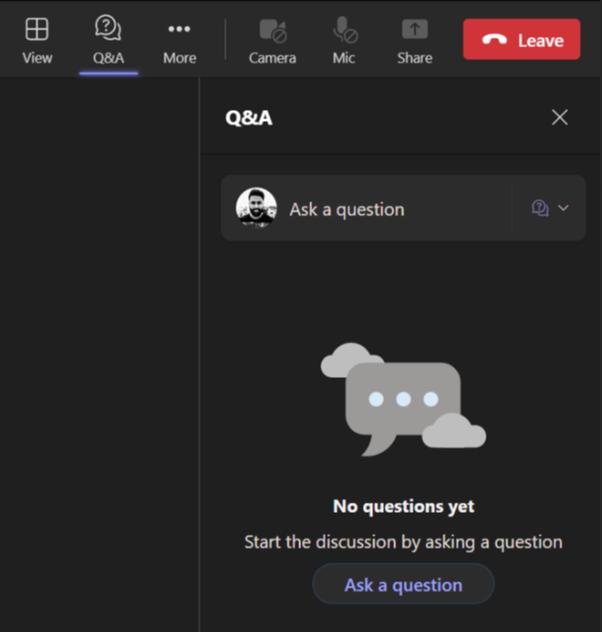
Housekeeping – Asking speaker a question
We want to hear from you!
Please submit your questions. We’ll reserve time for Q&A at the end of the webinar.
1
To submit questions, click on the Q&A at the top right corner
2
Clicking on the Q&A icon will open a window where you can type your question.
3
Click on the ‘Ask a question’ button & type your question.

Slide 4
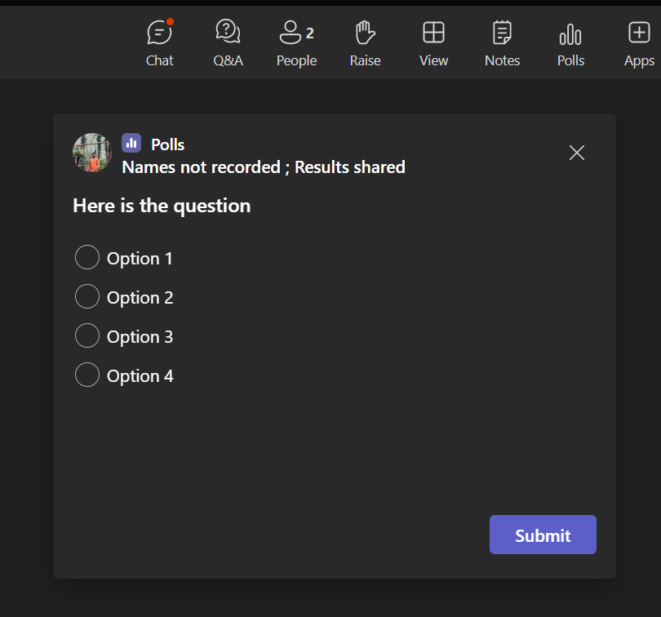
Housekeeping -Participating in Polls
Your opinion is valuable to us!
Please take part in our polls to help us understand your views.
1
Submit Your Vote:
A new window will pop up with the poll question.
Choose your answer from the provided options
2
Confirm Your Selection:
After selecting your option, make sure to hit the 'Submit' button to record your response..

Slide 5




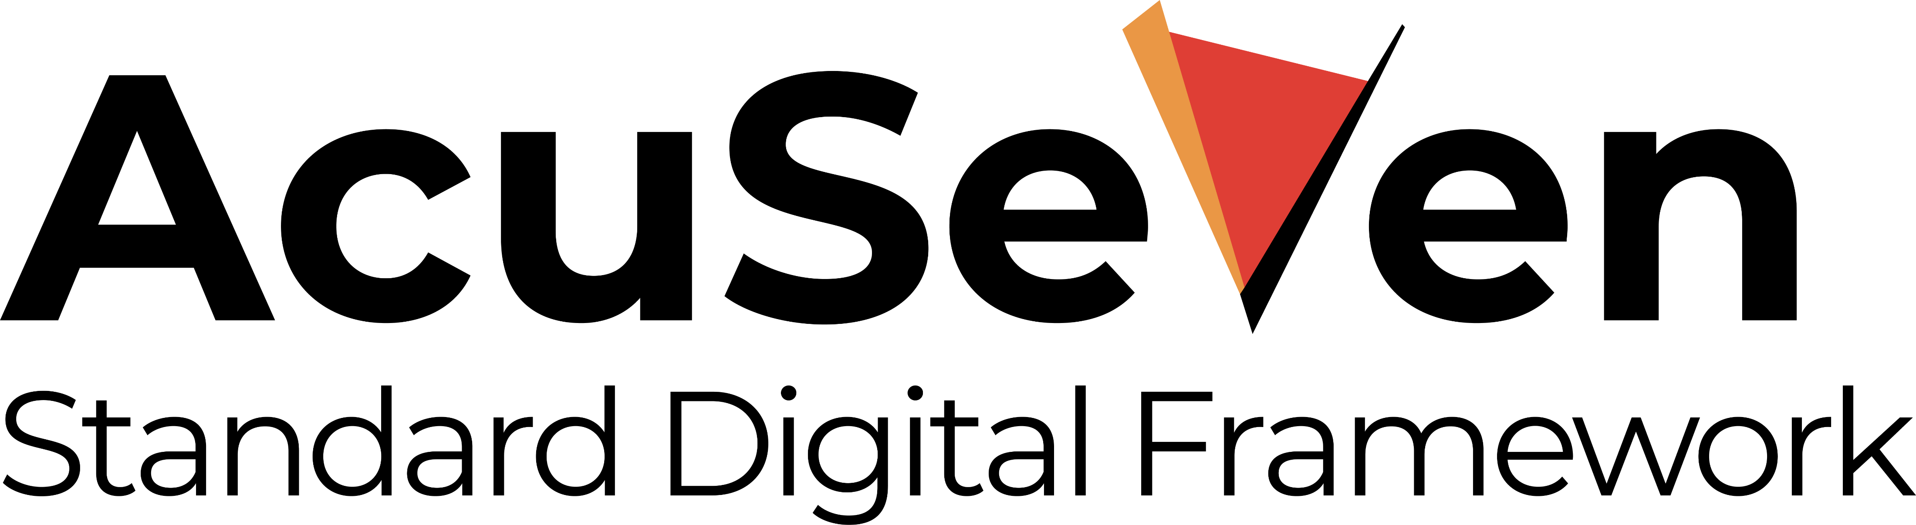

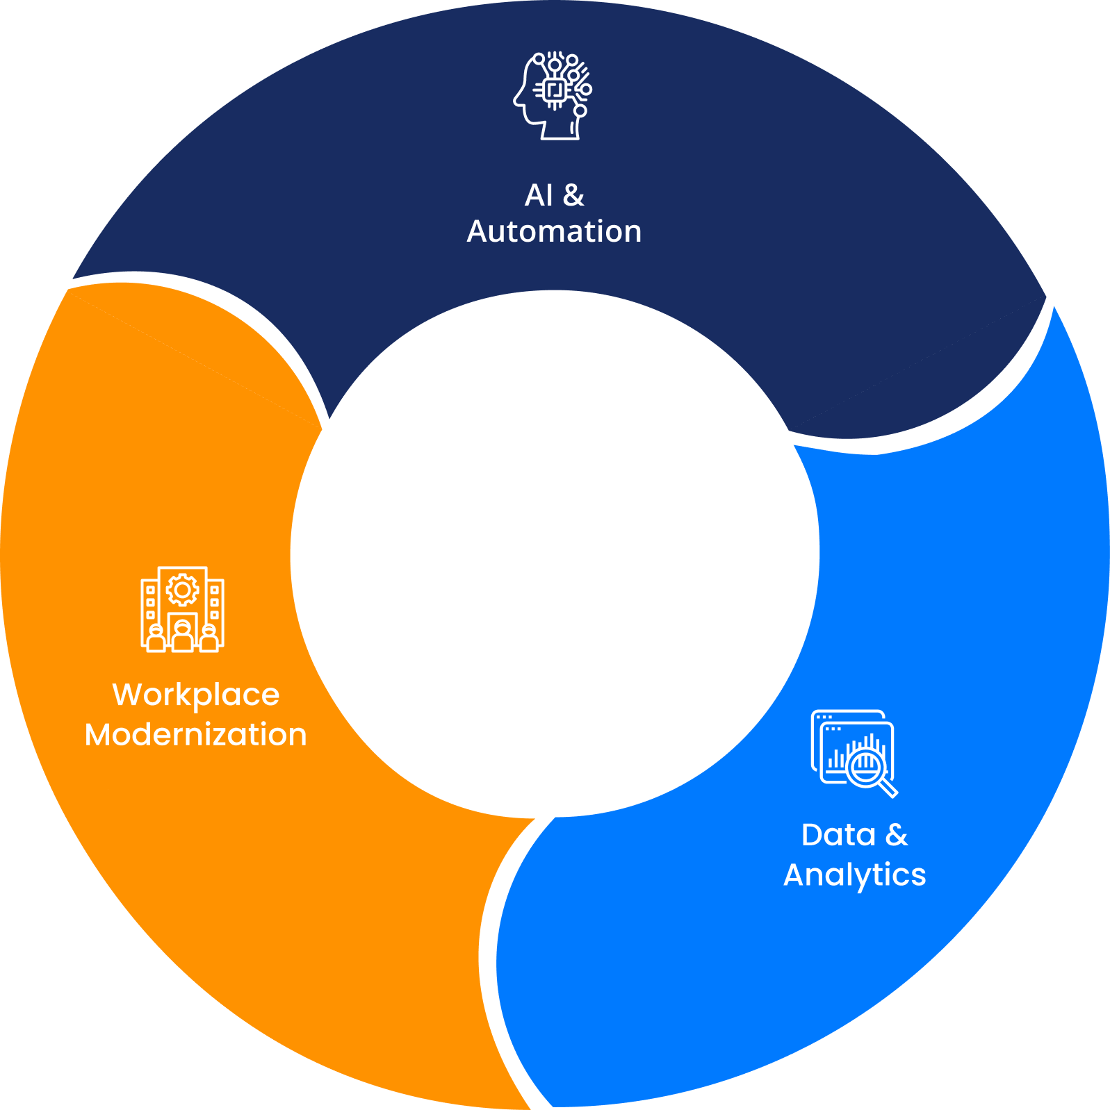





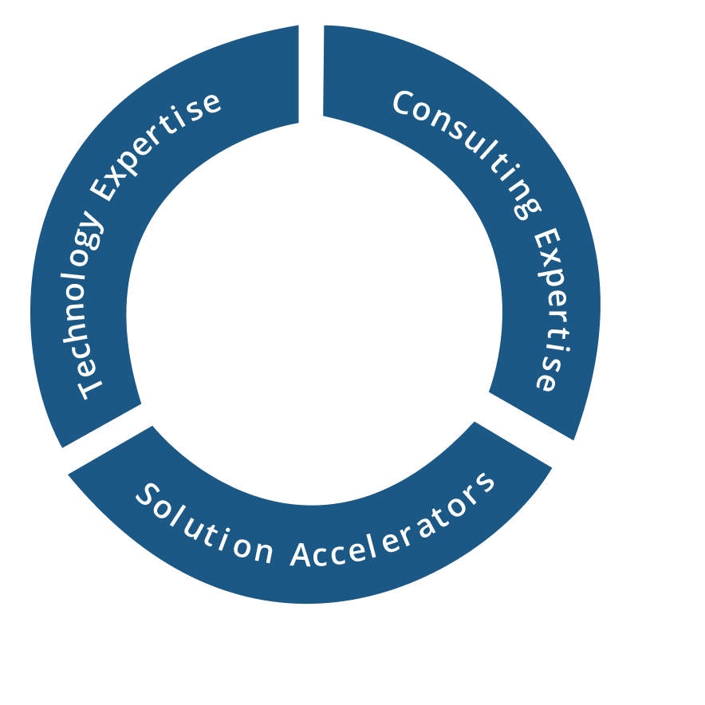
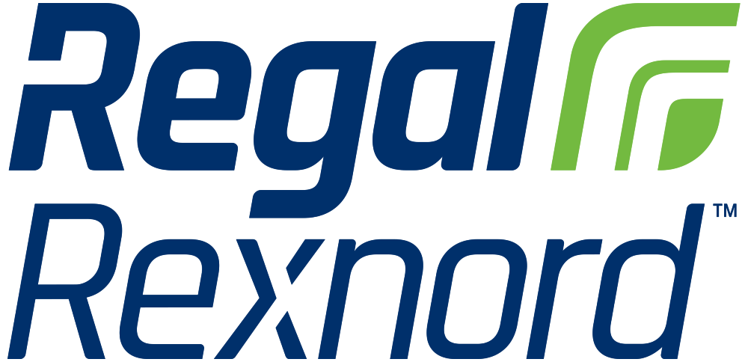



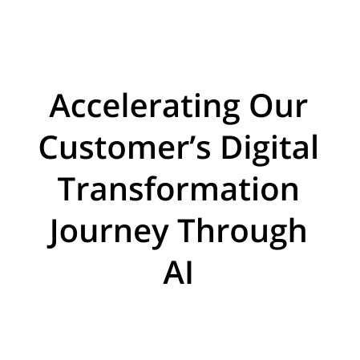


















About Acuvate
Acuvate is a global player in next-generation digital solutions & services that modernize, automate and transform enterprise applications. With over 19+ years of experience, we have been enabling our clients globally to steer their digital transformation strategy using AI, Data & Cloud.
ACCELERATORS
TRUSTED BY 200+ ENTERPRISES WORLDWIDE INCLUDING SEVERAL FORTUNE 500
Manufacturing
Our Focus
CPG, Retail
Oil & Gas,
Energy
Healthcare and Life Sciences
BSFI
Government
19+
Years in the Industry
500+
Multi-Skilled Professionals
3 Continents, 7 offices
North America, Europe, Asia
Travel and Hospitality / Others

Slide 6

Poll 1
What Is The Biggest Challenge With Your Plant Or Asset Information Today?

Slide 7








What Is The Problem We Are Trying To Solve?
CLARIFICATION
CHALLENGE
In our world, Digital is the combined exploitation of Data, Industrial AI, various AI flavours, Agents, Ontologies & Digital Twins driving your business ROI.
For business decision makers at any level, we make all data accessible — then let them ask, in their own business language, any question to improve current and future performance.
To make that possible we add an Ontology — what does this mean?
Business Structure
Familiar Language
What-If Analysis
Industrial AI View
Your business structures & dependencies are defined in your Ontology.
Business users work in the language they know — not what IT imposes.
Ask 'what if': changes in production levels, impact of logistics blockages, etc.
Ontology fully exposes your Industrial AI status and opportunities.
Growing Data
Past to Future
Accessible to All
Start Small
Over time, more relevant (external) data sources can be added.
Questions can cover the past, current and future of your business.
Reachable by business users, agents, dashboards, digital twins & copilot.
Begin where you have most issues — start small and grow stepwise.

Slide 8














: For digitizing Manufacturing
Manufacturing Plants
Manufacturing Operations · Maintenance · Engineering · Finance · Logistics — users
Working the end to end story
Complete story from collecting data, manipulating & storing data, Applying AI and showing the results in several different ways.
Proving end to end installation and configuration services.
Providing ongoing support (SLA) based services.
Software runs on your MS Azure cloud subscription and that means that data is under your control all the time.
Industrial AI is an important element where data is streaming and other data is collected and AI applied at the edge in case of (near) realtime decision making.
With supporting Industrial AI we of course also recognize OT.
Cadmatic eShare
Digital Twins
Copilot
Power BI
Coworker
Agents
Access to
AI flavours
Industrial AI
Advisory setpoints for OT
Various data types from production lines
Weather
Logistics
Ontology Services — including Planning
ML · MV
Gen-AI · LLM
Bi-directional
Enterprise Data & AI Platform
DiagramIQ
Business data · Documentation platform(s) · Websites with
relevant information · Messages / Teams / etc.
All relevant internal business applications
All relevant external business applications

Slide 9





: For digitizing Manufacturing
Manufacturing Plants
Manufacturing Operations · Maintenance · Engineering · Finance · Logistics — users
What can we do to get to the right data?
Access OT data such as PI Historian timeseries. → Drives Industrial AI
Cadmatic eShare
Digital Twins
Copilot
Power BI
Coworker
Agents
Access to
AI flavours
Select, install & configure the right sensors so relevant data is collected. → Drives Industrial AI
Industrial AI
Advisory setpoints for OT
Various data types from production lines
Weather
Logistics
Ontology Services — including Planning
ML · MV
Gen-AI · LLM
Robotics & drones reach hard-to-access locations. → Drives Industrial AI
Industrial AI deployed at the edge for real-time decisions.
Bi-directional
Enterprise Data & AI Platform
DiagramIQ
Business data · Documentation platform(s) · Websites with
relevant information · Messages / Teams / etc.
Camera images & AI Machine Vision open a broad spectrum of opportunities. → Drives Industrial AI
All relevant internal business applications
All relevant external business applications
We understand the networking different flavours and how to connect.

Slide 10


Industrial AI (AcuNow / AcuSignal accelerators)
Support for multiple AI deployment options
MS Fabric — Real-Time Intelligence
MS Azure IoT Operations
High-speed throughput of small sensor messages, with various AI options running natively on MS Fabric.
High-speed handling of very large messages such as camera images — Machine Vision options run on edge devices for real-time action.
AcuSignal
Agents
Coworker
Acuvate AcuPrism
Agent-based Solutions
High-speed streaming of OT-based Aveva (OSIsoft) PI data direct from PI Gateways into AcuPrism (MS Fabric or Databricks), where AI activities apply immediately. Many PI Gateways can stream to one enterprise AcuPrism.
Development of various Agent-based solutions supporting Industrial AI business workflows.

Slide 11
: For digitizing Manufacturing
Manufacturing Plants
Manufacturing Operations · Maintenance · Engineering · Finance · Logistics — users
What is the importance of AcuPrism our Enterprise Data & AI Platform
The place to get your asset tag naming conventions aligned; Indeed Look at our accelerator DiagramIQ
The place to address any data quality issue (bronze / silver / gold)
It is where you develop, train and run your AI models such as for OEE, Predictive Maintenance and many other scenarios
It is where you bring together your various data sources to get them ready for your ontology services
Datamodels such as ISA95 preloaded
Indeed Information Security needs to be in place end to end
Cadmatic eShare
Digital Twins
Copilot
Power BI
Coworker
Agents
Access to
AI flavours
Industrial AI
Advisory setpoints for OT
Various data types from production lines
Weather
Logistics
Ontology Services — including Planning
ML · MV
Gen-AI · LLM
Bi-directional
Enterprise Data & AI Platform
DiagramIQ
Business data · Documentation platform(s) · Websites with
relevant information · Messages / Teams / etc.
All relevant internal business applications
All relevant external business applications

Slide 12


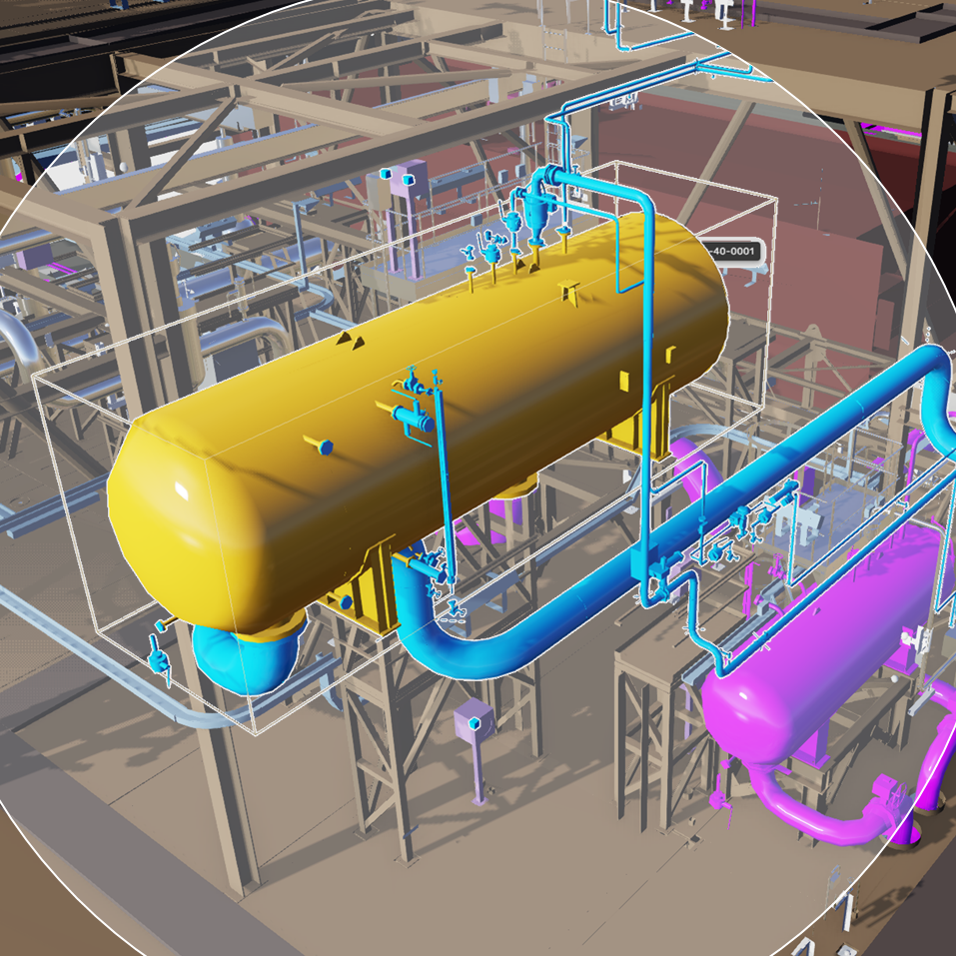

acuvate’s industrial intelligence data & AI platform - master
Data Sources
On-Prem & Cloud
MSD Azure IOT Operations
Data Lakehouse on Cloud
Application and Services
Inform Decision Makers/Support Decision making
M
U
L
T
I
P
L
E
P
L
A
N
T
S
MS Fabric IQ / Foundry IQ / Work IQ / Web IQ
M
U
L
T
I
P
L
E
P
L
A
N
T
S
OT Data
(Historian, SCADA, DCS)
Batch Processing
Portal / Dashboarding
Copilot
(includes Gen-AI)
Edge AI/Applications
GenAI
AI-ML
Reports and Dashboards
Internal Data (Owned)
Data Governance, Security and Compliance
Data Strategy, Domain Consulting, Technology & Analytics Consulting
Enterprise Data Architecture
Program and Change Management
Insights Serving Layer through Integration
GenAI
Data Chat Bots
3rd Party Data
Realtime Streaming
Edge Management
Raw
Clean
Curated
AI-MV
Gen-AI
Unstructured Data
PowerBI
Digital Twins
Contextualisation
Qualitative Data
Edge Cloud
Analytics application
Intelligent App
(including XR)
Model Deployment from Edge on Cloud
Real time Alerts
Data Catalog with Active Metadata Management
Data Observability and Data Operations

Slide 13
: For digitizing Manufacturing
Manufacturing Plants
Manufacturing Operations · Maintenance · Engineering · Finance · Logistics — users
DiagramIQ Accelerator & MS MarketPlace apps versions
Every Manufacturing site will have multiple assets such as engines, pumps, botteling lines, valves, etc. All of these assets need to be located for maintenance and other reasons. Here Tag-Ids make the difference.
Therefore an uptodate Enterprise Tag-ID Registry, which can be fully trusted, is very important.
In addition offer good facilities for (bulk) loading of P&ID various engineering files. As part of the loadign we use AI to scan all files and digitize the P&ID files.
Indeed we exploit Co Pilot to give easy access to all information
Overall DiagramIQ assists to minimize time wasted to locate information.
P&ID capabilities iexplained n the latter part of this presentation
Cadmatic eShare
Digital Twins
Copilot
Power BI
Coworker
Agents
Access to
AI flavours
Industrial AI
Advisory setpoints for OT
Various data types from production lines
Weather
Logistics
Ontology Services — including Planning
ML · MV
Gen-AI · LLM
Bi-directional
Enterprise Data & AI Platform
DiagramIQ
Business data · Documentation platform(s) · Websites with
relevant information · Messages / Teams / etc.
All relevant internal business applications
All relevant external business applications

Slide 14
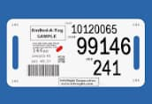
Background information to Energy / Manufacturing plants
Energy / Manufacturing assets are the physical and digital resources essential for production, including machinery, tools, facilities, and even skilled people,
Every Manufacturing plant has a large number of assets such as:
  Engines
  Pumps
  Conveyor belts
  Bottling lines
  Compressors
  Turbines
Every asset has an Tag-ID which is a unique identifier for tracking and connecting equipment
Several different types of drawings (Electrical / Instrumentation / Cabling / Safety / etc.) describe the facilities of an Manufacturing plant with a special role for P&ID (Piping & Instrumentation Diagrams): Detailed schematic in the process industry that shows the physical layout of pipes, equipment (like pumps, vessels, valves, tanks), and the instrumentation used for control (sensors, transmitters, controllers) within a process system, illustrating the flow of materials and control logic for operations, design, and maintenance.
Be aware that a typical factory might have over 10,000 technical drawings + all supplier documentation: Instrumentation; Cabling; Safety; Electrical; etc.
Also in Medical / Life sciences manufacturing facilities (assets) are used and therefore DiagramIQ is applicable

Slide 15
Problem statement: Issues experienced by Manufacturing companies when managing their assets
Often multiple Tag registries in place all of which are incomplete and not aligned:
→ In Excel, etc.
Tag registries have no uptodate information in what drawings each Tag id is used.
Engineers are unable to find the relevant drawing(s) for a given Tag id.
P&ID (Piping & Instrumentation Diagram) information is not available in digital format.
Tag information is stored in EXCEL spreadsheets and there are no controls who can update what.
Information in your Technical Drawing Management System (EDMS) is not aligned with your Tag Registry system.
Unable to scan your technical drawings for Tag information.
To find the updated information lots of time is wasted by your maintenance staff
→ Over 30%.
It is a safety risk for the plant.

Slide 16
Problem statement: Issues experienced by Manufacturing companies when managing their assets
Often multiple Tag registries in place all of which are incomplete and not aligned: In Excel, etc.
Tag registries have no uptodate information in what drawings each Tag id is used.
Engineers are unable to find the relevant drawing(s) for a given Tag id.
P&ID (Piping & Instrumentation Diagram) information is not available in digital format.
Tag information is stored in EXCEL spreadsheets and there are no controls who can update what.
Information in your Technical Drawing Management System (EDMS) is not aligned with your Tag Registry system.
To find the updated information lots of time is wasted by your maintenance staff Over 30%.
Unable to scan your technical drawings for Tag information.
It is a safety risk for the plant.

Slide 17
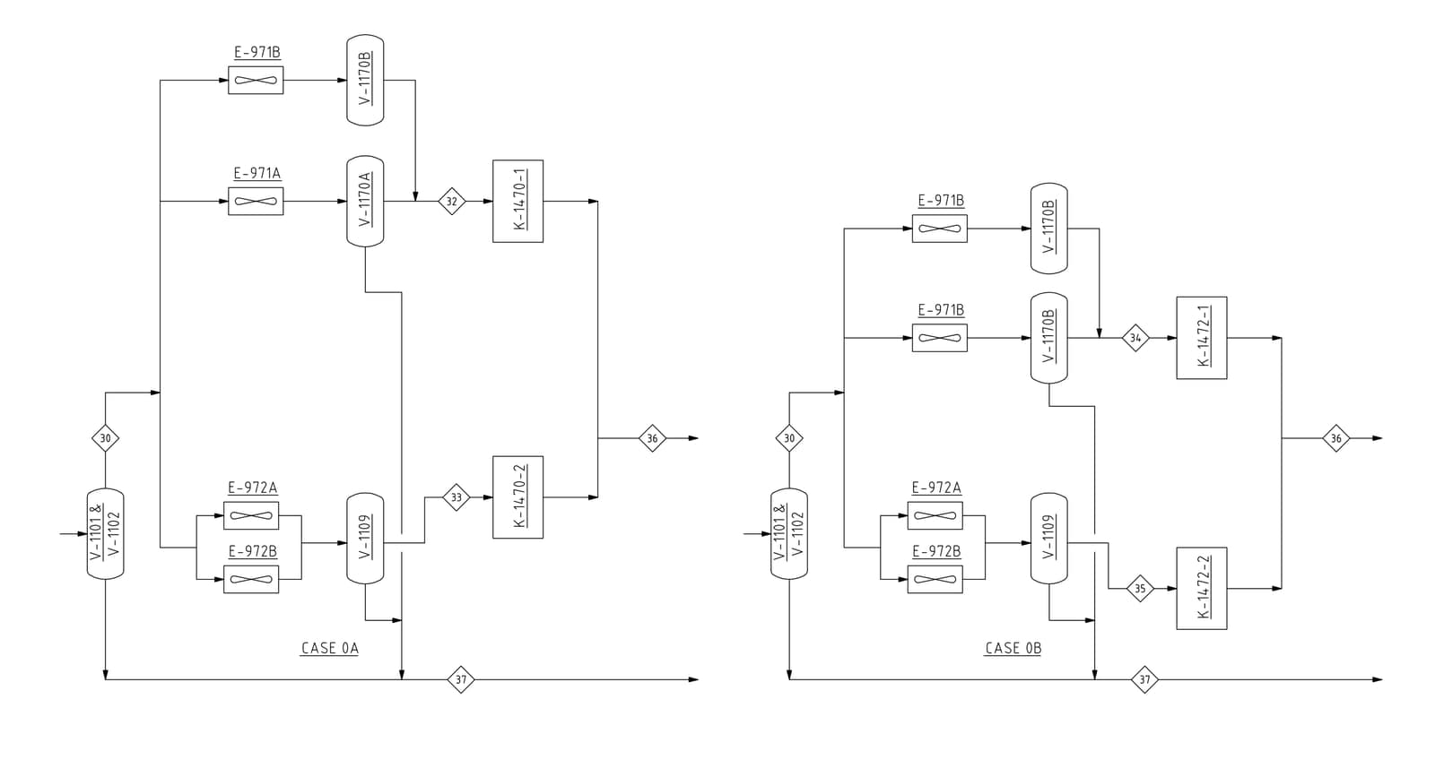
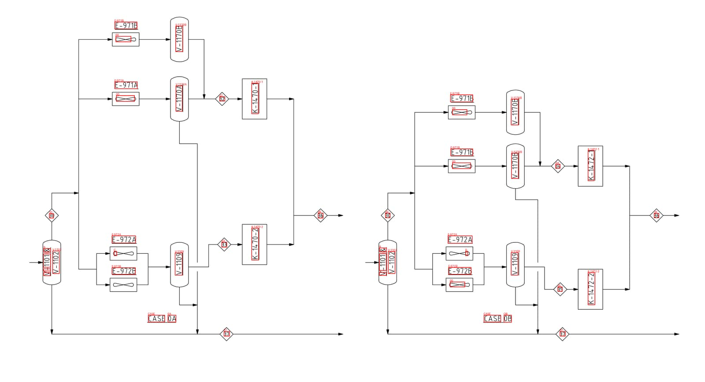
P&ID: Example
TAG | P&ID
E-971B | A4001-0004_00
V-1170B | A4001-0004_00
E-971A | A4001-0004_00
V-1170A | A4001-0004_00
K-1470-1 | A4001-0004_00
E-971B | A4001-0004_00
V-1170B | A4001-0004_00
E-971B | A4001-0004_00
V-1170B | A4001-0004_00
K-1472-1 | A4001-0004_00
E-972A | A4001-0004_00
33 | A4001-0004_00
K-1470-2 | A4001-0004_00
E-972A | A4001-0004_00
V-1102 | A4001-0004_00
V-1109 | A4001-0004_00
E-972B | A4001-0004_00
V | A4001-0004_00
-1101 | A4001-0004_00
& | A4001-0004_00
V-1102 | A4001-0004_00
V-1109 | A4001-0004_00
E-972B | A4001-0004_00
00 | A4001-0004_00
35 | A4001-0004_00
CASE | A4001-0004_00
0A | A4001-0004_00
CASE | A4001-0004_00
OB | A4001-0004_00
K-1472-2 | A4001-0004_00
37 | A4001-0004_00
37 | A4001-0004_00
Before
digitizing
Tag-id information extracted
After
digitizing
AI based scanning & digitizing of P&ID files

Slide 18

Main building blocks
Tag Registry portal & Enterprise Tag Registry:
  With a complete set of options to manage Tag Registry contents: Add / Delete / Update / Search / etc.
  If required: Support for multiple (special) tag registries such as for Cabling, Equipment, Instrumentation, etc.
  Support for flexibility in terms of fields to be included in the Tag Registeries.
  Support for three role levels.
  (Batch) Upload feature to get your current Tag information into this Tag Registry.
  Many rules (background) to make sure that correct data is loaded.
Tag information scanning all technical drawings:
  Often there are many 1000s of drawings (cabling / electrical / instrumentation / safety / etc.) and these can be (AI enabled) scanned to look for any Tag information and update the tag registry with all of this information → It means that the Tag Registry has, at all times, the latest information.
  Option for large number of drawings as once off batch upload.
Tag information scanning & Digitizing all P&IDs (knowledge graph):
  P&IDs have important information and this needs to be made more accessible: All Tag information is (AI enabled) scanned and stored in the Tag Registry. In addition P&IDs are digitized, sored in an graph database and then can be analyzed interactively.
  Option for large number of P&IDs as once off batch upload.
Copilot (GenAI) based search facility:
  Using natural language asking any questions about information stored in the Tag Registries and the P&ID Graph database → Very powerful query tool.

Slide 19
Main building blocks
Tag Registry portal & Enterprise Tag Registry:
Tag information scanning all technical drawings:
With a complete set of options to manage Tag Registry contents: Add / Delete / Update / Search / etc.
If required: Support for multiple (special) tag registries such as for Cabling, Equipment, Instrumentation, etc.
Support for flexibility in terms of fields to be included in the Tag Registeries.
Support for three role levels.
(Batch) Upload feature to get your current Tag information into this Tag Registry.
Many rules (background) to make sure that correct data is loaded.
Often there are many 1000s of drawings (cabling / electrical / instrumentation / safety / etc.) and these can be (AI enabled) scanned to look for any Tag information and update the tag registry with all of this information → It means that the Tag Registry has, at all times, the latest information.
Option for large number of drawings as once off batch upload.
Tag information scanning & Digitizing all P&IDs (knowledge graph):
Copilot (GenAI) based search facility:
P&IDs have important information and this needs to be made more accessible: All Tag information is (AI enabled) scanned and stored in the Tag Registry. In addition P&IDs are digitized, sored in an graph database and then can be analyzed interactively.
Option for large number of P&IDs as once off batch upload.
Using natural language asking any questions about information stored in the Tag Registries and the P&ID Graph database → Very powerful query tool.

Slide 20
Main Components
For each drawing type extract tag information
Tag Registry User Portal
Tag Registry
Tag number + Approx 30 fields
For each tag entry:
Show all drawings where this tag number is used.
Show links of these drawings.
Access to contents of these drawings
Digitization Engine
(Azure Cognitive Services
Azure AI Document Intelligence Services)
Digitize P&ID
Scan all drawing types
One by one / Batch uploads
Om Prem or Cloud systems like Aveva, Meridian, PIMS, etc..
Platform drawings (PDF format)
Important drawing types
A4 = P&ID
A6 = Electrical
A7 = Instrumentation
A8 = Safety
Or any other Engineering/ Technical Drawings
Gen AI Assistant
Quick access to insights with Copilot Assistant
Knowledge Graph
(Graph database)
Link to Tag Registry
Walk through an P&ID file
For each drawing type extract tag information
EDMS

Slide 21










Main Components
MS Fabric based
MS PowerBI for dashboarding
MS Teams
  Web frontend
Annotation: Roboflow for annotating components and lines
Models: YOLO models for component (object) detection and line detection
Model Training: Azure ML Studio
Tag Extraction (OCR): Azure OpenAI
For each drawing type extract tag information
MS Fabric Data Agent
MS Copilot
Tag Registry User Portal
Tag Registry
Tag number + Approx 30 fields
For each tag entry:
Show all drawings where this tag number is used.
Show links of these drawings.
Access to contents of these drawings
Digitization Engine
(Azure Cognitive Services
Azure AI Document Intelligence Services)
Digitize P&ID
Scan all drawing types
One by one / Batch uploads
Om Prem or Cloud systems like Aveva, Meridian, PIMS, etc..
Platform drawings (PDF format)
Important drawing types
A4 = P&ID
A6 = Electrical
A7 = Instrumentation
A8 = Safety
Or any other Engineering/ Technical Drawings
Gen AI Assistant
Quick access to insights with Copilot Assistant
Knowledge Graph
(Graph database)
Link to Tag Registry
Walk through an P&ID file
MS Azure
Neo4J
MS Fabric-Graph
For each drawing type extract tag information
EDMS

Slide 22
: For digitizing Manufacturing
Manufacturing Plants
Manufacturing Operations · Maintenance · Engineering · Finance · Logistics — users
Below are our sample questions for any business user to get benefits out of Ontology
What was the marketshare of Fedex, DHL and UPS in our logistics over Q1, 2026?
Which logistics provider has done the worst so far in 2026?
What happens to the SKU cost price when I replace orange juice from Florida by orange juice from Brasil?
How can I best spread the production capacity when I temporarily close our factory in Marseille due to maintenance?
What is the product quality compared between our factories in Seattle and Zurich?
Cadmatic eShare
Digital Twins
Copilot
Power BI
Coworker
Agents
Access to
AI flavours
Industrial AI
Advisory setpoints for OT
Various data types from production lines
Weather
Logistics
Ontology Services — including Planning
ML · MV
Gen-AI · LLM
Bi-directional
Enterprise Data & AI Platform
DiagramIQ
Business data · Documentation platform(s) · Websites with
relevant information · Messages / Teams / etc.
All relevant internal business applications
All relevant external business applications

Slide 23


Microsoft IQ spans four Microsoft-defined domains
Acuvate perspective
Fabric IQ
Foundry IQ
Business entities & operational data
Policies & authoritative documents
1
Ontology is the data layer for the Coworker and Agents.
Organizes structured data in OneLake into a living ontology of entities, relationships, rules and metrics — governed in one layer. Supports conversational analytics in business terms and an operations capability that monitors live data, flags rule violations, and acts with appropriate approval.
Built on Azure AI Search, it grounds AI in the organization's documents and policies through reusable, permission-aware knowledge bases with citations and compliance enforced. Delivered as a managed service that removes the retrieval pipeline teams would otherwise build and maintain.
2
MS IQ has been expanded with MS Fabric Planning — for future business planning.
3
Acuvate AcuCortex has been developed as an accelerator for Ontology deployments.
Work IQ
Web IQ
Organizational ways of working
External market intelligence
4
MS Copilot will be expanded to help speed up configuration & deployment of Ontologies.
Provides context on how people work across Microsoft 365, capturing collaboration signals and the memory behind decisions. It is the intelligence layer behind Microsoft 365 Copilot and is available to custom agents through open APIs.
Grounds AI in the open web with current, citation-ready intelligence on prices, news and market developments — so decisions reflect present conditions rather than historical assumptions.
5
The Enterprise Semantic Model can be one of the feeders of the Ontology layer.

Slide 24
Acuvate AcuSignal Accelerator for digitizing Manufacturing
Manufacturing Plants
Manufacturing Operations · Maintenance · Engineering · Finance · Logistics — users
Agents are the main development you hear about so how can they assist here
Having the Ontology layer means that Agents can as well use data in business context making their job easier
Often there will be multiple agents addressing different needs and an orchestration agents to oversee it all
Low / Nocode will be the important development platform allowing for development as well by non-IT staff
Automating workflows with human in the loop agents moving in several cases to autonomy
Acuvate have developed as well an extensive Agent Integration Architecture bringing all services together
Cadmatic eShare
Digital Twins
Copilot
Power BI
Coworker
Agents
Access to
AI flavours
Industrial AI
Advisory setpoints for OT
Various data types from production lines
Weather
Logistics
Ontology Services — including Planning
ML · MV
Gen-AI · LLM
Bi-directional
Enterprise Data & AI Platform
DiagramIQ
Business data · Documentation platform(s) · Websites with
relevant information · Messages / Teams / etc.
All relevant internal business applications
All relevant external business applications

Slide 25
: For digitizing Manufacturing
Manufacturing Plants
Manufacturing Operations · Maintenance · Engineering · Finance · Logistics — users
An AI coworker is an autonomous digital agent capable of handling complex, multi-step workflows from start to finish. Unlike chatbots or copilots that only answer questions or draft text, an AI coworker connects directly to your desktop or company software to execute tasks independently
Coworker
Skills
Toolsets
Agents
Cadmatic eShare Digital Twins
Copilot
Power BI
Access to
AI flavours
Industrial AI
Coworker and Agents: See above for AI Coworker anf Agents are more focused at executing discrete tasks
Skills are specialized instructions that teach the AI your specific workflows, voice, and rules so it can execute repetitive tasks automatically
In AI Cowork platforms (like Claude Cowork), Skills are reusable, saved instruction sets that teach an AI agent how to perform specific tasks, such as applying your brand guidelines, generating reports, or automating workflows
AI tool sets transform workflows by automating repetitive processes, enhancing research accuracy, and generating high-quality drafts or code.
Advisory setpoints for OT
Various data types from production lines
Weather
Logistics
Ontology Services — including Planning
ML · MV
Gen-AI · LLM
Bi-directional
Enterprise Data & AI Platform
DiagramIQ
Business data · Documentation platform(s) · Websites with
relevant information · Messages / Teams / etc.
All relevant internal business applications
All relevant external business applications

Slide 26
: For digitizing Manufacturing
Manufacturing Plants
Manufacturing Operations · Maintenance · Engineering · Finance · Logistics — users
You have heard about Digital Twin as User Interface but how will it help with my ROI
Coworker
Skills
Toolsets
Agents
Having an Manufacturing facility you will have many different components and roles to manage such as Operations, Engineering & Maintenance; How do you ensure that they look at the same or aligned data
Acuvate offers various 2D and 3D flavours.
Cadmatic eShare offers an 3D version and therefore laserscans or 3D digital drawings of your plant are visible as user interface.
Whilst pointing out an component such as pump you see all relevant data such as PI, ERP, (OEM) documents, Camera images, etc. So you get the complete picture
It allows you to better plan for maintenance job, turnarounds, etc.
Cadmatic eShare
Digital Twins
Copilot
Power BI
Access to
AI flavours
Industrial AI
Advisory setpoints for OT
Various data types from production lines
Weather
Logistics
Ontology Services — including Planning
ML · MV
Gen-AI · LLM
Bi-directional
Enterprise Data & AI Platform
DiagramIQ
Business data · Documentation platform(s) · Websites with
relevant information · Messages / Teams / etc.
All relevant internal business applications
All relevant external business applications

Slide 27
Poll 2
Where Do You See The Most Value From A Digital Twin?

Slide 28








Empowering industries with software since 1982
Cadmatic is trusted to manage the whole project and operation lifecycle better, faster and easier with unified solutions for the process industries and shipbuilding.
Information Management
6000+
17
Design Applications
Design
customers globally
offices globally
Operate
Build
48M€
thousands
turnover 2025
of projects completed
Notes:
Talk track: Cadmatic founded in Finland and born globally. With an international team of more than 300 experts, in 17 local offices and trusted by customers globally is a trusted software provider from Vancouver/Canada to Osaka/Japan.
Software for engineers by engineers, we understand your workflow
Industrial leaders use Cadmatic software to achieve better outcomes

Slide 29
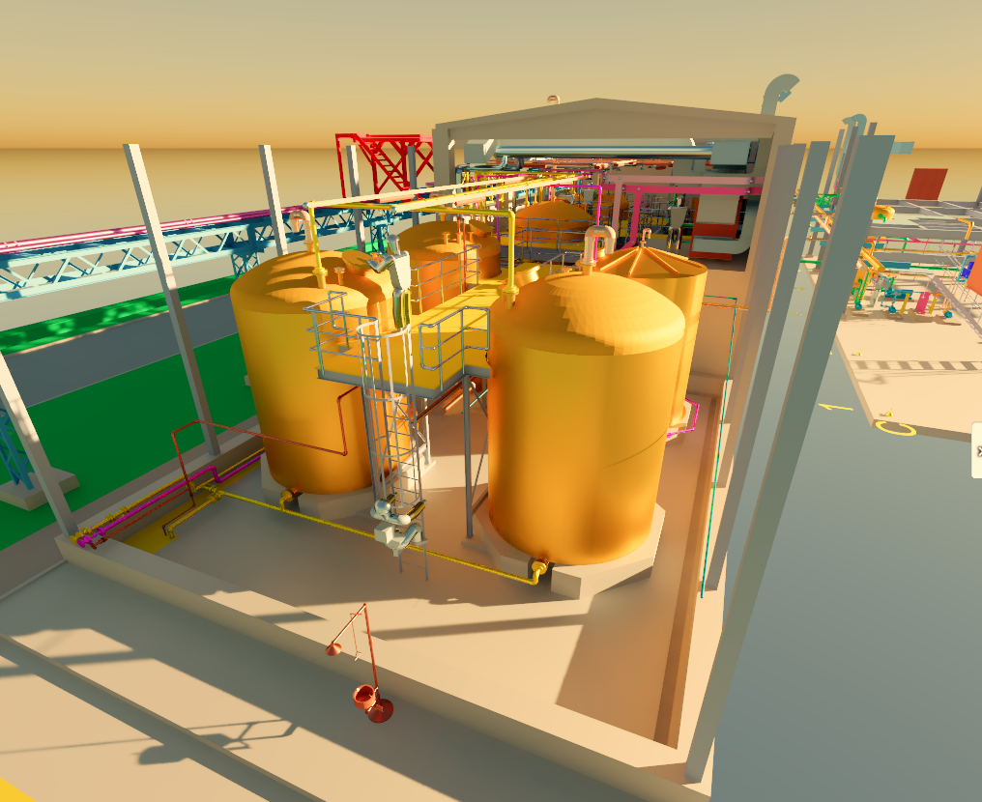
CADMATIC eShare
Digital twin use cases across the asset lifecycle

Slide 30

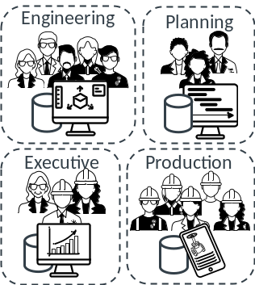
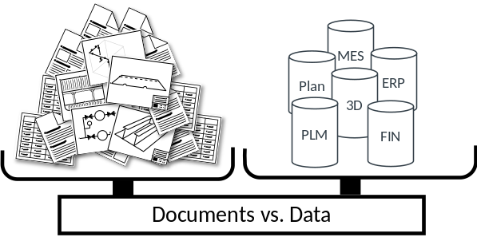
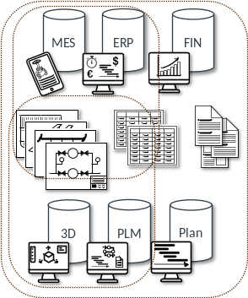
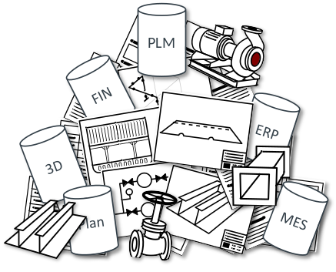
Typical organizational information system challenges
Time searching
for information…
Working in silos…
Data vs documents…
I can’t access the document?
Where is the document?
Is this the right the document?
I am not trained on this system?
I don’t feel Informed
IT-driven “rigid”
architecture
Team cohesion
Disorganized/Inaccessible information systems

Slide 31
Join the dots: Digital Twin built by contextual associations
Documents / Drawings / Deliverables
3D Model
Data systems
3D
PLM
Supplier/Tech
documentation
Coordination
drawings
703.645.001
Plan
ERP
703-645A
430-645A
“Excels”
Planning
MES
FIN
V-021
I-079
80-FL102/10
Engineering outputs
Production information

Slide 32
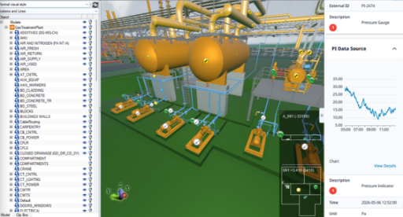
Connect every source into one digital twin
eShare unifies engineering, operations, field and AI data into a single visual source of truth.
Data sources & systems
What this enables
Engineering & design
3D models, P&IDs
Documents & knowledge
Manuals & SOPs
PROJECT
Transparency and control
Reality capture
Laser scans, clouds
Maintenance
CMMS / EAM
eShare
Review and solve fast
digital twin
OPERATIONS
ERP & procurement
Spares, materials
Operations data
Historian, SCADA
Operate & respond
Asset integrity
RBI, corrosion
Reliability & IoT
Condition data
Maintain & plan
Integrity & RBI
Safety & change
LOTO, permits, MOC
AI & simulations
Predict, simulate
Knowledge continuity
Notes:
TAR stands for Turnaround. It refers to a scheduled, large-scale event where an entire industrial plant, or a major process unit, is taken offline for an extended period to perform essential servicing, major repairs, inspections, and equipment upgrades
Risk-Based Inspection (RBI) is a methodology used to prioritize inspection and maintenance activities based on risk rather than fixed time intervals. Risk is typically calculated as:

Slide 33
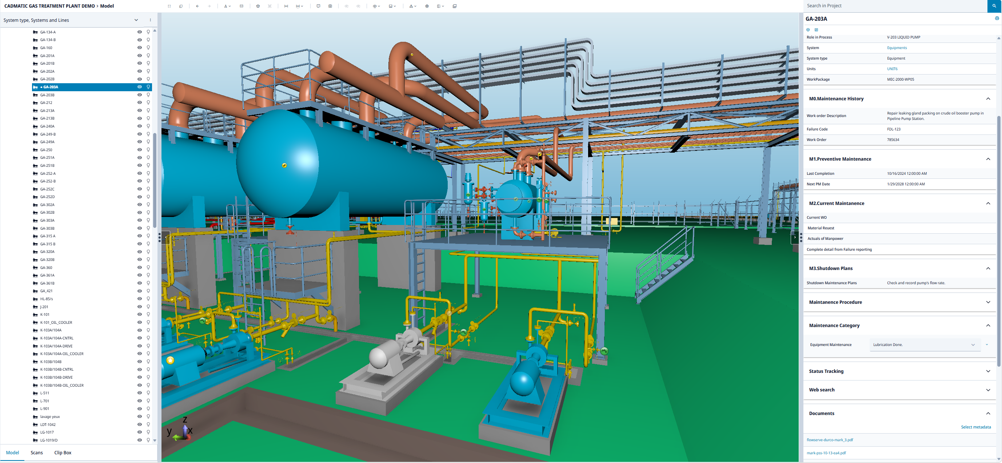
DEMO

Slide 34








eShare

Slide 35
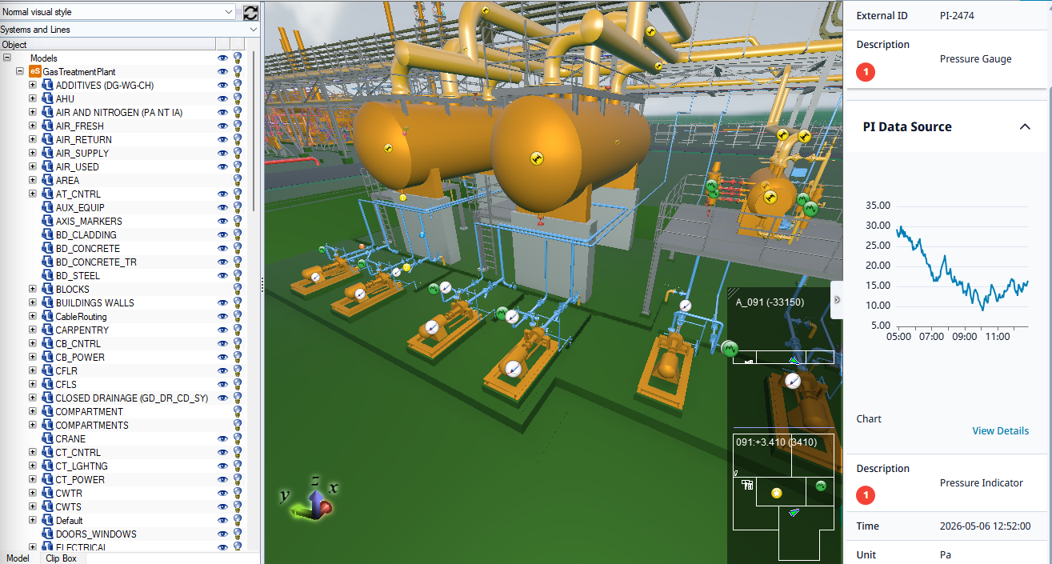
Beat downtime and complexity with a single source of truth, accessible for everyone
“We make the right information accessible for everyone.”
Chief Digitalization Officer
“We keep operations running with fewer disruptions.”
Operations Director
“Everyone works from the same up-to-date project data.”
Project Manager
“I have the right data on hand to do the job safely and fast.”
Technician
“I can plan and assign precise maintenance tasks in advance.”
Maintenance Manager
“Everyone can easily see the planned maintenance schedule and statuses.”
Operational Excellence
Notes:
Talk track:
We want to change the way capital projects are executed, and the way information is used to support plant operations and maintenance.
OR
With Cadmatic, owner-operators keep control of the engineering data and create one connected environment from design to operations.
CLICK
We offer an environment, where all the engineering is happening in shared design environment - owned by you. 100 % of project data is usable to support plant operations and maintenance.
Operations and Digitalization leaders keep engineering data usable long after project handover, creating the foundation for digital twins, AI initiatives, and future investments.
CLICK
Owning the shared design environment means that you can freely choose which ever engineering or EPC company, or multiple companies to you project. Based on what makes the most sense. Not based on vendor lock-in.
CLICK
And when the project is up and running, you constantly see how the design is evolving and able to do constant reviewing to find out trigger the needed changes as soon as possible, avoiding costly rework and schedule overruns.
CLICK
From Design → Procurement → construction → Commissioning: All stakeholders working on the same, up-to-date data.
CLICK
Maintenance teams access the right information in context, helping them plan and execute maintenance activities better and efficiently.
CLICK
From an operational perspective the outcome is that the plant keeps running with fewer disruptions.
To Summarize, We want to unleash the power of unified information so that it benefits everyone across the organization—not just one team or role.
And in the next slide we explain how.
Optional content:
A plant where every manager, technician, engineer, and contractor can instantly access the right, up-to-date information and act faster, safer, and with confidence.
Every stakeholder works from the same up-to-date information.
Project teams gain visibility into changes early, helping reduce rework and keep capital projects on track.
The result is better control across the full lifecycle:
projects move faster, teams stay aligned, and operations run more efficiently.

Slide 36
Value across the asset lifecycle
From the capital project to day-to-day operations — one digital twin
ACROSS THE CAPITAL PROJECT
See the whole project
Review continuously
Accept a verified handover
Carry the twin into operations
1
2
3
4
IN DAY-TO-DAY OPERATIONS
Respond to unplanned downtime faster
Plan and brief maintenance efficiently
Coordinate every team on one view
5
6
7
Retain expert knowledge, onboard faster
Manage asset integrity and inspections
Act on reliability data in context
8
9
10
Deliver turnarounds on time and on budget
Keep engineering data accurate
Turn operational data into decisions
11
12
13

Slide 37
Not just a model browser.
It’s the solution that lifts your plant operations to the next level.
✓
✓
✓
✓
One source of truth
Fits your landscape
Easy to implement and use
Best-in-market
A single point of entry for every part of the organisation.
Runs alongside your existing operations systems and software.
Configured and deployed in days, simple training.
Leading graphical performance and interoperability.
MANY USE CASES, ONE TWIN across operations, maintenance and reliability - and your capital projects too.

Slide 38
Idea of possible demo flow
Act 2 - Maintenance investigates and plans
The reliability engineer opens the mark up and then studies the asset view - no context loss, same tag, same 3D.. From eShare, all resolved to the tag: process/vibration history for context, the P&ID to locate isolation points (we could link an isolation plan or create one by redlining the integrated P&ID), the datasheet and maintenance procedure from DMS, the 3D to walk the access route, see what needs to be taken into account. Could we get related information from Acuprism: such as has this unit failed this way before, what's the fleet history on similar pumps, are the spares in stock? The engineer plans safe isolation and confirms the correct procedure without touching five systems.
To Do:
Cadmatic
Reliability Engineer / Maintenance manager starting page
  Markups (maintenance assignment from Act 1)
  Some KPI’s as a chart?
Documents
  P&ID
  Isolation plan in P&ID
  Equipment manual
Fake hyperlink to Maintenance management system CMMS (esim. IBM Maximo)
Acuvate:
Created Work order in CMMS to be visible in eShare
Historian data of vibration

Slide 39
Idea of possible demo flow
Act 3 - Work order raised (CMMS, as a deliberate boundary).
eShare gave the full context and the plan; the WO is created in the CMMS because that's the system of record for work. Shown as the intended architecture - click out or narrate -with the line landed plainly: eShare complements the CMMS, it doesn't replace it. Architectural discipline, not a missing feature. We would need to be able to show that the workorder comes visible in eShare. And then expalin that we can also create a direct link to the workorder in CMMS, but I don’t think we can do it for this demo, if not just a fake hyperlink)
Explaining that now all the relevant information is also available for the maintenance technician and that the work can be handed over with ”virtual” overview, instead just sending the team to work.

Slide 40
Idea of possible demo flow
Act 4 - Operations monitors to close the loop
Once the WO exists, its status shows in eShare against the same tag. Operations reopens P-101A and sees the planned work, status, procedure and isolation plan — in spatial and operational context, no CMMS login. The thread that began as "something looks off" ends as "planned work, correct procedure, safe isolation," entirely inside one UI for the operation personnel.
To Do
Cadmatic:
Operator starting page
Assignments and statuses
Some KPI’s needs to think….

Slide 41



AcuPrism: Acuvate’s Industrial Intelligence Data Platform – User Interfaces
AcuPrism Data interfaces
SAP (ERP):
  Interfaces with various SAP Modules such as Aset Mgt; Plant Mgt; etc.
  Of course as well other ERP solutions are supported.
Assai:
  APIs for Document Management System
Aveva (OSIsoft) PI:
  High speed streaming of Time Series data.
Camera images:
  (5G) Camer images streaming.
SQL based interfaces
OT based interfaces
Etc.
Data Laehouse on
MS Azure
Application and Services
Inform Decision Makers/Support Decision making
Batch Processing
Portal / Dashboarding
Copilot
(includes Gen-AI)
GenAI
AI-ML
Reports and Dashboards
AI-MV
Gen-AI
Data Chat Bots
Raw
Clean
Curated
Insights Serving Layer through Integration
GenAI
PowerBI
Digital Twins
Contextualisation
Analytics application
Intelligent App
(including XR)
Model Deployment from Edge on Cloud
Real time Alerts
Data Observability and Data Operations
Of course data interfaces from any party can be added here since Platform is either MS Fabric or Databricks based

Slide 42




AcuPrism: Manufacturing Business Apps
Acuvate Manufacturing business applications
Energy / Manufacturing Predictive Maintenance
( engine / turbine / compressor/ pump / transport belt / etc.).
Robotics driven Operator Rounds (addressing all needs)
Manufacturing product
Quality Control
Energy / Manufacturing applications (AcuNow based) real time decision making.
Microsoft Azure
Inform Decision Makers/
Support Decision making
Energy / Manufacturing Operations ( End to end Problem Solving services)
Energy / Manufacturing Operations (Leakage detection / Spillage / Emissions)
HSSE (PPE / smoke detection / lifting goods ( Zone protection)
Enterprise Energy Management (optimization)
Batch Processing
Portal / Dashboarding
Copilot
(includes Gen-AI)
GenAI
AI-ML
Reports and Dashboards
Insights Serving Layer through Integration GenAI
Raw
Clean
Curated
AI-MV
Gen-AI
Data Chat Bots
Gen AI search-based services for (technical) documentation
Gen-AI / Agentic user interfaces
Manufacturing OEE (Overall Equipment Effectiveness)
ESG Scope 1 / 2 / 3 reporting & analytics
Contextualisation
PowerBI
Digital Twins
Analytics Application
Intelligent App
(including XR)
Model Deployment from Edge on Cloud
Real time Alerts
Realtime business decision making
(AcuNow)
Data migration of several databases to MS Fabric
(AcuWeave)
Data contextualization
P&ID / Timeseries / ERP Asset
(DiagramIQ)
KDI Kognitwin Digital Twin - AcuPrism
End to End services
All Acuvate business applications have one or multiple (Gen)-AI components
End to End Information Security enabled
Ready for deployment
Partly ready for deployment
Of course business applications from any party can be added here since Platform is either MS Fabric or Databricks based

Slide 43
AcuPrism: Acuvate’s Industrial Intelligence Data Platform – User Interfaces
Acuvate User Interfaces
Dashboards:
  Often MS Power BI based including web based overview of dashboards users can select from.
Microsoft Co Pilot:
  Various flavours (look at slides 48-50): We have developed multiple Co-Pilot based applications and therefore have extensive experience in this space.
Gen-AI (Chat bots):
  Look at slides 48-50 for the many examples we have developed and made operational: Both as customer interface and as internal business interface such as for Operations.
PowerApp:
  Low / No code solutions
Agentic-AI:
  Agentic AI is an artificial intelligence system with enhanced autonomy, decision-making capabilities and adaptability. These systems are designed to pursue complex goals and execute workflow tasks with limited direct human supervision → Use cases under development.
Advisory Setpoints:
  Increasingly AI based analytics determine what the updated settings have to be for certain (OT) processes; These are Advisory soince often Operations staff have the final say before these recommended changes are accepted.
Digital Twin:
  Look at other slides for the latest developments / opportunities of such an integrated AcuPrism - Kognitwin Digital Twin approach including realtime data feeds.
Either eithereeeee
Data Lakehouse on MS Azure`
Application & Services
Inform Decision Makers/
Support Decision making
Batch Processing
Portal / Dashboarding
Copilot
(includes Gen-AI)
GenAI
AI-ML
Reports and Dashboards
Insights Serving Layer through Integration GenAI
Raw
Clean
Curated
AI-MV
Gen-AI
Data Chat Bots
Contextualisation
PowerBI
Digital Twins
Analytics Application
Intelligent App
(including XR)
Model Deployment from Edge on Cloud
Real time Alerts
Of course user interfaces from any party can be added here since Platform is either MS Fabric or Databricks based

Slide 44

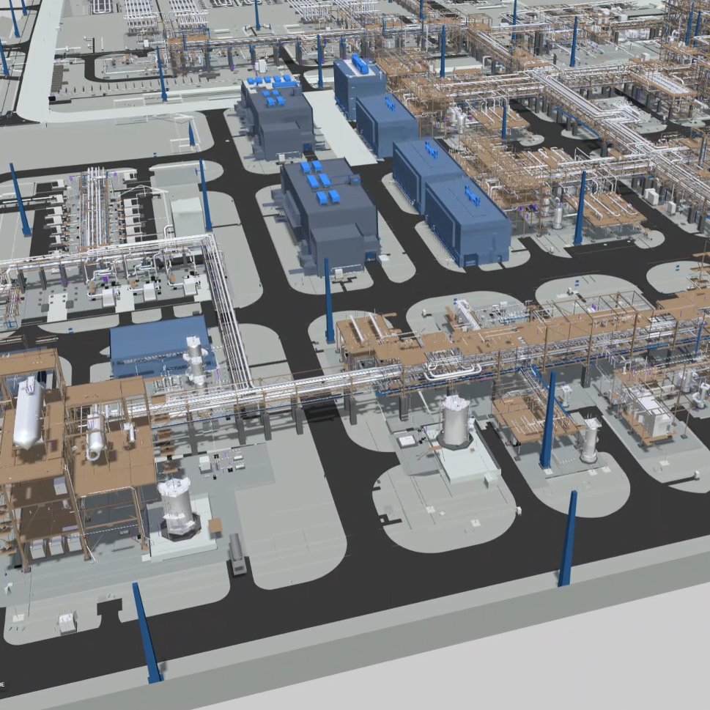
AcuPrism: Acuvate’s Industrial Intelligence Data & AI Platform - Master
MS Azure IOT
Operations
Microsoft Fabric
MS Azure IOT
Operations
Data Lakehouse on Cloud
Application and Services
Inform Decision Makers/Support Decision making
Data Sources
On-Prem & Cloud
ERP (SAP/Maximo) data
Batch Processing
Portal / Dashboarding
Copilot
(includes Gen-AI)
OT Data
(Historian, SCADA, DCS)
Edge AI/Applications
GenAI
AI-ML
Reports and Dashboards
Internal Data (Owned)
Data Governance, Security and Compliance
Enterprise Data Architecture
Program and Change Management
Data Strategy, Domain Consulting, Technology & Analytics Consulting
Aveva PI Timeseries data
AI-MV
Gen-AI
Insights Serving Layer through Integration
GenAI
Data Chat Bots
Realtime Streaming
Edge Management
Raw
Clean
Curated
3rd Party Data
2D/3D Digital Twins
Assai (technical) documents
PowerBI
Unstructured Data
Contextualisation
P&ID data
Edge Cloud
Analytics application
Intelligent App
(including XR)
Model Deployment from Edge on Cloud
Qualitative Data
Camera images
Real time Alerts
Data Catalog with Active Metadata Management
Data Observability and Data Operations
Data Catalog with Active Metadata Management
Fully integrated
solution
AcuSeven: Linking data sources immed to 2D / 3D visualisation
Data Observability and Data Operations
Notes:
Here we show the integrated end to end story from data collection + data manipulation + data storage + data (AI) analytics + Digital Twin using KDI Kognitwin. So we show and have an complete end to end story where we now can compete with Cognite.

Slide 45
How to start
We Acuvate are an System Integrator and therefore have the ideal skills to get you going in the world of Digital where bringing together all pieces is critical.
We do take into account what you already have done and will imbed that in our solutions.
We can start small with an Minimal Viable Product (MVP) and grow that over time.
1
2
3
We have certified staff in each of the relevant areas.
4
Based on your set up we can give advice what steps and target could be.
5
We have as well several AI based business solutions for the Energy and Manufacturing verticals.
6
Indeed Try Us And Ask For An Proposal

Slide 46
Poll 3
How Soon Do You See Your Organization Adopting A Connected Digital Twin Approach?

Slide 47
How to start
We Acuvate are an System Integrator and therefore have the ideal skills to get you going in the world of Digital where bringing together all pieces is critical.
We do take into account what you already have done and will imbed that in our solutions.
We can start small with an Minimal Viable Product (MVP) and grow that over time.
We have certified staff in each of the relevant areas.
Based on your set up we can give advice what steps and target could be.
We have as well several AI based business solutions for the Energy and Manufacturing verticals.
Indeed try us and ask for an proposal.

Slide 48



Slide 49
Thank you!
Markus Sukkinen
markus.sukkinen@cadmatic.com

Slide 50






Session presented by
THANK YOU
We are a global player in next-generation digital solutions & services that modernize, automate and transform enterprise applications. With over 19+ years of experience, we have been enabling our clients globally to steer their digital transformation strategy using Cloud, Data & AI. We build & develop smart & sustainable solutions to help our customers transform their conventional processes to match the next-generation technological trend.
We have a strong presence in the US, Europe, and Middle East, where we serve multiple ultra-large customers as well as SMBs from various sectors such as Public Sector, CPG, Retail, Oil & Gas, Energy, Manufacturing, BFSI, Healthcare, etc.
Contact: advisors@acuvate.com

