Slide 1


INDUSTRY TRACK SESSION
Forward-Deployed Engineering
The Operating Model for Enterprise AI
Presented by
K4
CLARITY
Time
15:00–15:45 CEST | 09:00–09:45 EDT
Date
16 / 09 / 26
Notes:
COVER SLIDE. Replace the session title, date, time, partner names and the two speaker blocks. Drop headshots into the grey photo squares (right-click > Change Picture). Keep the CORESHIFT 2026 lockup untouched.

Slide 2








K4
CLARITY
Your speakers
Meet the team presenting this session
Taiki Yoshida
Jagan Jami
Kim Wiley
Principal PM Manager
Chief Operating Officer
Fractional Chief AI Officer
K4
CLARITY

Slide 3
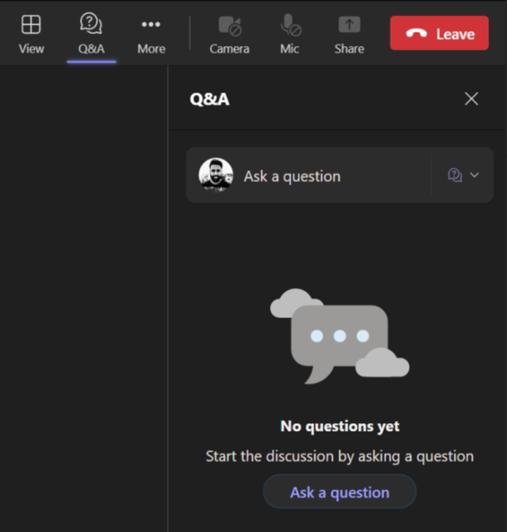
K4
CLARITY
Housekeeping – Asking speaker a question
We want to hear from you!
Please submit your questions. We’ll reserve time for Q&A at the end of the webinar.
1
To submit questions, click on the Q&A at the top right corner
2
Clicking on the Q&A icon will open a window where you can type your question.
3
Click on the ‘Ask a question’ button & type your question.

Slide 4
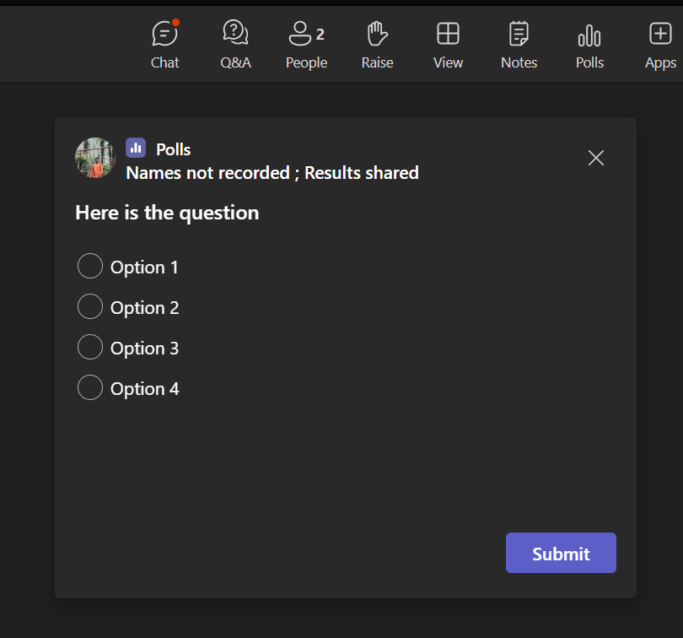
Housekeeping -Participating in Polls
K4
CLARITY
Your opinion is valuable to us!
Please take part in our polls to help us understand your views.
1
Submit Your Vote:
A new window will pop up with the poll question.
Choose your answer from the provided options
2
Confirm Your Selection:
After selecting your option, make sure to hit the 'Submit' button to record your response..

Slide 5






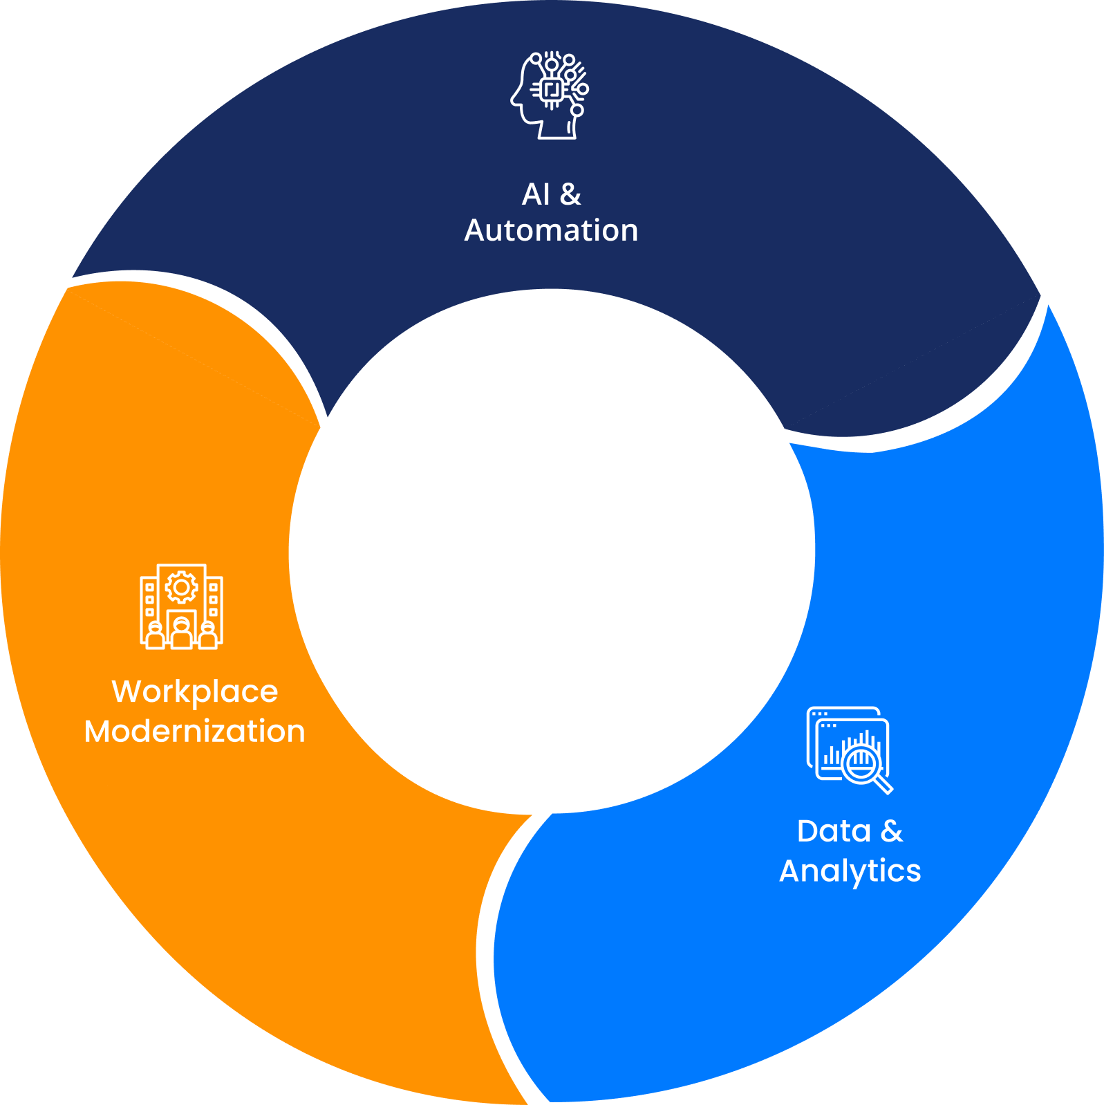





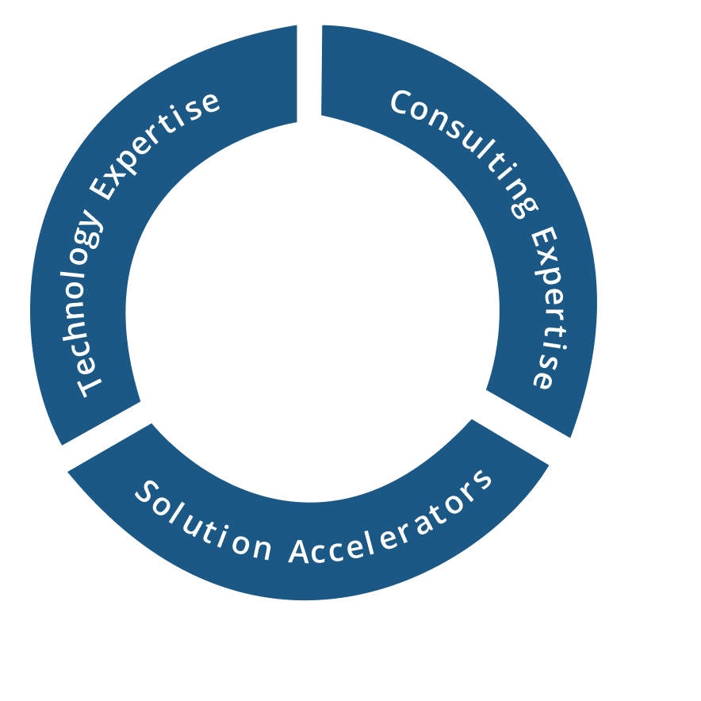




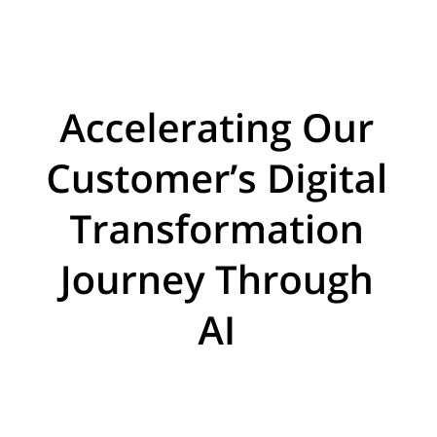


















About Acuvate
Acuvate is a global player in next-generation digital solutions & services that modernize, automate and transform enterprise applications. With over 19+ years of experience, we have been enabling our clients globally to steer their digital transformation strategy using AI, Data & Cloud.
ACCELERATORS
TRUSTED BY 200+ ENTERPRISES WORLDWIDE INCLUDING SEVERAL FORTUNE 500
Manufacturing
Our Focus
CPG, Retail
Oil & Gas,
Energy
Healthcare and Life Sciences
BSFI
Government
19+
Years in the Industry
500+
Multi-Skilled Professionals
3 Continents, 7 offices
North America, Europe, Asia
Travel and Hospitality / Others

Slide 6

K4
CLARITY
Poll 1
Where Does Your Current Digital Initiatives
Model Struggle The Most?

Slide 7


K4
CLARITY
Invite only FDE Program focused on Copilot, Copilot Cowork, and Copilot Studio

Slide 8



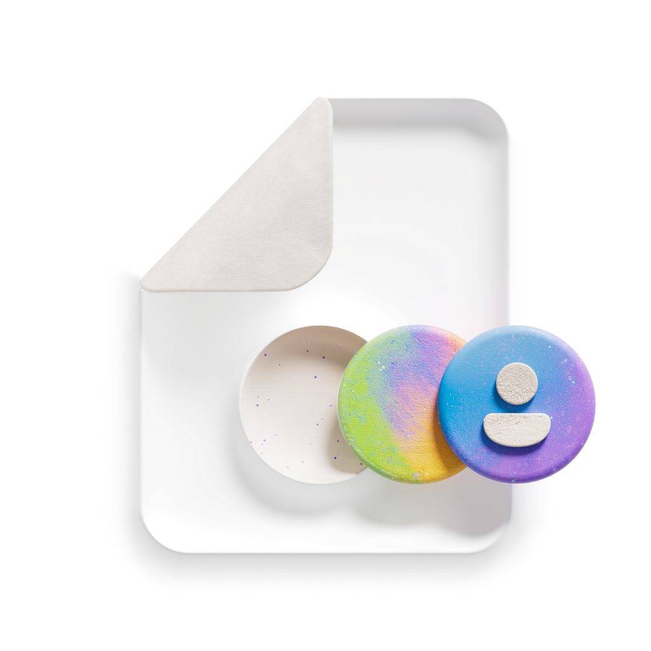

K4
CLARITY
What we provide and do
What we provide and do
Empowered AI Strategy
Guidance, Best Practices & Support
Envision High Value Scenarios
Architect & Build Quality POC Solutions
Product Feedback & Improvement
Microsoft demonstrates how to go from the “Art of the Possible” to the “Art of the Practical” with M365 Copilot and extensibility
Microsoft can help your makers, builders, & developers learn the right skills and best practices for agent implementation
Microsoft-hosted Discovery & Envisioning sessions help you identify, prioritize and scope high value scenarios to build
Microsoft will help customers build MVP* for personal, productivity, enterprise and Line of Business scenarios.
Provide a direct feedback channel to Copilot Extensibility and Copilot Studio engineering teams

Slide 9
K4
CLARITY
240
54
Nominations
Qualified

Slide 10
K4
CLARITY
Why?

Slide 11
K4
CLARITY
Agents Require Use Cases

Slide 12
K4
CLARITY
Agent Archetypes
Knowledge search and retrieval
Document Analysis and comparison
Content generation and editing
Trigger-based automations
Workflow orchestration
Meeting intelligence and actions
Knowledge curation
AGENT EXAMPLES:
Policy search, standard operating procedure search
Analyze meeting effectiveness, including participant engagement
Create competitor battle card for sales teams, from disparate sources
Legal document review/comparison
Customer sales proposal creation
IT/HR support ticket triage and routing
New hire onboarding
Executive support for Q&A, executive briefings
Compare supplier agreement with standard template
Store walk / operating procedures
Summarize leadership meetings with clear decisions and actions
Curate customer Q&A knowledge, extract common answers
Weekly newsletter update
Incoming mail triage and reply
Pre-meeting briefing or deal briefing summary
Summarize regulatory filing for top risks
Press release or media plan creation
Automate creation of project tasks based on meeting actions
Employee safety incident reporting
Consolidate post-mortem reports of past incidents
Analyze/provide sentiment from customer feedback
Define job description following company template
Knowledge pack for new hires from disparate sources
Expert skills finder
Employee assist and workflow automation

Slide 13
K4
CLARITY
The Technical Skeleton Of An Agent
User experience (optional)
Agents
Orchestrator
Knowledge
Grounding and memory
Tools
Your LOB applications and APIs
Autonomy
Planning, exceptions, etc.
Foundation models

Slide 14
K4
CLARITY
The “Real” Skeleton Of An Agent
ROI
Measurable value
User experience (optional)
Agents
Orchestrator
Knowledge
Grounding and memory
Requirements
What, when & where
Tools
Your LOB applications and APIs
Process
What is the process today?
Autonomy
Planning, exceptions, etc.
Goal
What are we trying to achieve?
Foundation models
The Business
The Solution

Slide 15
K4
CLARITY
Thinking through the business process
What is the task?
Who is doing the work?
What activities are being performed?
What data is needed, created or edited?
What decisions, approvals, or rules are there?
Visually mapping the process
How often is it done?
Where are they doing it?

Slide 16
K4
CLARITY
Thinking Through The Business Process
What is the task?
Actions
What activities are being performed?
Agent Flow
What decisions, approvals, or rules are there?
Triggers
How often is it done?
Credentials
Who is doing the work?
Knowledge
What data is needed, created or edited?
Instructions
Visually mapping the process
Where are they doing it?
Channel

Slide 17
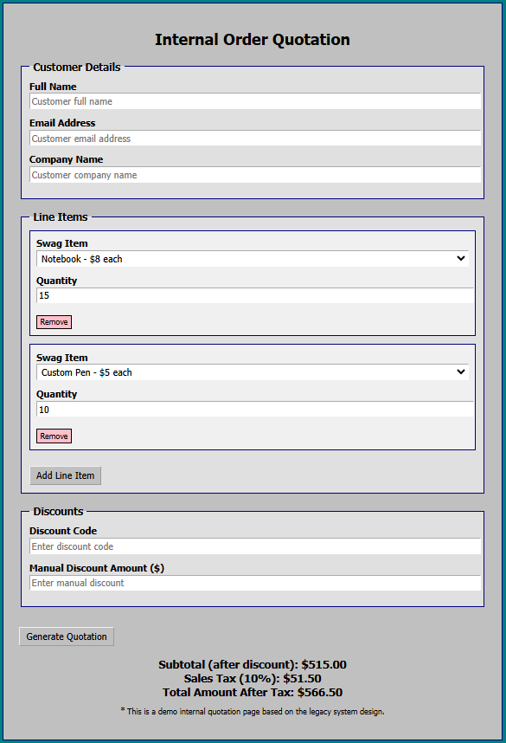
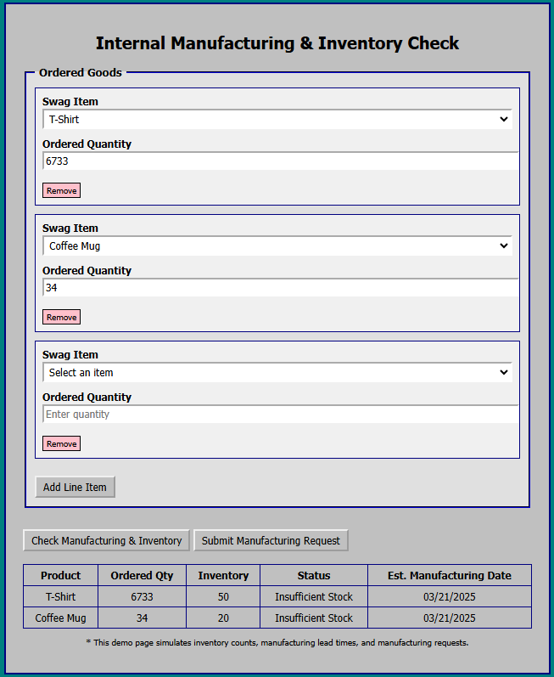
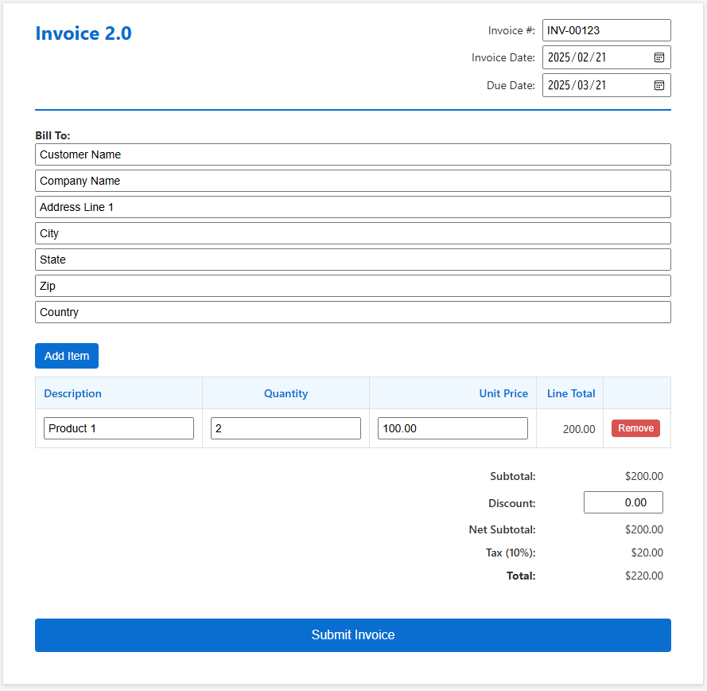
Order Processing – Before Automation
K4
CLARITY
Customer
Checks quote details
Email
Order
Phone
Order
Web
Order
Email back and forth for missing details
Quote confirmation
Order confirmation
Customer services representative
Lookup customer discount code and conditions from OneNote
Manually enter quote
Manually enter internal manufacturing system to checks estimated manufacturing date
Creates PDF quote with Word and estimates email to customer
Lookup Order # and submit manufacturing order
Sends order confirmation email
Enters sales invoicing details in a SaaS product
Systems used

Slide 18


Thinking Through The Business Process
K4
CLARITY
Customer
Checks quote details
Email
Order
Phone
Order
Web
Order
Agent gathers from customer on required order info
Quote confirmation
Order confirmation
Approval
to quote
Approval to manufacture
Customer services representative
Sales agent triggered, determines order info is fulfilled, and triggers cloud flow
Unattended desktop flow copies internal order details to manufacturing system
Order agent sends order confirmation email
Quote agent sends PDF quote and estimates email to customer
Order agent triggered, triggers desktop flow
Systems used
Generative Actions look up company discount code document
Agent flow creates quote PDF
Desktop flow submit manufacturing order

Slide 19



Change In How We Develop
K4
CLARITY
1-2W
2W
1W
Takes time to first MVP
Rebuild required from first version
Limited scope
Last FY
Requirements gathering
Dev / Test iteration
Provide MVP agent

Slide 20
Results For FY26
K4
CLARITY
200+
Customers
450+
Agents
4-6W
to implement
Notes:
The great thing is — agents aren’t limited to one use case or industry.
Whether you’re in travel, retail, finance, healthcare, or government, there are opportunities to deploy agents that solve department-specific challenges.
For Zava’s supply chain, that might mean:
A Customer Service agent to handle common delivery questions.
An Operations agent to digitize paper processes and automate restocking.
A Finance agent to speed up expense approvals for urgent freight.
And all of these can work with your data securely, connecting to hundreds of systems and apps.
Let’s look at some real-world examples of agents built with Copilot Studio:
Supply Chain Management: Agents help optimize inventory and logistics.
Student Admissions: Agents streamline the admissions process for educational institutions.
Banking: Agents manage accounts and handle lost card reports.
Healthcare: Agents assist with health insurance claims.
Retail: Agents help customers with exchanges and support.
Childcare Assistance: Agents simplify the process for families seeking support.
Lead Generation & Bookings:Agents drive sales and manage bookings in travel and professional services.
These examples span every industry and department—government, retail, healthcare, finance, education, manufacturing, and more.
The key takeaway:Agents can be tailored to your unique business needs and data.

Slide 21


Change in how we develop
K4
CLARITY
1-2w
2w
1w
Takes time to first MVP
Rebuild required from first version
Limited scope
Old
Requirements gathering
Dev / Test iteration
Provide MVP agent
2-3days
3w
1w
MVP after first call
Reduced back and forth
More complex requirements
can be included
Reporting and documentation
are 90% automated
New
First MVP while gathering
AI assisted dev
More complex delivery

Slide 22

How Microsoft Learnings Accelerates Partners
K4
CLARITY
2-3days
3w
1m
New
First MVP while gathering
AI assisted dev
More complex delivery
Shared with select partners
Skills / Plugins
Playbook
Templates
Packaged blueprint

Slide 23
What Acuvate FDE is
FDE coverage across domain and platform responsibilities
Domain FDE
Domain specialists who identify high-impact Data & AI opportunities within business operations and help take them from use-case definition through production deployment.They bring strong industry knowledge, process understanding, and working knowledge of AI and engineering to shape solutions that are practical, relevant, and deployable
Domains: Manufacturing, CPG, Oil & Gas
Sub-domains: Asset Management, Operations & Control, Supply Chain Management
They bring
Use-case Discovery • Domain Context • Value Definition • Adoption • Business Outcomes
Channel Partner FDE | Platform FDE
Our Platform FDEs bring end-to-end technical expertise to architect, integrate, deploy, and operationalize enterprise Data & AI solutions.
Core platforms
Microsoft
Databricks
They bring
Architecture • Engineering • Integration • Deployment • Production Readiness
4
Notes:
Four defining characteristics. The pod is embedded, senior, production-oriented and accelerator-backed — not a staffing line item.

Slide 24








What Acuvate FDE is
K4
CLARITY
An embedded delivery model that compresses the distance between AI opportunity and production outcome — pairing domain-led value definition with full-stack production engineering in a single team.
Channel Partner FDE | Platform FDE
Domain FDE
Our Platform FDEs bring end-to-end technical expertise to architect, integrate, deploy, and operationalize enterprise Data & AI solutions — inside the customer's existing data, identity, and security estate.
Our Domain FDEs are domain specialists who identify high-impact Data & AI opportunities within business operations and take them from use-case definition through production deployment, backed by industry knowledge, process understanding, and working knowledge of AI and engineering.
CORE PLATFORMS
DOMAINS
Manufacturing
CPG
Oil & Gas
THEY BRING
SUB-DOMAINS
Architecture
Engineering
Integration
Deployment
Production Readiness
Supply Chain Management
Asset Management
Operations & Control
THEY BRING
Use-case Discovery • Domain Context • Value Definition • Adoption • Business Outcomes
Notes:
Partner logo frames: replace the Microsoft, Databricks and Cadmatic boxes with the official logo files. Frames are 1.6 x 0.62 inches, evenly spaced.

Slide 25
K4
CLARITY
Poll 2
Which area would your organization benefit from the most support in?

Slide 26
K4
CLARITY
The Forward Deployed Engineer: Required Skillset
TECHNICAL
NON TECHNICAL
Full stack build. Ships production code, not prototypes that stop at demo.
Workflow fluency. Reads how the work actually happens, not the documented process
Solution architecture: data modeling, integration, identity, security.
FDE
Product management. Sets scope, sequence, and what gets cut.
Production
Mindset
Interoperability by default. APIs and FHIR assumed from the first design.
Direct user facilitation. Puts an imperfect build in front of users and takes the reaction.
AI assisted development. The velocity that makes one person viable.
Governance literacy. Knows what will fail review before it is built.
Consulting, product management, and engineering in one person. Not an implementation consultant. Not staff augmentation.
Notes:
Frame the distinction early: an implementation consultant configures what exists; a forward deployed engineer designs, builds, and ships inside the customer environment.
The economics are role collapse. Product manager plus full stack engineer plus product owner, each roughly 160 to 180K, consolidated into one senior person. AI coding assistants are what make that possible now and did not a few years ago.
Disqualifier to name if asked: a strong engineer who will not sit with users is not a forward deployed engineer.

Slide 27
K4
CLARITY
The Small Team Around the Engineer
Dedicated
Part Time Or Shared
Forward deployed engineer. Architecture and build.
Security, privacy, and compliance reviewer.
Product manager. Scope, sequencing, stakeholder management.
Data and integration support for source systems.
Three to six end users. Clinical and administrative, with protected time.
IT operations for environment, access, and deployment.
Executive sponsor. Decision rights and removal of blockers.
The internal staff who will own the solution after handoff.
Reference point: one engineer and one product manager rebuilt a device workflow orchestrator in six months, iterating with a small user group until those users called it ready.
Notes:
Hanger example. Ground up rebuild replacing an antiquated architecture. One forward deployed engineer architected the whole solution, one product manager, and a small group of clinicians and admin staff reacting to prototypes.
The team is deliberately small. Every additional voice adds a translation layer, and translation layers are what the model is designed to remove.
Key person risk question will come up. Answer: the deliverable is a support and change management team plus an ongoing capability, not a codebase. Name the owners at kickoff, not at handoff.

Slide 28
K4
CLARITY
The Last Mile: Why Healthcare AI Stalls Before Production
Where Deployments Stop
What Closes It
The model works. The workflow does not.
Requirements written before anyone has seen a working version.
EHR and data constraints discovered late, after the design is set.
Clinician time spent specifying instead of reacting.
No named owner for production support once the pilot ends.
Build alongside the EHR. Read from the record, write back only where sanctioned.
Modular, composable, extensible, scalable. Nothing solutioned in isolation.
Governance runs inside the build, not as a gate at the end.
Iterate on working software until the users say it is ready.
Example: CARA – Ambient clinical documentation weaved into the EHR Workflow
Notes:
Thesis: the complexity of the healthcare environment is the reason the last mile exists. Regulatory constraints, episodic care, role based workflow, and an EHR you do not control.
Regulatory speed does not come from moving faster around governance. It comes from an operating model with governance built in so review is continuous rather than terminal.
On clinician time: the forward deployed difference is bringing an imperfect prototype for users to react to rather than spending their scarce time on requirements from scratch. Reaction is cheaper than specification.

Slide 29
K4
CLARITY
What the Organization Must Do
01
PREPARE
02
SUPPORT
03
SUSTAIN
Look inside first. The best candidate is often already on staff.
Protect user time for weekly iteration. Treat it as committed capacity.
The deliverable is capability, not code.
Name the sponsor and the decision rights before the build starts.
Run compliance and security review in parallel with the build.
Name support and change management owners at kickoff.
Open the environment early: data access, sandbox, security review path.
Let the engineer talk to users directly. without a proxy
Upskill internal staff to run the solution before handoff.
Scopeto one workflow, end to end.
Measure adoption and user sentiment, not story points.
If the engineer is external, define the exit on day one.
The model fails on organizational readiness far more often than on engineering talent.
The model fails on organizational readiness far more often than on engineering talent.
Notes:
This is the point most likely to be underweighted on the panel. Organizations recruit for the engineer and neglect the conditions that let the engineer work.
If you go outside, define the exit at the start and upskill internal staff to support the solution after the engineer leaves. An engagement with no defined exit becomes a dependency.
Closing line if needed: the forward deployed model is not a staffing change, it is an operating model change.

Slide 30
K4
CLARITY
What Acuvate FDE is​
An embedded delivery model that compresses the distance between AI opportunity and production outcome — pairing
domain-led value definition with full-stack production engineering in a single team.​
Channel Partner FDE | Platform FDE​
Domain FDE​
Our Platform FDEs bring end-to-end technical expertise to architect,
integrate, deploy, and operationalize enterprise Data & AI solutions —
inside the customer's existing data, identity, and security estate.​
Our Domain FDEs are domain specialists who identify high-impact Data &
AI opportunities within business operations and take them from use-case
definition through production deployment, backed by industry knowledge,
process understanding and working knowledge of AI and engineering.​
THEY BRING​
DOMAINS​
Manufacturing
CPG
Oil & Gas
THEY BRING​
SUB - DOMAINS​
Architecture​
01
Asset Management​
Supply Chain Management​
02
Engineering​
Operations & Control​
Integration​
THEY BRING​
Deployment​
Integration​
Use-case Discovery • Domain Context • Value Definition • Adoption
• Business Outcomes​
Production Readiness​

Slide 31

The FDE Engagement Model​
K4
CLARITY
A small customer-edge team backed by Acuvate's engineering core and IP layer.​
01
CLIENT TEAM​
ACUVATE FDE​
03
ACUVATE CORE​
02
Executive sponsor​
AI & agent engineering​
Domain Proficiency​
Product owner​
Data & platform​
Business SMEs​
Data Proficiency​
Integration​
IT & security​
AI Proficiency​
UX & product design​
Data owners​
Security, DevOps, IP​
Acuvate IP & Accelerators​
​
Agent Factory | Data Contextualization | Data Engineering​
​

Slide 32
K4
CLARITY
Acuvate IP And Accelerators
The FDE pod does not start from a blank page.
AI and Agentic templates
Integration patterns
Data & ontology accelerators
Reusable implementations of Knowledge search, workflow automation, claims, maintenance and field-service agents.
ERP, CRM, D365, Salesforce, ServiceNow, Workday, SAP, APIs and data platforms.
Data Engineering, Semantic layers, data products, equipment/product/process models and knowledge structures.
Eval & AgentOps framework
Security toolkit
Adoption assets
Test sets, rubrics, monitoring, prompt/version governance, telemetry and runbooks.
Identity, access, audit, data controls, approval flows and production readiness.
User journeys, training, feedback loops, support model and KPI dashboards.
ACUVATE | FORWARD DEPLOYED ENGINEERING
6
Notes:
Six asset families the pod draws on from day one. This is the difference between a blank-page build and an accelerated one.

Slide 33












K4
CLARITY
The Accelerators You Inherit On Day One
AcuSignal
INDUSTRIAL ASSET INTELLIGENCE ACCELERATOR
Turn enterprise data into measurable business value with a proven framework
Connect plant data & drawings with AI for smarter asset operations
Simplify enterprise migrations to Microsoft Fabric quickly
Build scalable enterprise AI agents and intelligent automation
Acunow
ENTERPRISE EDGE PLATFORM
Harness the Collective Knowledge of Your Organization
Enable real time AI ML processing and intelligent edge operations
Digitize P&ID diagrams with AI insights for smarter operations
Centralize data, isolate tenants, and scale secure multi-tenant apps on MS Fabric
AcuCortex
ENTERPRISE ONTOLOGY ACCELERATOR
Unify enterprise data platform to scale innovation and transform operations
Automate enterprise migrations with governance and speed
Strengthen governance with AI insights and enterprise compliance
Turn enterprise knowledge into AI-ready business context

Slide 34
K4
CLARITY
How IP Is Leveraged During An FDE Engagement
Accelerators speed up the work, but the client receives a tailored production capability.
Fit
Extend
Map Acuvate patterns to the client workflow and systems.
Customize for client process, data, users and governance.
02
04
FDE build
Client problem
01
03
Vertical slice to production
Workflow, data, constraints
Configure
Productionize
Use templates, connectors, data models and eval packs.
Add security, telemetry, AgentOps, runbooks and adoption.
Acuvate brings reusable IP to reduce risk and time-to-value, but avoids lock-in by fitting the solution to the client's chosen platforms and controls.

Slide 35
K4
CLARITY
Commercial offers
Package FDE as outcome-oriented services, not rate-card staffing.
3–4 weeks
8–12 weeks
Quarterly
6–12 months
FDE Value Sprint
FDE Deployment Pod
Embedded FDE
Enterprise FDE Program
Working vertical slice, value case and production path.
Production capability with identity, data, integrations, telemetry and adoption.
Persistent FDE capacity for priority workflows.
Multiple pods across plants, functions or regions.
Best for
a first engagement
Best for
a proven workflow
Best for
continuous demand
Best for
multi-site rollout
Recommended first ask: one high-value workflow where speed, ambiguity and adoption all matter.
ACUVATE | FORWARD DEPLOYED ENGINEERING
13
Notes:
Lead with the Value Sprint. The other three are expansion paths, not alternatives to open with.

Slide 36
K4
CLARITY
Industry-led Use Cases, Accelerator-backed Delivery
Position the wedge by business problem, then show the IP that accelerates delivery.
Manufacturing
Healthcare
Acuvate IP - AcuPrism, Diagram IQ, AcuSignal
Acuvate IP - Ambient Listening, Healthcare agents
Energy & Utilities
CPG / BFSI
Acuvate IP - AcuPrism
Acuvate IP - AcuPrism, Diagram IQ
The platform need not be Microsoft Only — it can be a hybrid stack with Palantir, OpenAI, Salesforce, Google, AWS or Databricks. The offer is defined by the outcome, not the tech stack
ACUVATE | FORWARD DEPLOYED ENGINEERING
15
Notes:
Open with the business wedge for the client's industry, then bring in the matching accelerator set.

Slide 37
K4
CLARITY
Recommended Next Step
One workflow, one sponsor, one sprint — and a working capability at the end of it.
Run a 3–4 week
FDE Value Sprint
SPRINT OUTPUTS
Workflow map
Working vertical slice
Start with a ninety-minute session: bring three candidate workflows and the people who own them, and we leave with a scored shortlist. One workflow then goes into the Value Sprint, where a Deployment Strategist, Principal FDE and the accelerator library produce a working vertical slice and a production roadmap.
Architecture and security path
KPI and value case
Production roadmap
Ask: one workflow and one executive sponsor.
Reusability assessment
ACUVATE | FORWARD DEPLOYED ENGINEERING
18
Notes:
Single ask. Do not leave the room without a named workflow and a named sponsor.

Slide 38
K4
CLARITY
Poll 3
How Soon Do You See Your Organization Adopting A Forward-deployed Engineering Model?

Slide 39


Slide 40






Session-presented by
K4
CLARITY
THANK YOU
We are a global player in next-generation digital solutions & services that modernize, automate and transform enterprise applications. With over 19+ years of experience, we have been enabling our clients globally to steer their digital transformation strategy using Cloud, Data & AI. We build & develop smart & sustainable solutions to help our customers transform their conventional processes to match the next-generation technological trend.
We have a strong presence in the US, Europe, and Middle East, where we serve multiple ultra-large customers as well as SMBs from various sectors such as Public Sector, CPG, Retail, Oil & Gas, Energy, Manufacturing, BFSI, Healthcare, etc.
Contact: advisors@acuvate.com

Slide 41
What Acuvate FDE is
Channel Partner FDE
Tech FDE who have E2E knowledge of the Full Stack Data & AI applications in Production
Microsoft
DataBricks
Domain FDE
Deep Domain experts that can take care of discovering high impact Data & AI use cases to taking them to production. They are proficient
with understanding of AI tools and Engineering.
Domains: Mfg, CPG, Oil n Gas
Sub Domians: Asset management, Operations & Control, SCM,
ACUVATE | FORWARD DEPLOYED ENGINEERING
4
Notes:
Four defining characteristics. The pod is embedded, senior, production-oriented and accelerator-backed — not a staffing line item.

Slide 42
K4
CLARITY
The FDE Engagement Model
A small customer-edge team backed by Acuvate's engineering core and IP layer.
CLIENT TEAM
ACUVATE FDE
ACUVATE CORE
Executive sponsor
Use Case Discovery
AI & agent engineering
Product owner
Data & platform
Decision Intelligence
↔
↔
Integration
Business SMEs
Data & AI Proficiency
UX & product design
IT & security
Security, DevOps, IP
Data owners
↔
↔
Acuvate IP & Accelerators
Agent Factory | Data Contextualization | Data Engineering
ACUVATE | FORWARD DEPLOYED ENGINEERING
9
Notes:
Three-layer picture. Emphasise the single point of accountability in the middle column.

Slide 43
K4
CLARITY
How IP is leveraged during an FDE engagement
Accelerators speed up the work, but the client receives a tailored production capability.
1
2
3
4
Fit
Configure
Extend
Productionize
Client problem
›
›
›
›
›
FDE build
Workflow, data, constraints
Map Acuvate patterns to the client workflow and systems.
Use templates, connectors, data models and eval packs.
Customize for client process, data, users and governance.
Add security, telemetry, AgentOps, runbooks and adoption.
Vertical slice to production
Acuvate brings reusable IP to reduce risk and time-to-value, but avoids lock-in by fitting the solution to the client's chosen platforms and controls.
ACUVATE | FORWARD DEPLOYED ENGINEERING
8
Notes:
Use this to pre-empt the lock-in objection. Accelerators shorten the path; the delivered capability is the client's, on the client's stack.

Slide 44

Learnings From FDE
Taiki Yoshida
Principal PM Manager
Copilot & Agent Platform

Slide 45
What we provide and do
Empowered AI Strategy
Guidance, Best Practices & Support
Envision High Value Scenarios
Architect & Build Quality POC Solutions
Product Feedback & Improvement
Microsoft demonstrates how to go from the “Art of the Possible” to the “Art of the Practical” with M365 Copilot and extensibility
Microsoft can help your makers, builders, & developers learn the right skills and best practices for agent implementation
Microsoft-hosted Discovery & Envisioning sessions help you identify, prioritize and scope high value scenarios to build
Microsoft will help customers build MVP* for personal, productivity, enterprise and Line of Business scenarios.
Provide a direct feedback channel to Copilot Extensibility and Copilot Studio engineering teams

Slide 46
240
54

Slide 47
240
54
Nominations
Qualified

Slide 48
Why?

Slide 49
Agents Require Use Cases

Slide 50
Agent Archetypes
Knowledge search and retrieval
Document Analysis and comparison
Content generation and editing
Trigger-based automations
Workflow orchestration
Meeting intelligence and actions
Knowledge curation
Agent examples:
Policy search, standard operating procedure search
Analyze meeting effectiveness, including participant engagement
Create competitor battle card for sales teams, from disparate sources
Legal document review/comparison
Customer sales proposal creation
IT/HR support ticket triage and routing
New hire onboarding
Executive support for Q&A, executive briefings
Compare supplier agreement with standard template
Store walk / operating procedures
Summarize leadership meetings with clear decisions and actions
Curate customer Q&A knowledge, extract common answers
Weekly newsletter update
Incoming mail triage and reply
Pre-meeting briefing or deal briefing summary
Summarize regulatory filing for top risks
Press release or media plan creation
Automate creation of project tasks based on meeting actions
Employee safety incident reporting
Consolidate post-mortem reports of past incidents
Analyze/provide sentiment from customer feedback
Define job description following company template
Knowledge pack for new hires from disparate sources
Expert skills finder
Employee assist and workflow automation

Slide 51
Thinking through the business process
What is the task?
Who is doing the work?
What activities are being performed?
What data is needed, created or edited?
What decisions, approvals, or rules are there?
Visually mapping the process
How often is it done?
Where are they doing it?

Slide 52
Thinking through the business process
What is the task?
Actions
What activities are being performed?
Agent Flow
What decisions, approvals, or rules are there?
Triggers
How often is it done?
Credentials
Who is doing the work?
Knowledge
What data is needed, created or edited?
Instructions
Visually mapping the process
Where are they doing it?
Channel

Slide 53
Order processing – before automation
Customer
Checks quote details
Email
Order
Phone
Order
Web
Order
Email back and forth for missing details
Quote confirmation
Order confirmation
Customer services representative
Lookup customer discount code and conditions from OneNote
Manually enter quote
Manually enter internal manufacturing system to checks estimated manufacturing date
Creates PDF quote with Word and estimates email to customer
Lookup Order # and submit manufacturing order
Sends order confirmation email
Enters sales invoicing details in a SaaS product
Systems used

Slide 54
The “real” skeleton of an agent
ROI
Measurable value
User experience (optional)
Agents
Orchestrator
Knowledge
Grounding and memory
Requirements
What, when & where
Tools
Your LOB applications and APIs
Process
What is the process today?
Autonomy
Planning, exceptions, etc.
Goal
What are we trying to achieve?
Foundation models
The business
The solution

Slide 55
The technical skeleton of an agent
User experience (optional)
Agents
Orchestrator
Knowledge
Grounding and memory
Tools
Your LOB applications and APIs
Autonomy
Planning, exceptions, etc.
Foundation models

Slide 56
Order processing – Agentic Automations
Customer
Checks quote details
Email
Order
Phone
Order
Web
Order
Agent gathers from customer on required order info
Quote confirmation
Order confirmation
Approval
to quote
Approval to manufacture
Customer services representative
Sales agent triggered, determines order info is fulfilled, and triggers cloud flow
Unattended desktop flow copies internal order details to manufacturing system
Order agent sends order confirmation email
Quote agent sends PDF quote and estimates email to customer
Order agent triggered, triggers desktop flow
Computer Use Agents enters sales invoicing details in a SaaS product
Systems used
Generative Actions look up company discount code document
Agent flow creates quote PDF
Desktop flow submit manufacturing order

