Slide 1


Manufacturing & Process Industries / Asset Management
INDUSTRY TRACK SESSION
Industrial AI for Smarter Manufacturing Operations
Presented by
Time
14:00–14:45 CEST | 08:00–08:45 EDT
Date
16 / 09 / 26
Notes:
COVER SLIDE. Replace the session title, date, time, partner names and the two speaker blocks. Drop headshots into the grey photo squares (right-click > Change Picture). Keep the CORESHIFT 2026 lockup untouched.

Slide 2






Your speakers
Meet the team presenting this session
Logan Finke
Johan Krebbers
Principal AI Data Architect
Chief Technology Officer

Slide 3









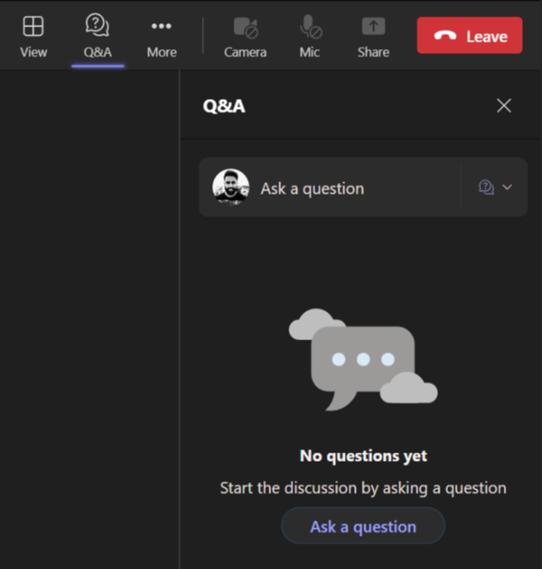
Housekeeping – Asking speaker a question
We want to hear from you!
Please submit your questions. We’ll reserve time for Q&A at the end of the webinar.
1
To submit questions, click on the Q&A at the top right corner
2
Clicking on the Q&A icon will open a window where you can type your question.
3
Click on the ‘Ask a question’ button & type your question.

Slide 4
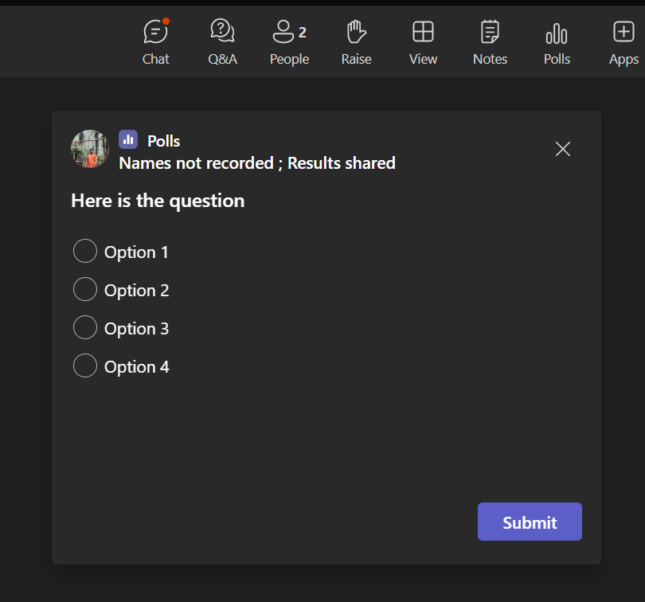
Housekeeping -Participating in Polls
Your opinion is valuable to us!
Please take part in our polls to help us understand your views.
1
Submit Your Vote:
A new window will pop up with the poll question.
Choose your answer from the provided options
2
Confirm Your Selection:
After selecting your option, make sure to hit the 'Submit' button to record your response..

Slide 5




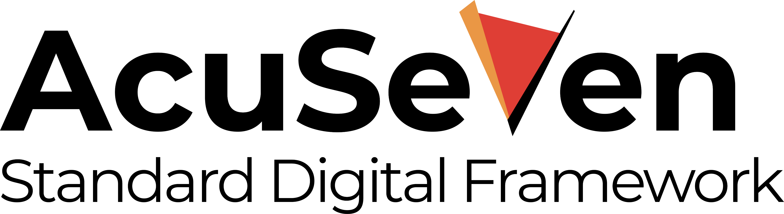

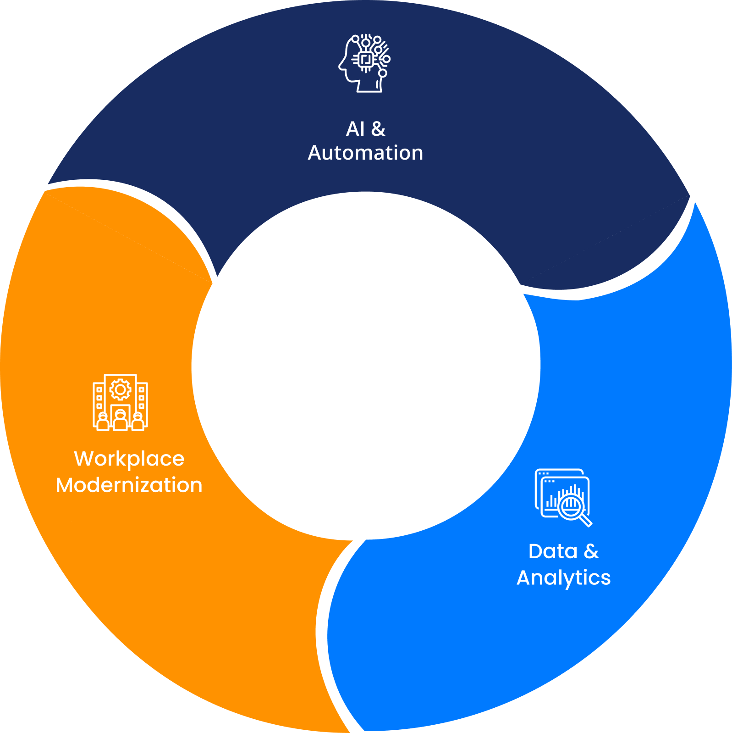





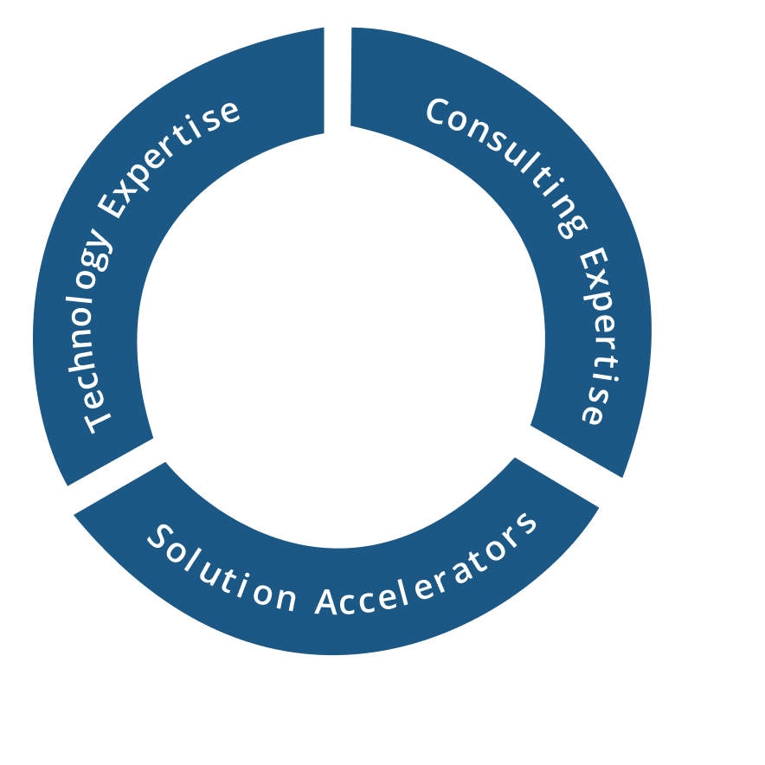
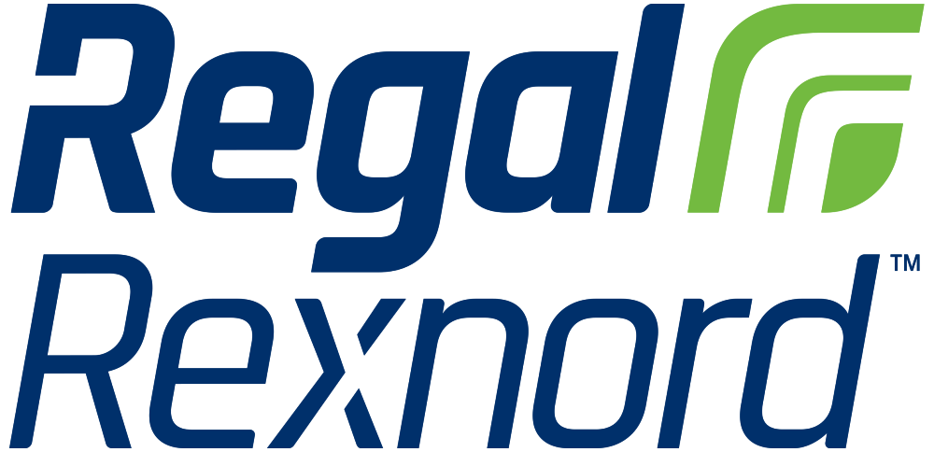



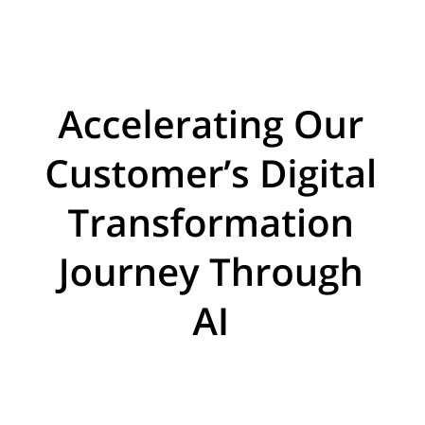


















About Acuvate
Acuvate is a global player in next-generation digital solutions & services that modernize, automate and transform enterprise applications. With over 19+ years of experience, we have been enabling our clients globally to steer their digital transformation strategy using AI, Data & Cloud.
ACCELERATORS
TRUSTED BY 200+ ENTERPRISES WORLDWIDE INCLUDING SEVERAL FORTUNE 500
Manufacturing
Our Focus
CPG, Retail
Oil & Gas,
Energy
Healthcare and Life Sciences
BSFI
Government
19+
Years in the Industry
500+
Multi-Skilled Professionals
3 Continents, 7 offices
North America, Europe, Asia
Travel and Hospitality / Others

Slide 6

Poll 1
Where Are You Today
With Industrial AI?

Slide 7



About Eastman
Fortune 500 specialty materials company with 2025 revenue of ~$8.8 billion
Global manufacturer and marketer of advanced materials and specialty additives operating in four business segments
Global team of ~13,000
Serves customers in >100 countries
We feel a responsibility to deliver products that are needed for society and are better for the planet.
Principal AI Data Architect on Eastman's Generative AI team
Before this role, the past eight years was spent architecting and delivering scalable data solutions in Data Science Operations and Commercial BI.

Slide 8
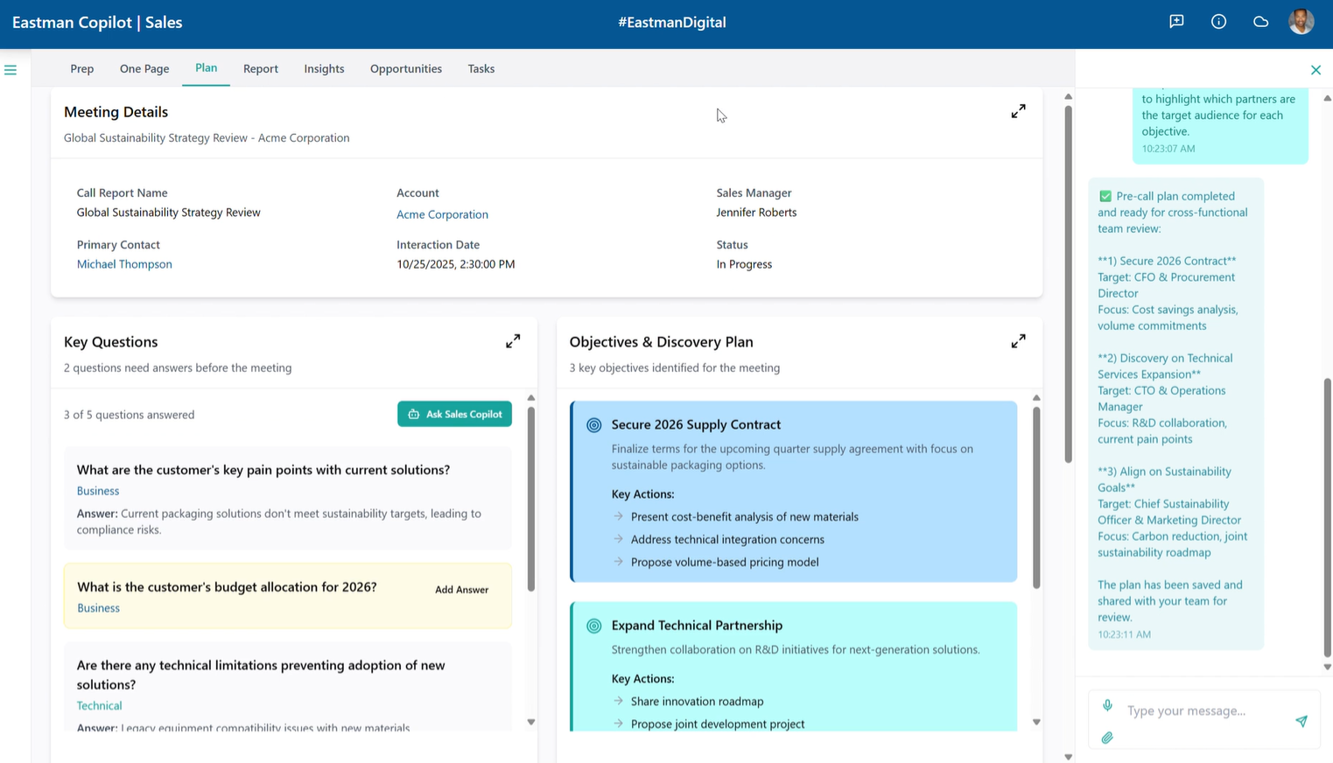
Use Case: Eastman Sales Copilot
Features:
Voice first allows sellers to just speak into their device as they prepare for meetings
Dynamic dashboards are populated based on this input
Search agent can perform hybrid search on previous call text
Salesforce integration enables closed-loop writeback with clean and organized call details
Entra security enables app to only show what user should see

Slide 9
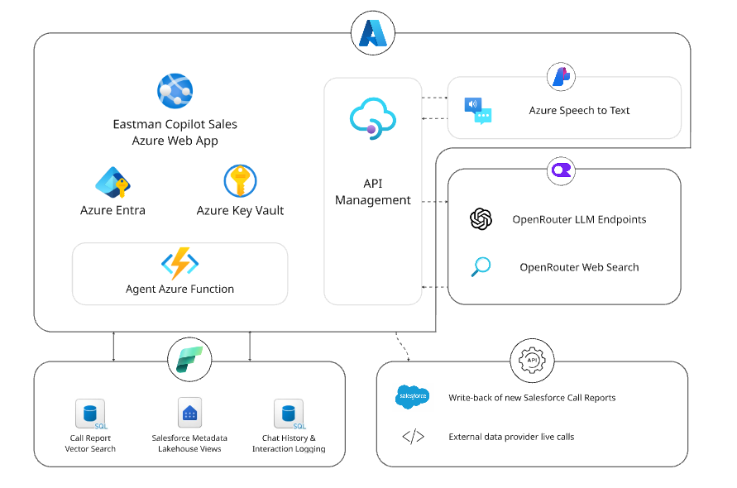
High Level Architecture
Azure Components
Azure Web App to host the app
AI Foundry for speech to text service
API Management enables load-balancing and endpoint access management
OpenRouter
LLM Endpoints
Web Search
Fabric Components
SQL Database in Fabric for vector storage, hybrid search, and logging
Lakehouse & Shortcuts
Pipelines & Notebooks

Slide 10
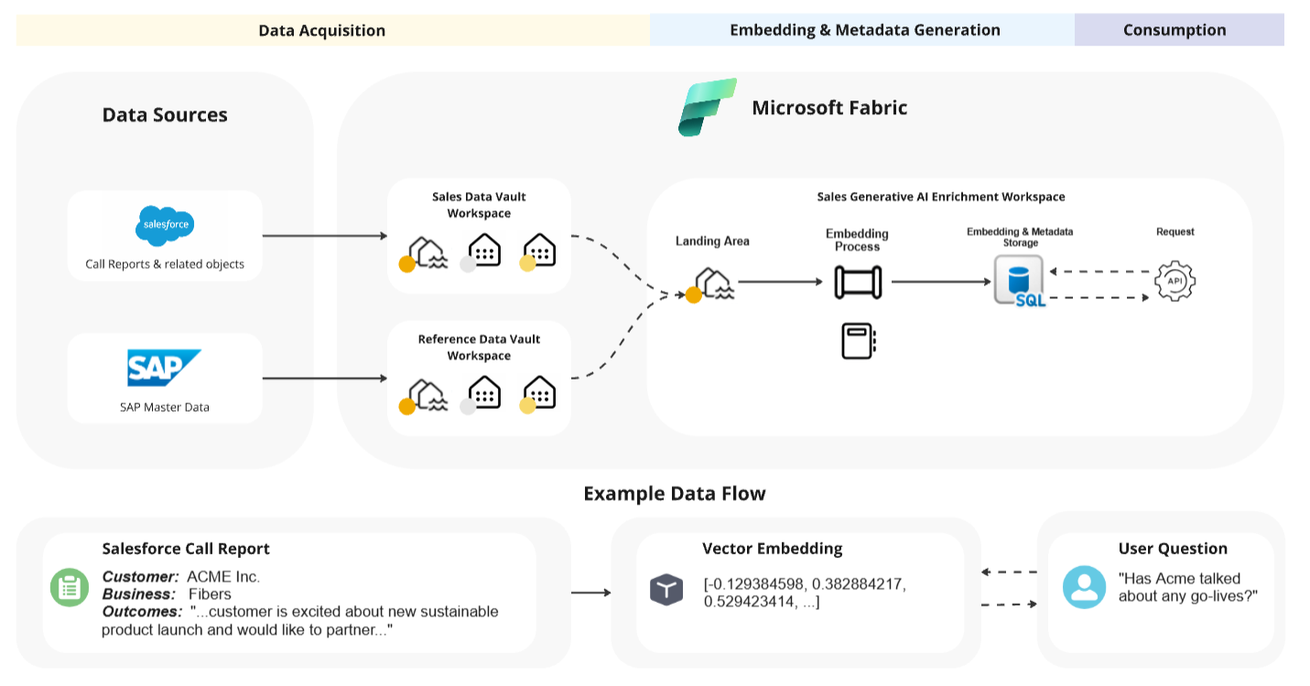
End-to-end Fabric Flow

Slide 11
Poll 2
Which Manufacturing Use Case Is The Biggest Priority For You Right Now?

Slide 12








What is the problem we are trying to solve?
CLARIFICATION
CHALLENGE
In our world, Digital is the combined exploitation of Data, Industrial AI, various AI flavours, Agents, Ontologies & Digital Twins driving your business ROI.
For business decision makers at any level, we make all data accessible — then let them ask, in their own business language, any question to improve current and future performance.
To make that possible we add an Ontology — what does this mean?
Business Structure
Familiar Language
What-If Analysis
Industrial AI View
Your business structures & dependencies are defined in your Ontology.
Business users work in the language they know — not what IT imposes.
Ask 'what if': changes in production levels, impact of logistics blockages, etc.
Ontology fully exposes your Industrial AI status and opportunities.
Growing Data
Past to Future
Accessible to All
Start Small
Over time, more relevant (external) data sources can be added.
Questions can cover the past, current and future of your business.
Reachable by business users, agents, dashboards, digital twins & copilot.
Begin where you have most issues — start small and grow stepwise.

Slide 13














: For digitizing Manufacturing
Manufacturing Plants
Manufacturing Operations · Maintenance · Engineering · Finance · Logistics — users
Working the end to end story
Complete story from collecting data, manipulating & storing data, Applying AI and showing the results in several different ways.
Proving end to end installation and configuration services.
Providing ongoing support (SLA) based services.
Software runs on your MS Azure cloud subscription and that means that data is under your control all the time.
Industrial AI is an important element where data is streaming and other data is collected and AI applied at the edge in case of (near) realtime decision making.
With supporting Industrial AI we of course also recognize OT.
Cadmatic eShare
Digital Twins
Copilot
Power BI
Coworker
Agents
Access to
AI flavours
Industrial AI
Advisory setpoints for OT
Various data types from production lines
Weather
Logistics
Ontology Services — including Planning
ML · MV
Gen-AI · LLM
Bi-directional
Enterprise Data & AI Platform
DiagramIQ
Business data · Documentation platform(s) · Websites with
relevant information · Messages / Teams / etc.
All relevant internal business applications
All relevant external business applications

Slide 14





: For digitizing Manufacturing
Manufacturing Plants
Manufacturing Operations · Maintenance · Engineering · Finance · Logistics — users
What can we do to get to the right data?
Access OT data such as PI Historian timeseries. → Drives Industrial AI
Cadmatic eShare
Digital Twins
Copilot
Power BI
Coworker
Agents
Access to
AI flavours
Select, install & configure the right sensors so relevant data is collected. → Drives Industrial AI
Industrial AI
Advisory setpoints for OT
Various data types from production lines
Weather
Logistics
Ontology Services — including Planning
ML · MV
Gen-AI · LLM
Robotics & drones reach hard-to-access locations. → Drives Industrial AI
Industrial AI deployed at the edge for real-time decisions.
Bi-directional
Enterprise Data & AI Platform
DiagramIQ
Business data · Documentation platform(s) · Websites with
relevant information · Messages / Teams / etc.
Camera images & AI Machine Vision open a broad spectrum of opportunities. → Drives Industrial AI
All relevant internal business applications
All relevant external business applications
We understand the networking different flavours and how to connect.

Slide 15


Industrial AI (AcuNow / AcuSignal accelerators)
Support for multiple AI deployment options
MS Fabric — Real-Time Intelligence
MS Azure IoT Operations
High-speed throughput of small sensor messages, with various AI options running natively on MS Fabric.
High-speed handling of very large messages such as camera images — Machine Vision options run on edge devices for real-time action.
AcuSignal
Agents
Coworker
Acuvate AcuPrism
Agent-based Solutions
High-speed streaming of OT-based Aveva (OSIsoft) PI data direct from PI Gateways into AcuPrism (MS Fabric or Databricks), where AI activities apply immediately. Many PI Gateways can stream to one enterprise AcuPrism.
Development of various Agent-based solutions supporting Industrial AI business workflows.

Slide 16

: For digitizing Manufacturing
Manufacturing Plants
Manufacturing Operations · Maintenance · Engineering · Finance · Logistics — users
What is the importance of AcuPrism our Enterprise Data & AI Platform
The place to get your asset tag naming conventions aligned; Indeed Look at our accelerator DiagramIQ
The place to address any data quality issue (bronze / silver / gold)
It is where you develop, train and run your AI models such as for OEE, Predictive Maintenance and many other scenarios
It is where you bring together your various data sources to get them ready for your ontology services
Datamodels such as ISA95 preloaded
Indeed Information Security needs to be in place end to end
Cadmatic eShare
Digital Twins
Copilot
Power BI
Coworker
Agents
Access to
AI flavours
Industrial AI
Advisory setpoints for OT
Various data types from production lines
Weather
Logistics
Ontology Services — including Planning
ML · MV
Gen-AI · LLM
Bi-directional
Enterprise Data & AI Platform
DiagramIQ
Business data · Documentation platform(s) · Websites with
relevant information · Messages / Teams / etc.
All relevant internal business applications
All relevant external business applications

Slide 17


acuvate’s industrial intelligence data & AI platform - master
Data Sources
On-Prem & Cloud
MSD Azure IOT Operations
Data Lakehouse on Cloud
Application and Services
Inform Decision Makers/Support Decision making
M
U
L
T
I
P
L
E
P
L
A
N
T
S
MS Fabric IQ / Foundry IQ / Work IQ / Web IQ
M
U
L
T
I
P
L
E
P
L
A
N
T
S
OT Data
(Historian, SCADA, DCS)
Batch Processing
Portal / Dashboarding
Copilot
(includes Gen-AI)
Edge AI/Applications
GenAI
AI-ML
Reports and Dashboards
Internal Data (Owned)
Data Governance, Security and Compliance
Data Strategy, Domain Consulting, Technology & Analytics Consulting
Enterprise Data Architecture
Program and Change Management
Insights Serving Layer through Integration
GenAI
Data Chat Bots
3rd Party Data
Realtime Streaming
Edge Management
Raw
Clean
Curated
AI-MV
Gen-AI
Unstructured Data
PowerBI
Digital Twins
Contextualisation
Qualitative Data
Edge Cloud
Analytics application
Intelligent App
(including XR)
Model Deployment from Edge on Cloud
Real time Alerts
Data Catalog with Active Metadata Management
Data Observability and Data Operations

Slide 18
: For digitizing Manufacturing
Manufacturing Plants
Manufacturing Operations · Maintenance · Engineering · Finance · Logistics — users
DiagramIQ Accelerator & MS MarketPlace apps versions
Every Manufacturing site will have multiple assets such as engines, pumps, botteling lines, valves, etc. All of these assets need to be located for maintenance and other reasons. Here Tag-Ids make the difference.
Therefore an uptodate Enterprise Tag-ID Registry, which can be fully trusted, is very important.
In addition offer good facilities for (bulk) loading of P&ID various engineering files. As part of the loadign we use AI to scan all files and digitize the P&ID files.
Indeed we exploit Co Pilot to give easy access to all information
Overall DiagramIQ assists to minimize time wasted to locate information.
P&ID capabilities iexplained n the latter part of this presentation
Cadmatic eShare
Digital Twins
Copilot
Power BI
Coworker
Agents
Access to
AI flavours
Industrial AI
Advisory setpoints for OT
Various data types from production lines
Weather
Logistics
Ontology Services — including Planning
ML · MV
Gen-AI · LLM
Bi-directional
Enterprise Data & AI Platform
DiagramIQ
Business data · Documentation platform(s) · Websites with
relevant information · Messages / Teams / etc.
All relevant internal business applications
All relevant external business applications

Slide 19
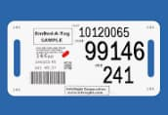
Background information to Energy / Manufacturing plants
Energy / Manufacturing assets are the physical and digital resources essential for production, including machinery, tools, facilities, and even skilled people,
Every Manufacturing plant has a large number of assets such as:
  Engines
  Pumps
  Conveyor belts
  Bottling lines
  Compressors
  Turbines
Every asset has an Tag-ID which is a unique identifier for tracking and connecting equipment
Several different types of drawings (Electrical / Instrumentation / Cabling / Safety / etc.) describe the facilities of an Manufacturing plant with a special role for P&ID (Piping & Instrumentation Diagrams): Detailed schematic in the process industry that shows the physical layout of pipes, equipment (like pumps, vessels, valves, tanks), and the instrumentation used for control (sensors, transmitters, controllers) within a process system, illustrating the flow of materials and control logic for operations, design, and maintenance.
Be aware that a typical factory might have over 10,000 technical drawings + all supplier documentation: Instrumentation; Cabling; Safety; Electrical; etc.
Also in Medical / Life sciences manufacturing facilities (assets) are used and therefore DiagramIQ is applicable

Slide 20
Problem statement: Issues experienced by Manufacturing companies when managing their assets
Often multiple Tag registries in place all of which are incomplete and not aligned:
→ In Excel, etc.
Tag registries have no uptodate information in what drawings each Tag id is used.
Engineers are unable to find the relevant drawing(s) for a given Tag id.
P&ID (Piping & Instrumentation Diagram) information is not available in digital format.
Tag information is stored in EXCEL spreadsheets and there are no controls who can update what.
Information in your Technical Drawing Management System (EDMS) is not aligned with your Tag Registry system.
Unable to scan your technical drawings for Tag information.
To find the updated information lots of time is wasted by your maintenance staff
→ Over 30%.
It is a safety risk for the plant.

Slide 21
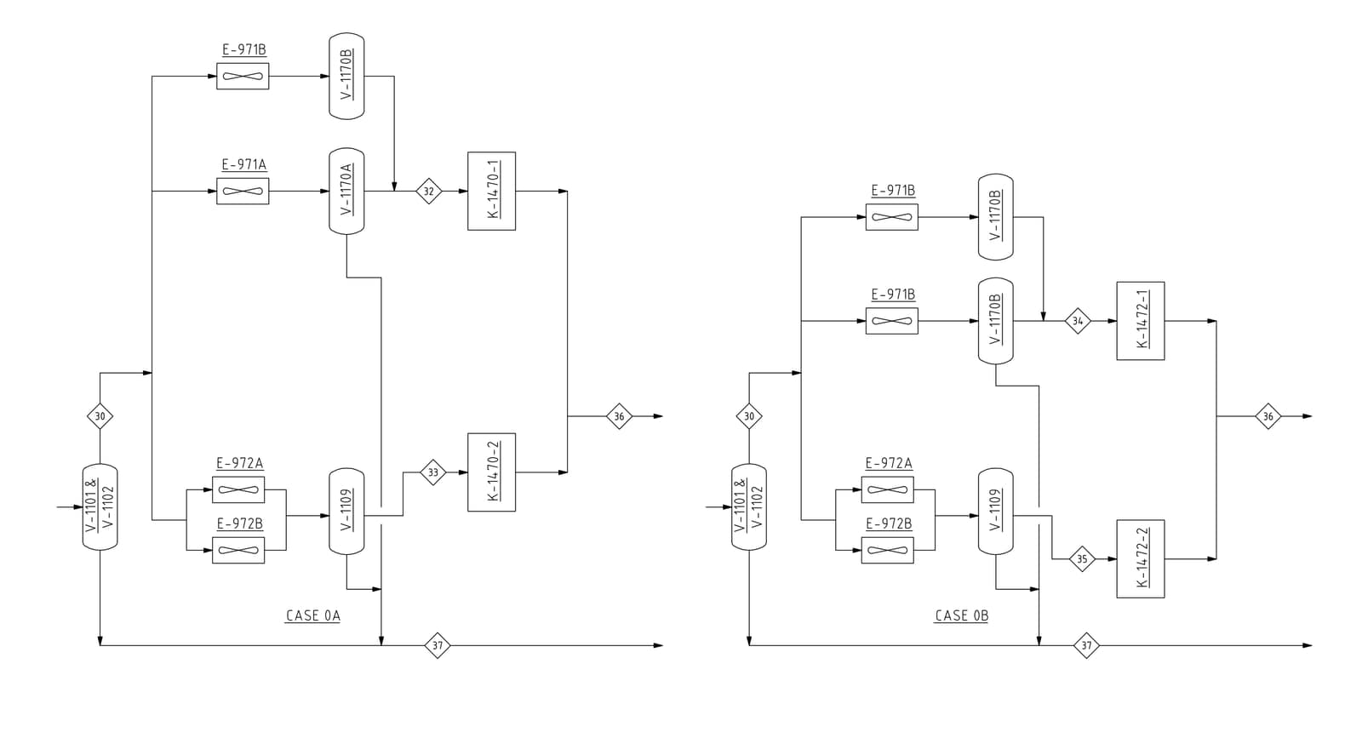
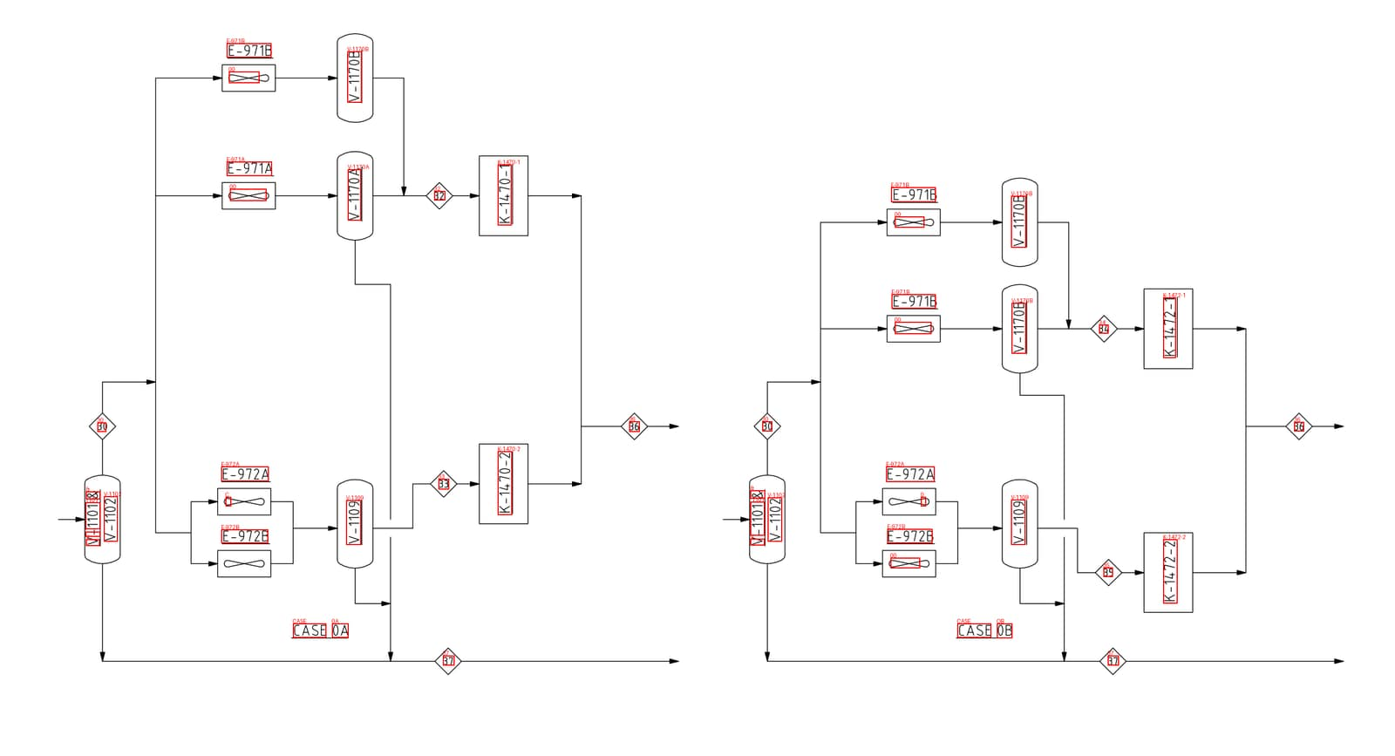
P&ID: Example
TAG | P&ID
E-971B | A4001-0004_00
V-1170B | A4001-0004_00
E-971A | A4001-0004_00
V-1170A | A4001-0004_00
K-1470-1 | A4001-0004_00
E-971B | A4001-0004_00
V-1170B | A4001-0004_00
E-971B | A4001-0004_00
V-1170B | A4001-0004_00
K-1472-1 | A4001-0004_00
E-972A | A4001-0004_00
33 | A4001-0004_00
K-1470-2 | A4001-0004_00
E-972A | A4001-0004_00
V-1102 | A4001-0004_00
V-1109 | A4001-0004_00
E-972B | A4001-0004_00
V | A4001-0004_00
-1101 | A4001-0004_00
& | A4001-0004_00
V-1102 | A4001-0004_00
V-1109 | A4001-0004_00
E-972B | A4001-0004_00
00 | A4001-0004_00
35 | A4001-0004_00
CASE | A4001-0004_00
0A | A4001-0004_00
CASE | A4001-0004_00
OB | A4001-0004_00
K-1472-2 | A4001-0004_00
37 | A4001-0004_00
37 | A4001-0004_00
Before
digitizing
Tag-id information extracted
After
digitizing
AI based scanning & digitizing of P&ID files

Slide 22
Acuvate’s accelerator – Main building blocks
Tag Registry portal & Enterprise Tag Registry:
  With a complete set of options to manage Tag Registry contents: Add / Delete / Update / Search / etc.
  If required: Support for multiple (special) tag registries such as for Cabling, Equipment, Instrumentation, etc.
  Support for flexibility in terms of fields to be included in the Tag Registeries.
  Support for three role levels.
  (Batch) Upload feature to get your current Tag information into this Tag Registry.
  Many rules (background) to make sure that correct data is loaded.
Tag information scanning all technical drawings:
  Often there are many 1000s of drawings (cabling / electrical / instrumentation / safety / etc.) and these can be (AI enabled) scanned to look for any Tag information and update the tag registry with all of this information → It means that the Tag Registry has, at all times, the latest information.
  Option for large number of drawings as once off batch upload.
Tag information scanning & Digitizing all P&IDs (knowledge graph):
  P&IDs have important information and this needs to be made more accessible: All Tag information is (AI enabled) scanned and stored in the Tag Registry. In addition P&IDs are digitized, sored in an graph database and then can be analyzed interactively.
  Option for large number of P&IDs as once off batch upload.
Copilot (GenAI) based search facility:
  Using natural language asking any questions about information stored in the Tag Registries and the P&ID Graph database → Very powerful query tool.

Slide 23
Main Components
For each drawing type extract tag information
Tag Registry User Portal
Tag Registry
Tag number + Approx 30 fields
For each tag entry:
Show all drawings where this tag number is used.
Show links of these drawings.
Access to contents of these drawings
Digitization Engine
(Azure Cognitive Services
Azure AI Document Intelligence Services)
Digitize P&ID
Scan all drawing types
One by one / Batch uploads
Om Prem or Cloud systems like Aveva, Meridian, PIMS, etc..
Platform drawings (PDF format)
Important drawing types
A4 = P&ID
A6 = Electrical
A7 = Instrumentation
A8 = Safety
Or any other Engineering/ Technical Drawings
Gen AI Assistant
Quick access to insights with Copilot Assistant
Knowledge Graph
(Graph database)
Link to Tag Registry
Walk through an P&ID file
For each drawing type extract tag information
EDMS

Slide 24
Main Components
MS Fabric based
MS PowerBI for dashboarding
MS Teams
  Web frontend
Annotation: Roboflow for annotating components and lines
Models: YOLO models for component (object) detection and line detection
Model Training: Azure ML Studio
Tag Extraction (OCR): Azure OpenAI
For each drawing type extract tag information
MS Fabric Data Agent
MS Copilot
Tag Registry User Portal
Tag Registry
Tag number + Approx 30 fields
For each tag entry:
Show all drawings where this tag number is used.
Show links of these drawings.
Access to contents of these drawings
Digitization Engine
(Azure Cognitive Services
Azure AI Document Intelligence Services)
Digitize P&ID
Scan all drawing types
One by one / Batch uploads
Om Prem or Cloud systems like Aveva, Meridian, PIMS, etc..
Platform drawings (PDF format)
Important drawing types
A4 = P&ID
A6 = Electrical
A7 = Instrumentation
A8 = Safety
Or any other Engineering/ Technical Drawings
Gen AI Assistant
Quick access to insights with Copilot Assistant
Knowledge Graph
(Graph database)
Link to Tag Registry
Walk through an P&ID file
MS Azure
Neo4J
MS Fabric-Graph
For each drawing type extract tag information
EDMS

Slide 25
DEMO
Notes:
SECTION DIVIDER. Duplicate this slide for each new section and update the number and title. Light background keeps the deck consistent throughout.

Slide 26
: For digitizing Manufacturing
Manufacturing Plants
Manufacturing Operations · Maintenance · Engineering · Finance · Logistics — users
Below are our sample questions for any business user to get benefits out of Ontology
What was the marketshare of Fedex, DHL and UPS in our logistics over Q1, 2026?
Which logistics provider has done the worst so far in 2026?
What happens to the SKU cost price when I replace orange juice from Florida by orange juice from Brasil?
How can I best spread the production capacity when I temporarily close our factory in Marseille due to maintenance?
What is the product quality compared between our factories in Seattle and Zurich?
Cadmatic eShare
Digital Twins
Copilot
Power BI
Coworker
Agents
Access to
AI flavours
Industrial AI
Advisory setpoints for OT
Various data types from production lines
Weather
Logistics
Ontology Services — including Planning
ML · MV
Gen-AI · LLM
Bi-directional
Enterprise Data & AI Platform
DiagramIQ
Business data · Documentation platform(s) · Websites with
relevant information · Messages / Teams / etc.
All relevant internal business applications
All relevant external business applications

Slide 27


Microsoft IQ spans four Microsoft-defined domains
Acuvate perspective
Fabric IQ
Foundry IQ
Business entities & operational data
Policies & authoritative documents
1
Ontology is the data layer for the Coworker and Agents.
Organizes structured data in OneLake into a living ontology of entities, relationships, rules and metrics — governed in one layer. Supports conversational analytics in business terms and an operations capability that monitors live data, flags rule violations, and acts with appropriate approval.
Built on Azure AI Search, it grounds AI in the organization's documents and policies through reusable, permission-aware knowledge bases with citations and compliance enforced. Delivered as a managed service that removes the retrieval pipeline teams would otherwise build and maintain.
2
MS IQ has been expanded with MS Fabric Planning — for future business planning.
3
Acuvate AcuCortex has been developed as an accelerator for Ontology deployments.
Work IQ
Web IQ
Organizational ways of working
External market intelligence
4
MS Copilot will be expanded to help speed up configuration & deployment of Ontologies.
Provides context on how people work across Microsoft 365, capturing collaboration signals and the memory behind decisions. It is the intelligence layer behind Microsoft 365 Copilot and is available to custom agents through open APIs.
Grounds AI in the open web with current, citation-ready intelligence on prices, news and market developments — so decisions reflect present conditions rather than historical assumptions.
5
The Enterprise Semantic Model can be one of the feeders of the Ontology layer.

Slide 28
Acuvate AcuSignal Accelerator for digitizing Manufacturing
Manufacturing Plants
Manufacturing Operations · Maintenance · Engineering · Finance · Logistics — users
Agents are the main development you hear about so how can they assist here
Having the Ontology layer means that Agents can as well use data in business context making their job easier
Often there will be multiple agents addressing different needs and an orchestration agents to oversee it all
Low / Nocode will be the important development platform allowing for development as well by non-IT staff
Automating workflows with human in the loop agents moving in several cases to autonomy
Acuvate have developed as well an extensive Agent Integration Architecture bringing all services together
Falkor Surface
Cadmatic eShare
PNID.IO Digital Twins
Copilot
Power BI
Coworker
Agents
Access to
AI flavours
Industrial AI
Advisory setpoints for OT
Various data types from production lines
Weather
Logistics
Ontology Services — including Planning
ML · MV
Gen-AI · LLM
Bi-directional
Enterprise Data & AI Platform
DiagramIQ
Business data · Documentation platform(s) · Websites with
relevant information · Messages / Teams / etc.
All relevant internal business applications
All relevant external business applications

Slide 29
: For digitizing Manufacturing
Manufacturing Plants
Manufacturing Operations · Maintenance · Engineering · Finance · Logistics — users
An AI coworker is an autonomous digital agent capable of handling complex, multi-step workflows from start to finish. Unlike chatbots or copilots that only answer questions or draft text, an AI coworker connects directly to your desktop or company software to execute tasks independently
Coworker
Skills
Toolsets
Agents
Cadmatic eShare Digital Twins
Copilot
Power BI
Access to
AI flavours
Industrial AI
Coworker and Agents: See above for AI Coworker anf Agents are more focused at executing discrete tasks
Skills are specialized instructions that teach the AI your specific workflows, voice, and rules so it can execute repetitive tasks automatically
In AI Cowork platforms (like Claude Cowork), Skills are reusable, saved instruction sets that teach an AI agent how to perform specific tasks, such as applying your brand guidelines, generating reports, or automating workflows
AI tool sets transform workflows by automating repetitive processes, enhancing research accuracy, and generating high-quality drafts or code.
Advisory setpoints for OT
Various data types from production lines
Weather
Logistics
Ontology Services — including Planning
ML · MV
Gen-AI · LLM
Bi-directional
Enterprise Data & AI Platform
DiagramIQ
Business data · Documentation platform(s) · Websites with
relevant information · Messages / Teams / etc.
All relevant internal business applications
All relevant external business applications

Slide 30
: For digitizing Manufacturing
Manufacturing Plants
Manufacturing Operations · Maintenance · Engineering · Finance · Logistics — users
You have heard about Digital Twin as User Interface but how will it help with my ROI
Coworker
Skills
Toolsets
Agents
Having an Manufacturing facility you will have many different components and roles to manage such as Operations, Engineering & Maintenance; How do you ensure that they look at the same or aligned data
Acuvate offers various 2D and 3D flavours.
Cadmatic eShare offers an 3D version and therefore laserscans or 3D digital drawings of your plant are visible as user interface.
Whilst pointing out an component such as pump you see all relevant data such as PI, ERP, (OEM) documents, Camera images, etc. So you get the complete picture
It allows you to better plan for maintenance job, turnarounds, etc.
Cadmatic eShare
Digital Twins
Copilot
Power BI
Access to
AI flavours
Industrial AI
Advisory setpoints for OT
Various data types from production lines
Weather
Logistics
Ontology Services — including Planning
ML · MV
Gen-AI · LLM
Bi-directional
Enterprise Data & AI Platform
DiagramIQ
Business data · Documentation platform(s) · Websites with
relevant information · Messages / Teams / etc.
All relevant internal business applications
All relevant external business applications

Slide 31
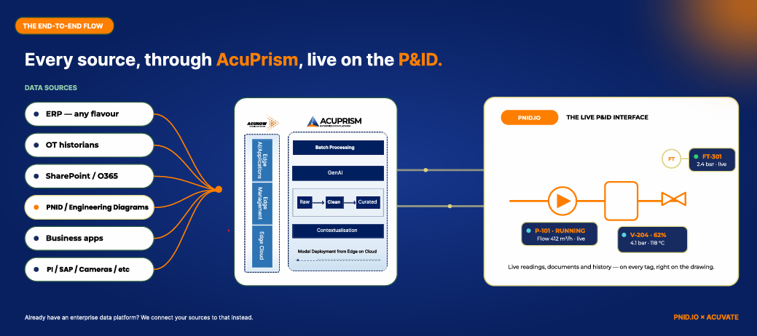
Integrated PNID.IO – AcuPrism solution

Slide 32

How to start
Acuvate and PNID.IO have the ideal skill set to get you going in the world of Digital — where bringing together all the pieces is critical
We take into account what you already have in place and embed that in our solutions: we optimise where possible
We can start small with a Minimal Viable Product (MVP) and grow that over time
1
2
3
We have certified staff in each of the relevant areas & can deploy as a “single-click” solution.
PNID.IO can be deployed as PaaS (in your MS Azure subscription) or as a SaaS solution, while the Data & AI platform is deployed as PaaS.
Based on your set-up, we can advise what the right steps and targets could be.
4
5
6
We also have several AI-based business solutions for the Energy and Manufacturing verticals.
7
Indeed — try us and ask for a proposal

Slide 33
How to start
Acuvate and PNID.IO have the ideal skill set to get you going in the world of Digital — where bringing together all the pieces is critical.
We take into account what you already have in place and embed that in our solutions: we optimise where possible.
We can start small with a Minimal Viable Product (MVP) and grow that over time.
We have certified staff in each of the relevant areas & can deploy as a “single-click” solution.
PNID.IO can be deployed as PaaS (in your MS Azure subscription) or as a SaaS solution, while the Data & AI platform is deployed as PaaS.
Based on your set-up, we can advise what the right steps and targets could be.
We also have several AI-based business solutions for the Energy and Manufacturing verticals.
Indeed — try us and ask for a proposal.

Slide 34
Poll 3
How Soon Do You See Your Organization Adopting Industrial AI Across Manufacturing Operations?

Slide 35


Slide 36






Session presented by
THANK YOU
We are a global player in next-generation digital solutions & services that modernize, automate and transform enterprise applications. With over 19+ years of experience, we have been enabling our clients globally to steer their digital transformation strategy using Cloud, Data & AI. We build & develop smart & sustainable solutions to help our customers transform their conventional processes to match the next-generation technological trend.
We have a strong presence in the US, Europe, and Middle East, where we serve multiple ultra-large customers as well as SMBs from various sectors such as Public Sector, CPG, Retail, Oil & Gas, Energy, Manufacturing, BFSI, Healthcare, etc.
Contact: advisors@acuvate.com

